Slide 1
New York Culturally Responsive-Sustaining Education Framework
Teacher Session
Notes:
As participants arrive, welcome them to the session.
“Welcome to the professional development session specific to teachers on the New York Culturally Responsive-Sustaining (CR-S) Education Framework.”
Note: Allow 20 minutes for welcome and introductions.

Slide 2
Introductions
Name
Title
Organization
Name
Title
Organization
Notes:
Please introduce yourself!
Share: “After we review the agenda and objectives, we will do more introductions.”

Slide 3
Welcome
Notes:
Share: “We will begin by sharing the agenda and engaging in an activity.”

Slide 4

Agenda
Welcome
Why the New York Culturally Responsive-Sustaining (CR-S) Education Framework
Principles of the CR-S Education Framework and Teacher-Specific Strategies
Closing and Next Steps
Notes:
Share the agenda: “After the welcome activities, the session will continue focusing attention on why the New York Culturally Responsive-Sustaining Education Framework is being implemented and then move into what principles and strategies the Culturally Responsive-Sustaining Education Framework offers.
We will close by sharing resources and suggesting next steps.”

Slide 5

Objectives of this Session
Develop our understandings of the why, what, and where of the New York CR-S Education Framework
Why the CR-S Education Framework?
How can CR-S support students?
What are the principles of the CR-S Education Framework and the strategies specific to teachers?
Where can I find out more?
Where do I go next?
Notes:
Share the objectives: “We will be working on developing our understanding of the why, what, and where of the CR-S Education Framework.
Why the Framework and how does it support students,
what are the principles and specific strategies for teachers, and
where can I find out more and where do I go next.
We are building your understanding of the CR-S Education Framework and the strategies.”

Slide 6

Building Community
We will use the principles of the New York CR-S Education Framework to guide our learning today:
Notes:
Share how we will build community: “In order to build our understanding of the New York CR-S Education Framework and the strategies, we need to work as a learning community.
We will follow the principles of the CR-S Education Framework in our work.
The principles are
creating a welcoming and affirming environment,
establishing high expectations and following rigorous instruction,
providing inclusive curriculum and assessment, and
refining our strategies with ongoing professional learning.
The principles are designed to guide the implementation of policies and facilitate ideal learning environments for everyone involved.”

Slide 7
Getting Ready
During this session on the New York CR-S Education Framework and the strategies specific to teachers,
I hope to learn about . . .
Notes:
Share: “Please complete the following sentence about this session on the New York CR-S Education Framework and strategies specific to teachers.
During this session on the New York CR-S Education Framework and the strategies specific to teachers, I hope to learn about . . .
Reflect privately. We will not share these at this time.”

Slide 8
Any questions about the session agenda or objectives?
Notes:
Ask participants if they have any questions on the session agenda or objectives.
Note that you can answer questions during the session, also designate a whiteboard or other place to post questions.

Slide 9

Getting Ready: Introductions
Please record your responses to the following prompts. Be prepared to share your responses with a partner or in a small group.
What is your full name?
Do you know who chose it or why it was chosen for you?
Is there any family or ethnic significance to your name?
Notes:
Please refer to the Introductions handout and prompt participants to complete the activity.
Share: “Please record your responses to the following prompts. We will have about two to three minutes to work independently.”

Slide 10
Introductions: Partner/Group Work
Please share your responses with a partner or in a small group.
What is your full name?
Do you know who chose it or why it was chosen for you?
Is there any family or ethnic significance to your name?
Notes:
Share: “Please share your responses with a partner or in a small group.
You will have three minutes to discuss. Within that time, make sure that each person has an opportunity to share.”

Slide 11
Introductions: Full Group Discussion
What did you learn about others?
How did it feel to share about your culture, identity, and history?
Notes:
Lead a debrief of the activity: Give enough wait time for participants to think about both questions and then ask for volunteers.
“What did you learn about others? How did it feel to share about your culture, identity, and history?”
Prompt participants to share: Encourage them to be specific about how the activity supported their feelings of belongingness.

Slide 12
Introductions: Debrief
Purpose of this activity:
  Bring every participant’s voice into the room
  Highlight and affirm the variety of cultures, identities, and histories that we bring to this work
  Establish a learning environment that values sharing and discussion
How is this activity an example of engaging in CR-S education?
Which principles does it reference?
Notes:
Share the purpose of this activity: “This activity allowed us the opportunity to bring all participants’ voices into the room, highlight and affirm our diversity, and establish our learning environment.
We shared the four principles of the New York Culturally Responsive-Sustaining Education Framework.”
Prompt participants: “Would anyone like to share how this activity is an example of engaging in CR-S education? Or which principle it references?”
Share how this activity is an example of creating a welcoming and affirming environment, being inclusive of others, and encouraging ongoing professional learning. Encourage participants to share other ideas as well. Most importantly, it is an example of doing culturally responsive-sustaining education.

Slide 13
Why the New York Culturally Responsive-Sustaining Education Framework
Why
What
Notes:
Share: “Now we will discuss the why and what of the New York Culturally Responsive-Sustaining Education Framework.”
Note: Allow 15 minutes for this topic.

Slide 14
Defining Culturally
Responsive-Sustaining Education
Culturally responsive-sustaining education
is grounded in a cultural view of learning and human development in which multiple expressions of diversity — race, social class, gender, language, sexual orientation, nationality, religion, ability — are recognized and regarded as assets for teaching and learning.
Notes:
Share: “First, what is culturally responsive-sustaining education?
CR-S takes a cultural view of learning and human development in which multiple expressions of diversity are recognized and regarded as assets for teaching and learning.
The school community is representative of many cultures, and therefore schools need to be intentional about the relationship between culture and schools.
Our students’ cultures can be positioned as strengths and as the foundation of empowering, rigorous, and innovative learning.”

Slide 15

What is culture?
Culture includes multiple components of one’s identity, including but not limited to:
Culture transcends practices such as cuisines, art, music, and celebrations to include ways of thinking, values, and forms of expression.
race
economic status
nationality
religion
gender
language
sexual orientation
ability
Notes:
Share: “To discuss culturally responsive-sustaining education, let’s pause and define culture.
The New York State Education Department defines culture as the multiple components of one’s identity, including but not limited to race, economic background, nationality, religion, gender, language, sexual orientation, and ability.
Culture transcends practices such as cuisines, art, music, and celebrations to also include ways of thinking, values, and forms of expression.
Schools then become a meeting point for cultures, containing children and adults who bring with them multiple facets of their identity, along with unique experiences and perspectives.”
Prompt participants: “Is there anything new, interesting, or surprising about this definition of culture? Is there anything that you would like to add to this definition?”

Slide 16
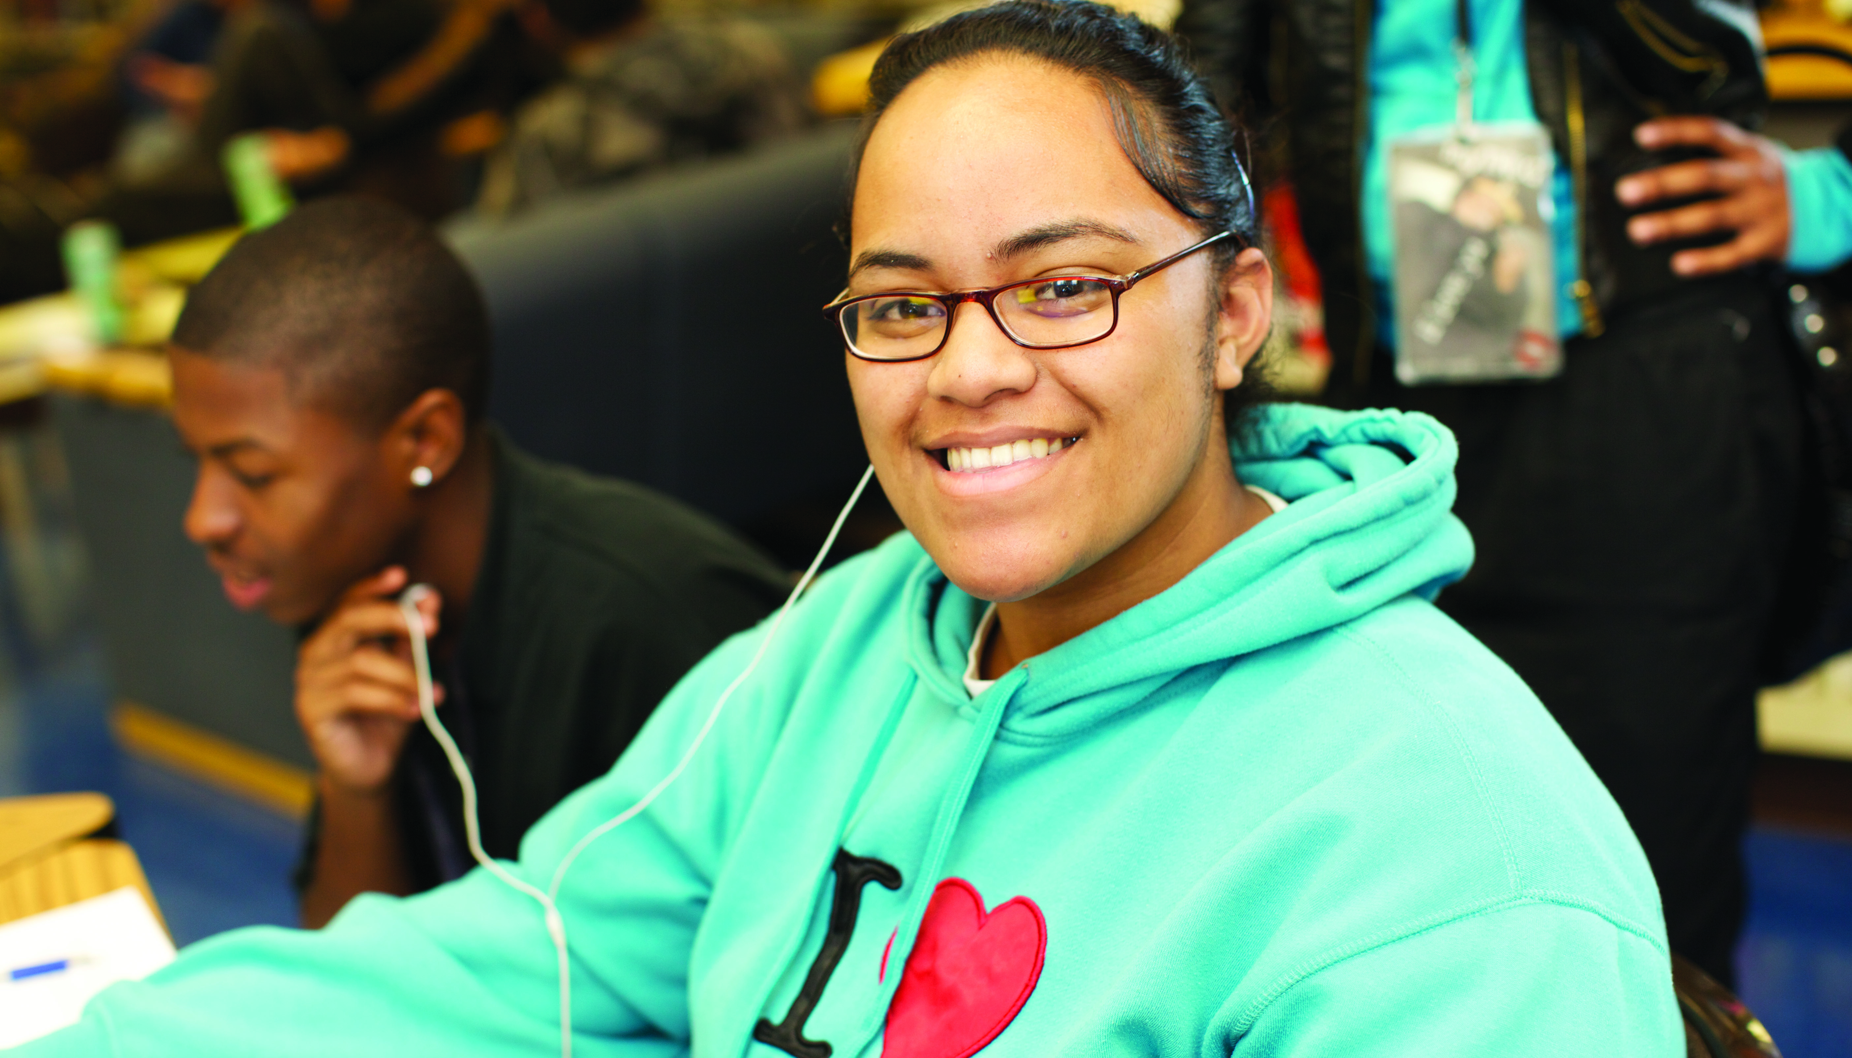
Culture in School Communities
The school community is representative of many cultures, and culture influences how students experience schools.
Reflect on this statement with a partner.
Notes:
Share: “As we consider why culturally responsive-sustaining education, let’s consider culture in schools.
The school community is representative of many cultures, and therefore culture influences how students experience schools.
Schools need to be intentional about the relationship between culture and schools.”
Prompt participants to reflect on this statement with a partner.
Share with participants how learning is rooted in the lives and experiences of people and cultivated through activities that people find meaningful. Therefore, when teaching is not rooted in students’ lives, student learning suffers. Biases take hold and deficit perspectives become normalized throughout our schools and classrooms, structuring entire systems that blame students for failure.

Slide 17

Our students’ cultures can be positioned as strengths and as the foundation of empowering, rigorous, and innovative learning.
Representing students’ cultures and making learning meaningful supports the students’ sense of belonging, motivation, success,
and achievement.
Notes:
Share: “Students’ cultures should be positioned as strengths in order to support their success. Learning is rooted in the lives and experiences of people and cultivated through activities that people find meaningful. It is critical that schools seek to highlight the strengths of culture. Representing students’ culture and making learning meaningful supports their sense of belonging, motivation, success, and ownership.
Through implementing classroom practice aligned with culturally responsive-sustaining education students experience academic success. From their success:
Students are prepared for the rigor of independent learning as they understand themselves as contributing members of the school and classroom community.
They demonstrate an ability to use critical reasoning, take academic risks, and leverage a growth mindset to learn from mistakes. Students are self-motivated, setting and revising personal academic goals to drive their own learning and growth.
Students also acknowledge the limitations of their own perspectives. They have empathy for others while they appreciate and respect others’ differences.
They build and maintain strong relationships, including those along lines of difference, in their class and school communities. All layers of the environment in which students learn (classroom, school, family, and community) affirm and value the various aspects of students’ cultural identities (i.e., race, ethnicity, age, gender, sexual orientation, ability, religion, socioeconomic background).
They also bring a critical lens to the world as they study historical and contemporary conditions of inequity and learn from marginalized voices.
Students learn about power and privilege in the context of various communities and are empowered as agents of positive social change.”

Slide 18

Culturally Responsive-Sustaining Education in Practice
Culturally responsive-sustaining education
is about teaching
each and every student
in front of you.
Notes:
Begin a conversation about what culturally responsive-sustaining education looks like.
Share: “Culturally responsive-sustaining education is about teaching each and every student in front of you. This requires getting to know students and developing meaningful relationships with them, engaging in the students’ communities, and welcoming home and youth culture into the classroom as areas ripe for discussion. The Introductions activity exemplifies culturally responsive-sustaining education by getting to know each other and welcoming home culture into the session. Next, we are going to dig more into the principles and strategies of CR-S education so we can define practices that affirm this statement. “
Prompt participants to share their practices as school leaders that affirm this statement and that demonstrate what culturally responsive-sustaining education looks like in practice.
Encourage participants to be as specific as they can. Remind participants that our opening activity was an example of bringing ourselves into the learning environment, highlighting our individual differences, and supporting our learning community.

Slide 19

Culturally Responsive-Sustaining Education Framework
Supports your continued implementation of effective and equitable policies and practices
Focuses on establishing learning environments that support all students and their learning
Notes:
Share: “The Culturally Responsive-Sustaining Education Framework helps education stakeholders implement policies and practices that educate all students effectively and equitably while focusing on establishing learning environments that
affirm cultural identities and foster positive academic outcomes,
develop students’ abilities to connect across lines of difference,
elevate historically marginalized voices, and
cultivate critical thinking and empower students as agents of social change.
The Framework lays out these ideas and then provides principles and strategies for all education stakeholders.”

Slide 20
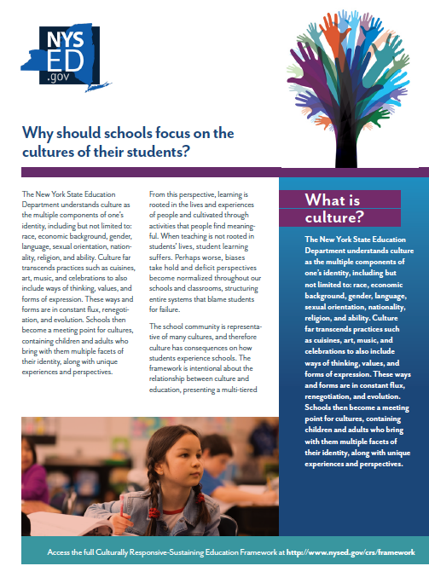
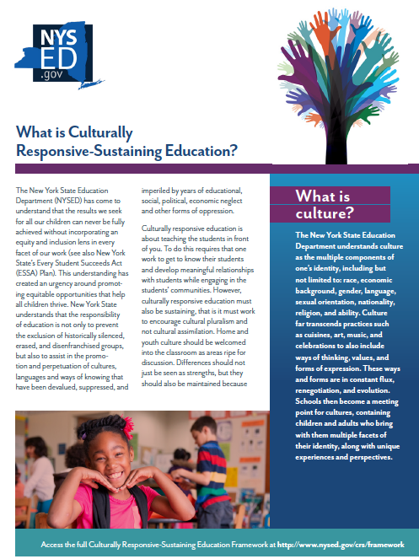
Why: Learn more!
The Framework Briefs detail responses to:
  What is culturally responsive-sustaining education?
  What is the New York Culturally Responsive-Sustaining Education Framework?
  What do students gain when culturally responsive-sustaining education guides our education system?
  Why should schools focus on the cultures of their students?
  How does implementing the New York Culturally Responsive-Sustaining Education Framework improve the school community as a whole?
Notes:
Share: “The Framework Briefs share critical information from the CR-S Education Framework in a shorter format, where each brief is one to two pages long.
The Framework Briefs detail responses to:
What is culturally responsive-sustaining education?
What is the New York Culturally Responsive-Sustaining Education Framework?
What do students gain when culturally responsive-sustaining education guides our education system?
Why should schools focus on the cultures of their students?
How does implementing the New York Culturally Responsive-Sustaining Education Framework improve the school community as a whole?”

Slide 21
Principles of the CR-S Education Framework and Teacher-Specific Strategies
What
Notes:
Share: “We will now move on to discuss more of the Culturally Responsive-Sustaining Education Framework and strategies specific to teachers.”
Note: Allow 45 minutes for the principles and strategies.

Slide 22
Principles of CR-S Education Framework
Notes:
Share: “The following principles support the implementation of policies and facilitate ideal learning environments for students.
There are four principles in the Framework:
Welcoming and affirming environment,
High expectations and rigorous instruction,
Inclusive curriculum and assessment, and
Ongoing professional learning.”

Slide 23
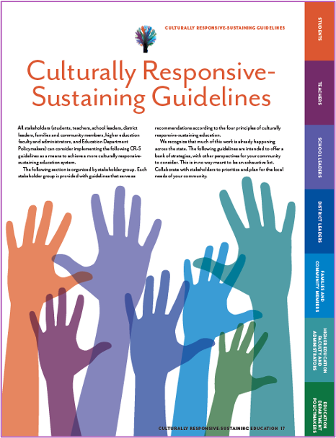
Who is involved?
All stakeholders must work together to create the conditions under which our vision of education can flourish.
Students
Teachers
District leaders
Family and community members
Education department policy makers
School leaders
Higher education faculty and administration
Notes:
Share: “Who is involved in this work? All stakeholders must work together to create the conditions under which our vision of education can flourish.
NYSED recognizes for CR-S education to thrive, the impetus cannot be placed solely on students, teachers, and school leaders.
Stakeholders include students, teachers, school leaders, district leaders, families and community members, higher education faculty and administrators, and education department policymakers.”

Slide 24
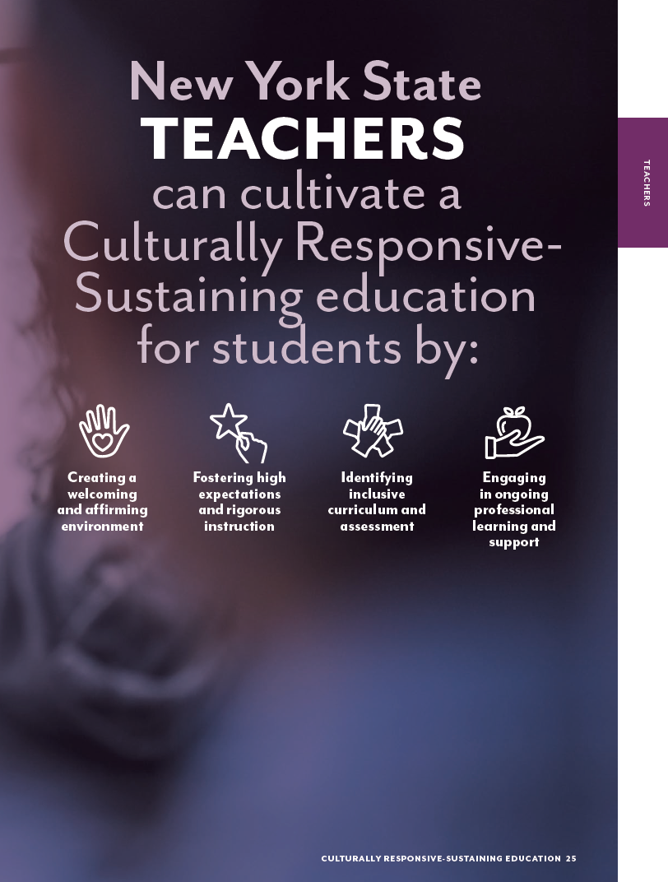
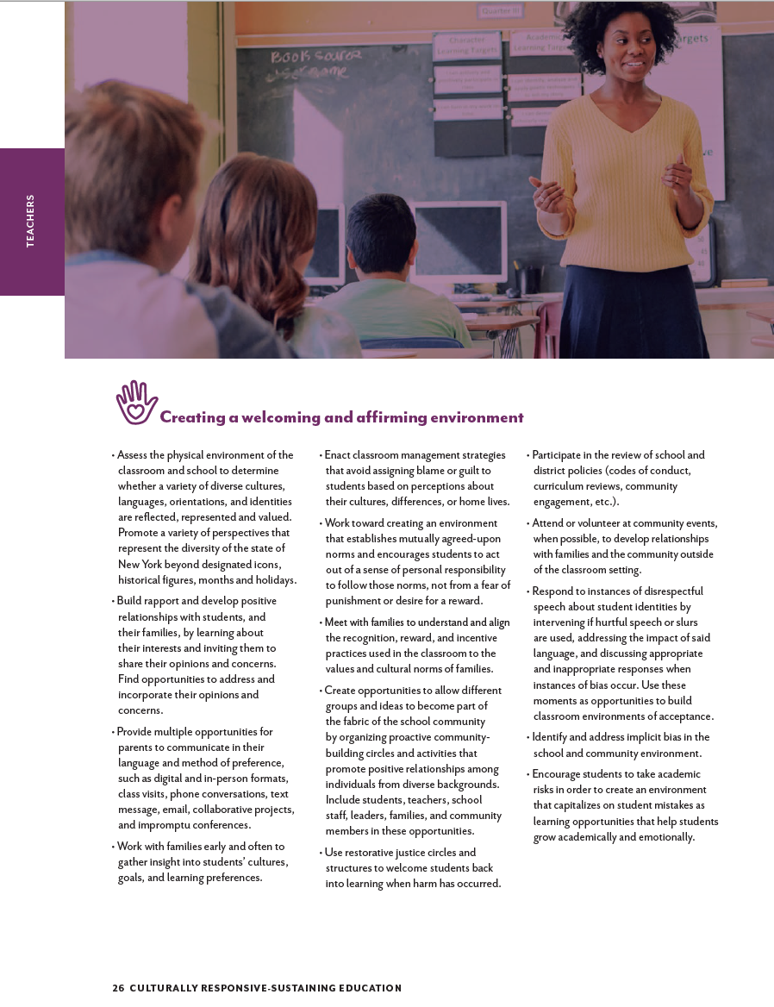
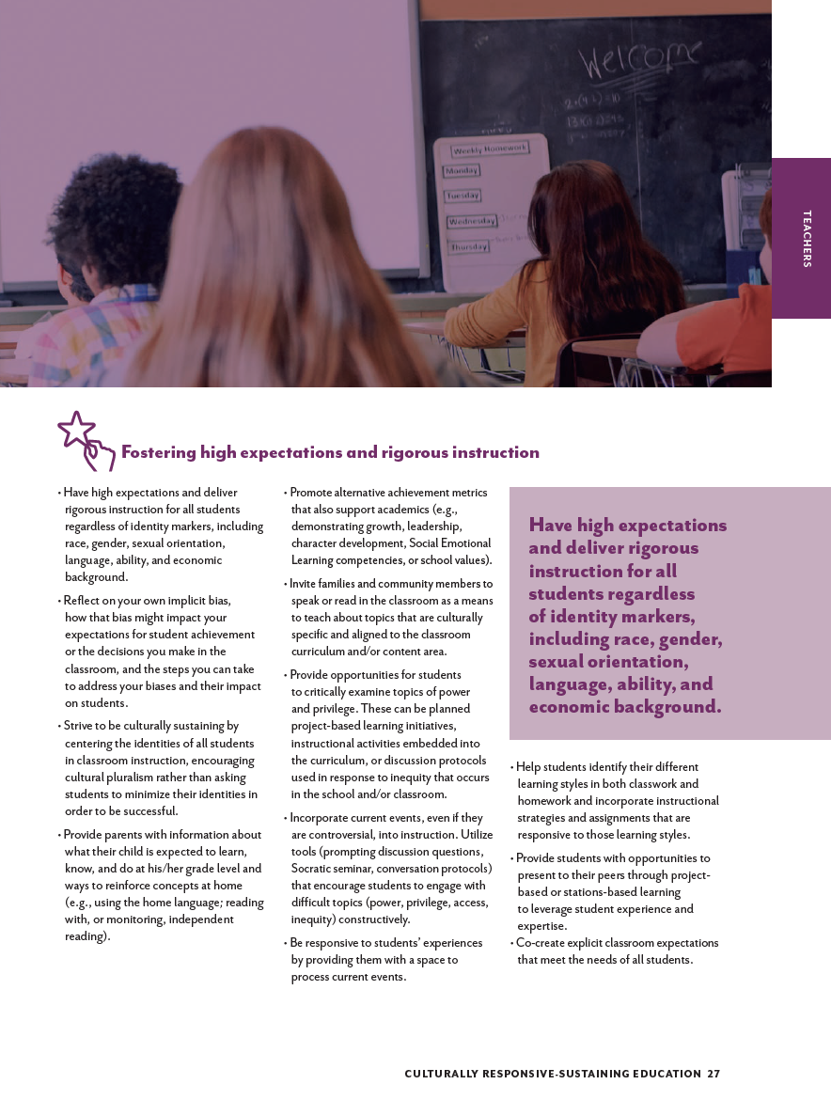
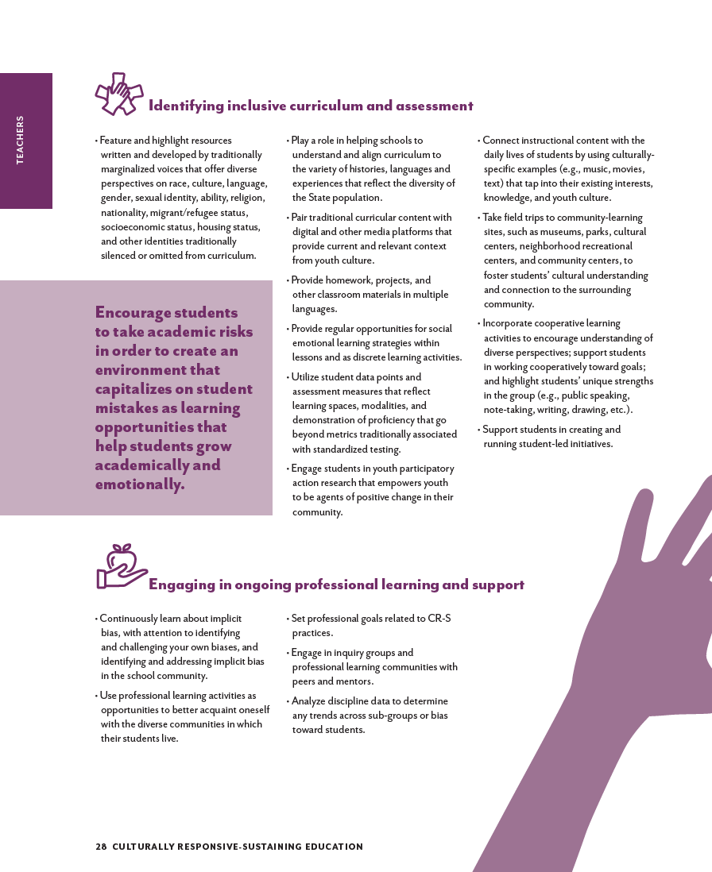
Teacher-Specific Strategies
Page 24 | Page 25 | Page 26 | Page 27
Notes:
Share: “The framework lays out strategies specific to teachers, organized by principle, beginning on page 24.”
Support notes:
Remind participants to access the CR-S Education Framework to review the strategies: http://www.nysed.gov/common/nysed/files/programs/crs/culturally-responsive-sustaining-education-framework.pdf

Slide 25
Example Teacher-Specific Strategies
Engage in classroom management strategies that avoid assigning blame or guilt to students based on perceptions about their cultures, differences, or home lives.
Utilize student data points and assessment measures that reflect learning spaces, modalities, and demonstration of proficiency that go beyond metrics traditionally
associated with standardized testing.
Notes:
Share: “There are four principles in the Framework, and we are going to dive deep into selected strategies. These strategies are a part of the CR-S Education Framework, and we chose them to have a conversation about them and what they involve. We selected complex strategies to discuss; we did not choose them because they are any more important than other strategies, but we wanted the set of strategies to show variety and highlight the complexity of the strategies.
We will start by reviewing two strategies, one from the principle of creating a welcoming and affirming environment and one related to inclusive curriculum and instruction. After our initial review of these, you will explore strategies from the other principles in a small group activity.
Please take a minute now to read them. Then, we will share initial impressions of the strategy with a partner or in a small group.”

Slide 26
Share Initial Impressions and Questions
Engage in classroom management strategies that avoid assigning blame or guilt to students based on perceptions about their cultures, differences, or home lives.
Utilize student data points and assessment measures that reflect learning spaces, modalities, and demonstration of proficiency that go beyond metrics traditionally
associated with standardized testing.
Notes:
Share: “What are your initial impressions and questions about these strategies? Please take a minute for independent thought, and then we will briefly share.”
Pose the question and prompt participants to share. Encourage participants to respond to each others’ questions. Make sure to acknowledge that the strategies are complex; they include multiple steps, spur different interactions with students and the community, and require personal reflection and planning.
Support notes:
For the strategy, Engage in classroom management strategies that avoid assigning blame or guilt to students based on perceptions about their cultures, differences, or home lives, take note of how a teacher would need prior knowledge of the students’ cultures and differences first to then bring awareness into their classroom management strategies. Engaging in these classroom management strategies requires many steps ahead of the actual instruction.
When discussing the strategy, Utilize student data points and assessment measures that reflect learning . . . , note the necessity of understanding which alternative methods of assessment to use across disciplines and grade levels; when using data from non-traditional metrics, teachers may need to develop those metrics and align them with other district and state learning goals.

Slide 27
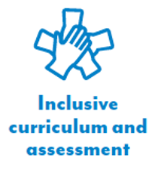
Example Strategies for Teachers
Activity Instructions
Principle | Example Strategy
Discuss the following questions for at least one strategy:
  Why is this strategy important?
  What questions do you have about this strategy?
  What ideas do you have about implementation?
Engage in classroom management strategies
that avoid assigning blame or guilt to students
based on perceptions about their cultures, differences, or home lives.
Continuously learn about implicit bias, with attention
to identifying and challenging your own biases and identifying and addressing implicit bias in the school community.
Strive to be culturally sustaining by centering the identities of all students in classroom instruction, encouraging cultural pluralism rather than asking students to minimize their identities in order to be successful.
Utilize student data points and assessment measures that reflect learning spaces, modalities, and demonstration of proficiency that go beyond metrics traditionally associated with standardized testing.
Notes:
Distribute the handout, Example Strategies for Teachers.
Prompt participants to work in partners or small groups. “In partners or a small group, work together to discuss and respond to the following questions for at least one strategy. Record your ideas on the handout.
Why is this strategy important?
What questions do you have?
What ideas do you have about implementation?”
Share: “Each partnership or small group will discuss at least one strategy, or more than one if time allows. Be ready to share your responses with the group. Please be specific about how this strategy is important in your teaching context, content, or school and be specific in how you would implement it.”
Prompt for questions about the activity. Give each partnership or small group ten minutes to work together.
As participants are working, encourage them to ask questions and be specific about the steps they would take to implement the strategy (if they have ideas), but also recognize that participants may not have ideas about how to implement a strategy yet, and that is understandable. Be sure to build on and support teacher knowledge; for example, as teachers share their own instructional practice, highlight the ways in which they are being culturally responsive and/or how they could make adjustments or modifications. Highlight what teachers bring to the classroom and the importance of their roles. Encourage participants to consider how they would know that a strategy is being implemented authentically and to ask questions of each other as well.

Slide 28
Example Strategies for Teachers
Activity: Full Group Share
Principle | Example Strategy
Please share your ideas:
  Why is this strategy important?
  What questions do you have about this strategy?
  What ideas do you have about implementation?
Engage in classroom management strategies
that avoid assigning blame or guilt to students
based on perceptions about their cultures, differences, or home lives.
Continuously learn about implicit bias, with attention
to identifying and challenging your own biases and identifying and addressing implicit bias in the school community.
Strive to be culturally sustaining by centering the identities of all students in classroom instruction, encouraging cultural pluralism rather than asking students to minimize their identities in order to be successful.
Utilize student data points and assessment measures that reflect learning spaces, modalities, and demonstration of proficiency that go beyond metrics traditionally associated with standardized testing.
Notes:
Share: “Now let us share your insights into the importance of your strategies, questions, and ideas for implementation of the strategies.”
Prompt participants to share their ideas about the strategies with the whole group.
Encourage participants to respond to each others’ questions. Make sure to acknowledge that the strategies are complex; they include multiple steps, spur different interactions with students and the community, and require personal reflection and planning. Encourage participants to be specific about how they would conduct a strategy in their content and school. Remind them that they may need more information before they are ready to implement a strategy.
Try discussing for all four sample strategies if possible. There are 10 minutes scheduled for this full-group discussion.
Prompt for questions before moving to the closing.

Slide 29
Closing and Next Steps
Who
Where
Notes:
Share: “As we move to the end of the session, we will share resources and explain how you can continue your learning.”
Note: Allow 10 minutes for closing and next steps.

Slide 30
Learn more!
New York Culturally Responsive-Sustaining Education:
http://nysed.gov/crs
Culturally Responsive-Sustaining Education Framework
Framework Briefs
Culturally Responsive-Sustaining Education Roadmap
Notes:
Share: “More information on the Framework is available at these sites. Please review the Roadmap and the briefs. Your involvement is critical!
The Framework Briefs share critical information from the CR-S Education Framework in a shorter format; each brief is one to two pages long.
The Framework Briefs detail responses to:
What is culturally responsive-sustaining education?
What is the New York Culturally Responsive-Sustaining Education Framework?
What do students gain when culturally responsive-sustaining education guides our education system?
Why should schools focus on the cultures of their students?
How does implementing the New York Culturally Responsive-Sustaining Education Framework improve the school community as a whole?”

Slide 31
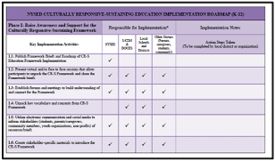
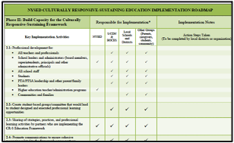
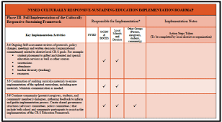
Culturally Responsive-Sustaining (CR-S) Education Roadmap
Phase I: Raise awareness of and support for the CR-S Education Framework
Phase II: Build capacity for the CR-S Education Framework
Phase III: Full implementation of the CR-S Education Framework
Notes:
Share: “The Roadmap has three phases: raising awareness of and support for the Framework, building capacity for the Framework, and fully implementing the Framework. The published Roadmap details key implementation activities and provides a template for detailed notes and next steps.”

Slide 32
Reflect on the Session
Record your reflections:
What are three points that you want to remember about culturally responsive-sustaining education as related to your role as a teacher?
What are two next steps that you are going to take with the strategies you reviewed or with the CR-S Education Framework?
What is one lingering question that you have?
Notes:
Share: “Please reflect on the session.
What are three points that you want to remember as related to your role as a teacher?
What are two next steps that you are going to take with the strategies you reviewed or with the CR-S Education Framework?
What is one lingering question that you have?
Record your reflections.”

Slide 33
Reflect on the Session: Share
Share your reflections with others:
What are three points that you want to remember about culturally responsive-sustaining education as related to your role as a teacher?
What are two next steps that you are going to take with the strategies you reviewed or with the CR-S Education Framework?
What is one lingering question that you have?
Notes:
Share: “Share your reflections with a partner or in the full group, depending on group size.”
Ask participants to consider sharing their reflections or learnings on their preferred social media platform, if they would like.

Slide 34

Assess Your Learning and Share Feedback
Please complete the survey to help us understand how we have supported your awareness of the New York Culturally Responsive-Sustaining Education Framework!
Your feedback helps us continue to improve our work and meet your needs.
Thank you for sharing your learning with us!
Notes:
Share: “Please complete the survey to assess your understanding of the concepts presented here, as well as providing us with valuable feedback.”
Your feedback helps us to continue to improve our work to meet your needs. Thank you for sharing your learning with us.

Slide 35

Questions?
Notes:
Prompt for questions.

Slide 36
Thank you!
@
[List name and email contact]
NY Culturally Responsive-Sustaining Education:
http://www.nysed.gov/crs
Notes:
Share: “Thank you for coming!”
In closing, share your contact information and present the NY Culturally Responsive-Sustaining Education website.

Slide 37

CR-S Education

