Slide 1

Clinical Experiences in Illinois: A Look at the State Requirements and Different Local Models

Slide 2

State Requirements for Illinois Principal Preparation Internships

Slide 3

Key Elements of
Principal Preparation Legislation
Termination of Type 75 – general administrative programs.
Creation of a new Principal Endorsement attached to Professional Ed License.
Requirement of a formal university/district partnership involved in the design, delivery and improvement of the program.
Selective admissions criteria for applying to principal endorsement programs.
PreK-12 licensure structure; required candidate experiences across grade span.
Performance-based internship with required leadership experiences competency-based assessments with standardized scoring rubric.
Collaborative supervision of candidates by a qualified and trained faculty supervisor and mentor principal.
An 8-hour Principal Endorsement exam on Instructional Leadership administered by the Illinois State Board of Education.

Slide 4
Illinois’ New State Internship Requirements
Mandated year-long, performance-based internship designed to provide authentic leadership experiences intended to increase proficiency in areas shown to improve student learning.
Mandated competency-based assessments of candidate performance aligned to both the ISLLC Standards and Southern Regional Education Board’s 13 Critical Success Factors and 36 Leadership Tasks.
Required 80% of internship activities be completed in a leadership capacity rather than an observational role.
A PreK-12 grade span focus that requires coursework and internship experiences across the grade levels including a focus on specific student subgroups (special education, ELL, early childhood, gifted).
Established minimum qualification and training requirements for mentor principals and faculty supervisors.

Slide 5
Illinois’ State Requirements Based on Two Evidenced-Based Models in Chicago
Dr. Alicia Haller, IL-PART co-director
Former administrator, Chicago Public Schools

Slide 6
Illinois Demonstration Site: Chicago Public Schools
CPS is the largest district in Illinois and the third largest in the U.S.
CPS serves just under 400,000 students in 660 schools.
CPS student demographics include: 91% minority, 87% low income, 18% limited English, 14% IEP, and 5% homeless.
The district invests heavily in leadership development including:
1. Preparing a pipeline of effective school leaders through partnerships with selected principal preparation programs.
2. Rigorous screening of aspiring principals.
3. Principal mentoring (pre- and in-service).
4. Extensive professional development for school leaders.

Slide 7
Illinois Demonstration Site: Partners
Original District Partners in Principal Preparation:
New Leaders is a national non-profit with a mission to improve student outcomes by developing transformational school leaders through an intensive and authentic principal preparation program.
UIC is a public university with an urban-focused principal preparation program designed around a five year EdD program.
The initial partnerships between CPS and select principal preparation programs began in 2001.
Partnerships began organically and have grown into a very formal structure: the Chicago Leadership Collaborative, launched in 2015.

Slide 8
CPS Partnerships with New Leaders-Chicago and the University of Illinois-Chicago: What They Do
CPS officials and Preparation Partners work together to recruit and select roughly 30-40 high potential teacher leaders for participation in full time/full semester principal internships (annually).
CPS pays the salary and benefits of the principal candidates to complete a full time/full year principal internship.
The preparation programs provide coursework, supervision and coaching, and faculty from the program collaborate with CPS officials on the continuous improvement process.
The district and partners collaboratively identify placement sites for the principal candidates to complete the internship.
Dual mentoring and supervision is provided by the CPS host principal and faculty supervisor from the preparation program.
Assessment of intern performance is completed jointly by the host principal and faculty supervisor.
Faculty and host principals work with interns to assist them in securing positions upon completion of the internship.

Slide 9
CPS/New Leaders/UIC Outcomes
Impact on the District: Between 2001-2015: New Leaders and UIC have supplied the district with over 270 principals, directly impacting over 130,000 students.
UIC & NL led schools are outperforming CPS averages on numerous measures (from 2015 data):
NWEA MAP Growth in Math (66% vs. 69%) and Reading (58% vs. 60%).
Percent of Freshman on Track (59% vs. 84%).
High School Graduation (68% vs. 70%) – with the impact even greater in schools with 90% low income and 90% minority (69% vs. 87%).

Slide 10
CPS/New Leaders/UIC Strategy
Partnerships between the district and preparation programs are focused on the following elements:
Rigorous selection process focused on previous experience and performance.
Relevant coursework that truly blends theory, empirical research, and practice.
Authentic leadership experience in an intensive full time/full year internship.
Comprehensive supervision and support throughout the program with coaching that spans from pre-service through the transition to novice principal.

Slide 11
Another Innovative Model: Full Time/Full Semester Internship
Dr. erika hunt, IL-PART Co-Project Director
Led Wallace Funded School Leadership Work in Illinois

Slide 12
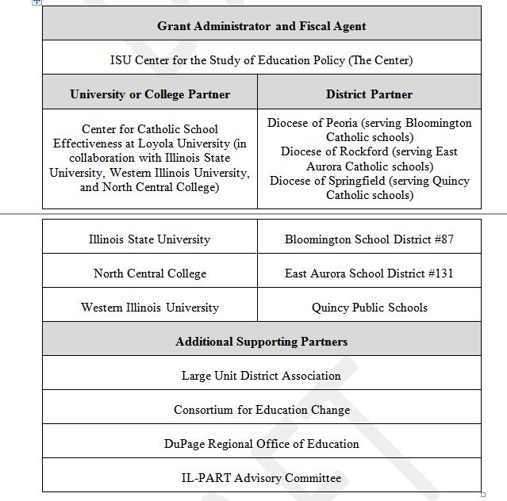
IL-PART Grant

Slide 13
Illinois State Legislation on Principal Preparation
Schools Demonstrate Positive Change(s) via Working Conditions and Student Growth Gains (outcome)
Partnership Advisory Committee
University-–District Partnerships
Principal and APs Retained for at Least 2 Years (outcome)
Principal Preparation Program(s)
Principals and APs Placed in High-Need Schools (outcome)
Selection of High-Potential Candidates
School-Based Learning Experiences (Internships)
Performance-Based Assessments
Principal Certification Earned
Pool of Highly Effective Principals and Assistant Principals (APs) for High- Need Schools in the State or Region
Extensive teaching experience
Knowledge & and Skills
Portfolio of accomplishments (including evidence of student growth and leadership)
Training for faculty supervisors
Training for district mentor
Network and development opportunities
Data sharing and analysis
Alignment of assessments with district principal evaluation system
Assessments used to match potential principals with high- need schools
IL-PART Theory of Action

Slide 14
Full Time Internship Model
IL-Part has piloted an intensive full time/full semester long internship model.
The intensive model provides a longer duration of full-time, job embedded experiences than a traditional internship allows.
The intensive model’s approach to funding the substitute is a cost effective and replicable strategy.
Project covers the substitute teacher’s cost, versus the salary cost of the principal intern.
Lessons learned on compliance with:
  How to utilize this model for successful succession planning to sustain the principal pipeline.
  Implications involving the new teacher evaluation system.
  Implications involving the Affordable Care Act.
  Identification and placement of quality substitute teachers.

Slide 15
IL-PART Satisfaction Survey
  Candidates completing full time internships expressed greater satisfaction with the program than do those completing traditional internships.
  Candidates serving full time internships reported a higher degree of supervision and a stronger belief that their programs prepared them to take on the challenge of school principal.
  Principal candidates, mentor principals, and university supervisors all acknowledged the benefits of the full time internship experience.

Slide 16
Mentor Principal Perspectives: Candidates Participation in Internship Experiences (n = 20)

Slide 17
Faculty Supervisor Perspective: Candidates Participation in Internship Experiences (n = 8)

Slide 18
Traditional Yearlong Candidate Internship Activities (n =17)

Slide 19
Mentor Principal Matching
Full-Time, Full-Semester Respondents (n = 5)
Traditional Yearlong Candidates (n = 17)

Slide 20
Internship Matching
Full-Time, Full-Semester Respondents (n = 5)
Traditional Yearlong Respondents (n = 17)

Slide 21
Experience With Mentor Principal Supervision
Full-Time, Full-Semester Candidate Perspectives (n = 5)
Traditional Yearlong Candidate Perspectives (n = 17)

Slide 22
Frequency of Observations
Full-Time, Full-Semester Candidates (n = 5)
Traditional Yearlong Candidates (n = 17)

Slide 23
Number of Formal Mentor Principal Observations: Full-Time, Full Semester Candidates (n = 4) and Traditional Yearlong Candidates (n = 9)

Slide 24

The New Internship Requirements from a University Perspective
Dr. Carol Webb, Associate Professor, Western Illinois University

Slide 25
Internship Requirements
The internship portion of the program shall…enable the candidate to be exposed to and to participate in a variety of school leadership situations in settings that represent diverse economic and cultural conditions and involve interaction with various members of the school community… IL Code Section 30.40(a)
              Engagement of the candidate in instructional activities that involve teachers at all grade levels (preschool through grade 12):
                In General Education Settings.
                In Special Education Settings.
                In Bilingual Education Settings.
                In Gifted Education Settings.
                In the observation of the hiring of teachers, other certified staff, and non-certificated staff.
  In the observation of supervision and evaluation of various staff.
  In the development of a professional development plan for teachers.
  In the engagement of the candidate in leadership opportunities.
  (No student supervision activities will be logged by a candidate.)

Slide 26
Internship Requirements
Assessment 1: The candidate conveys an understanding of how the school’s vision and mission affect the work of the staff in enhancing student achievement.
1.1. Explain the purpose of the SIP and its relationship to the school’s vision in a presentation to a group of stakeholders.... (SREB 6a, 6b, 12a).
1.2. Analyze, review and disaggregate data, including but not limited to, student work and state test results, and work with a faculty group/team to identify areas for improvement and interventions, with particular attention given to student subgroups and low performing students.(SREB 2c, 5a. 5b, 9a).
1.3. Work with faculty teams to create, implement, and formatively evaluate a school improvement action plan based on research based instructional practices. (SREB 1a, 7a, 13a).
1.4. Work with administration and faculty or faculty teams to gather and examine data and current best practices research to assess progress on the SIP and make recommendations for improvements and modifications to the SIP for the following year. (SREB 1b, 1c).

Slide 27
Internship Requirements
Assessment 2: The candidate demonstrates a comprehensive understanding of the process used for hiring, evaluation and professional development of staff to meet the learning needs of the students.
2.1. Participate in the hiring process including, at a minimum: creation of job description; creation of interview questions and assessment rubric; participation in interviews for the position; recommendation of the candidate to hire with rationale and data to support the selection; and preparation of letters of rejection for candidates who were not selected.
2.2. Conduct a full cycle of clinical observation, including a pre-observation conference, a classroom observation, and a post-observational conference for 4 different teachers. Write a summary that provides evidence utilizing actual notes, observations, discussion, forms, and student achievement data providing feedback to the teacher. Provide examples of interventions and supports needed for the non-tenured or struggling teacher. (SREB 8b)
2.3. In conjunction with stakeholders, lead in the development of a professional development plan for a school building that includes: (1) data analysis (reviewed in Focus Area 1.2); (2) multiple options for teacher development; and (3) a method for evaluating the professional development plan and the extent to which it will lead to school improvement. (SREB 8a, 8b, 8c)

Slide 28
Internship Requirements
Assessment 3: The candidate demonstrates the ability to understand and manage personnel, resources and systems on a school-wide basis to ensure adequacy and equity.
3.1. Investigate, define, and delineate the systems and factors for advocating, nurturing, and sustaining a culture of collaboration, trust, learning, high expectations, and a personalized and motivating learning environment for students with a focus on curriculum implementation that emphasizes effective research practices and strategies designed to close the achievement gap. (SREB 3a, 3b, 3c, 3d, 3e, 3f, 3g)
3.2. Review the school’s budget and other resources with the internship principal. Detail how the resources are typically used, evaluated for adequacy, assess for effectiveness and efficiency. Provide recommendations for improvement. Address the impact of the budget on the following student subgroups: limited English proficiency, special education and economically disadvantaged. Present recommendations for improvement to a faculty group and solicit input in the budget developmental process. (SREB 11a)
3.3. Determine and analyze the different systems that exist within the school to fulfill the school’s mission (i.e. instructional: curriculum, assessment, technology, class structure; and management: discipline plan; attendance; maintenance; transportation, etc.). Choose one instructional and one management system; create an assessment tool that will be used to rate the two systems. Finally, develop recommendations for improvement of aspects of the two systems that need improvement and report the findings to the internship principal.

Slide 29
Internship Requirements
Assessment 4: The candidate demonstrates a thorough understanding of the requirements for, and development of, individualized education programs.
  8 Specific Tasks
Assessment 5: Candidates demonstrate experiences and learnings that reflect common performance situations associated with success in the principalship.
  18 Specific Tasks

Slide 30
Internship Requirements
  Mentor principals must…
  Complete an online tutorial on the principal internship requirements.
  Support interns in meeting the 3 SREB Competencies (13 Critical Success Factors & 36 associated activities).
  Hold a valid and current administrative certificate.
  Have 3 years of successful experience as a building principal.
  Have 2 years data (of last 5 years) showing student growth.
  University supervisors must…
  Conduct 4 face-to-face meetings with mentors.
  Observe, evaluate and provide feedback 4 times a year to the intern.
  Host 3 seminars relating to student learning and school improvement.
  Complete, with the mentor, an intern assessment of the candidate’s performance.

Slide 31
Traditional Model
(Non-IL-PART Schools)
Candidates complete internships in buildings in which they teach over a calendar year; often, because they have been leaders in their own schools, they continue “to do what they’ve done”.
Tasks completed during prep time, summer, or school breaks can lack the leadership practice of working with groups.
Difficult to find time for planning, executing, and debriefing tasks with the mentor principal.
Difficult to schedule meaningful time in other districts having exceptionality in academics, income, grade levels, and diversity.
Lacks providing experience that broadens the candidate’s perspective about education in a different setting.
Principal mentor has been the intern’s supervising principal; intern may only experience one style of leadership.

Slide 32
Benefits of the Partnership Model
  Opportunity to shape partnership activities across the district.
  Opportunity to do internship at a different level within the district.
  Opportunity to experience a different leadership style; mentors apply and are selected to serve as mentors.
  Growth in knowledge of other grade levels’ unique challenges and opportunities.
  Because of the district support, interns have leadership opportunities throughout the year.
  Creates a focus on leadership for the district.
  University personnel participate in district professional development—not just visit 4 times during the year.
  Partners assist in recruitment; screening from the district identifies best candidates.

Slide 33
Together, We’re Better
P – Partnership, not placement
A – Active involvement, not activity-driven
R – Rigorous, not restrained
T – Teams, not isolates
N – Natural, not negative
E – Enlightening, not enigmatic
R – Reflective, not redundant

Slide 34

What Does This Look Like at District Level?
MS. Michaela fray, IL-PART District University Partnership Coordinator
Quincy public schools

Slide 35

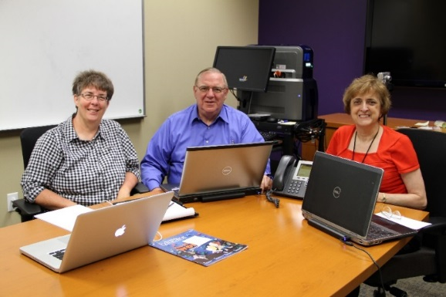
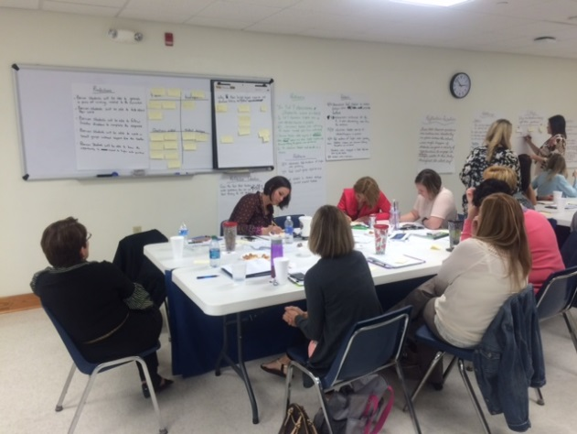
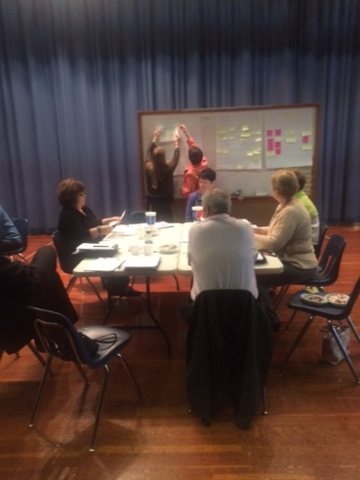
The Power of the Partnership
Mutually Beneficial Partnerships

Slide 36

Training for All
QPS Administrators
Eight Professional Development Sessions for Administrators
  Building a New Structure for School Leadership
  Supervision of Principal Interns Administrative Academy
  Instructional Rounds
  Superintendent Rounds Training
  Network Instructional Rounds
  Crucial Conversations for School Leadership
  Implementing the QPS-WIU Internship Project
Full-Day Principal Mentor Training by DuPage County ROE
Blended Coaching Training- Dr. Gary Bloom
IL-PART Symposium & Teacher Evaluation Professional Development

Slide 37

Resources for All
QPS Administrators
Professional Books
  Instructional Rounds in Education: A Network Approach to Improving Teaching & Learning by City, Elmore, Fiarman, and Teitel.
  School-Based Instructional Rounds: Improving Teaching & Learning Across Classrooms by Lee Teitel.
  Talk About Teaching: Leading Professional Conversations by Charlotte Danielson.
  Brain Science for Principals: What School Leaders Need to Know by Dr. Linda Lyman.
  Blended Coaching by Dr. Gary Bloom.
Networking Opportunities
  WIU, ISU, & NCC Professors
  LUDA Executive Directors
  CEC External Coaches
  Partner District Administration
  Illinois School Leadership Advisory Council – Convened by ISBE & IBHE
  U.S. Department of Education’s School Leadership Program

Slide 38
The Intentional Internship
Rapport & PD
Principal Mentor Selection
Strategic Matching
Continuous Support
Collaborative Internship Action Plan

Slide 39

An Intentional
Internship Experience
Identification & Recruitment
  Collaboration Between QPS & WIU to Recruit Principal Preparation Candidates
  Communication & Strategic Planning During Course-Work Leading Into the Internship
Principal Mentor Selection Process
  Principal Mentor Application, Reviewed by QPS & WIU
  Interview Process Conducted Collaboratively by QPS & WIU
  Input from QPS & WIU for Selection
Mentor & Intern Pairing Process
  Strategic Pairings Based on Experience, Expertise, and Strengths

Slide 40
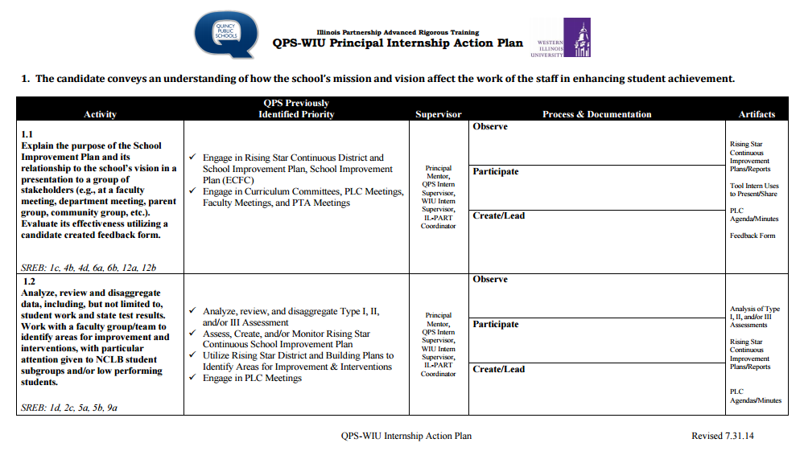

Slide 41

A Culture & Continuum
CEC External Coach
Principal Mentors
Academic Directors
Principal Mentor
University Supervisor
IL-PART Coordinators & Directors
Practicing Principals
Teacher Mentor
Principal
PLC Team
Principal Interns
Classroom Teachers

Slide 42

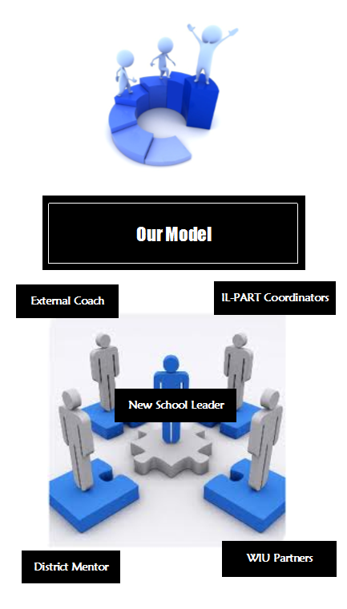
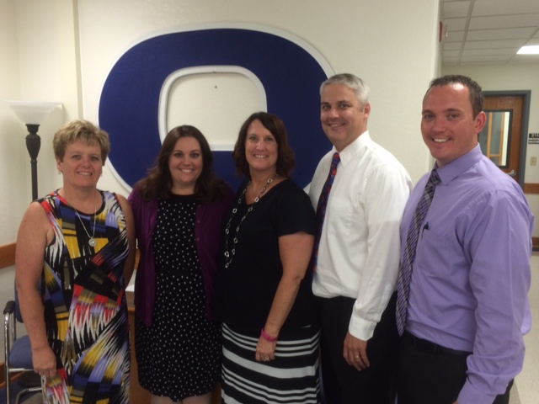
New School Leaders in Year 1-3
Receive Internal & External Support
  Internal Support
    Access to District Principal Mentors & IL-PART Co-Directors
  External Support
    Regular & Ongoing Coaching from a Consortium for Educational Change (CEC)
    Access to WIU & ISU Professors

Slide 43
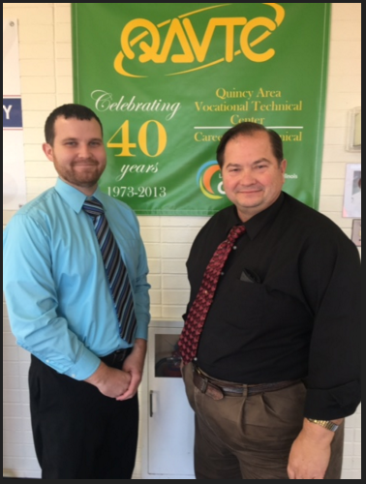
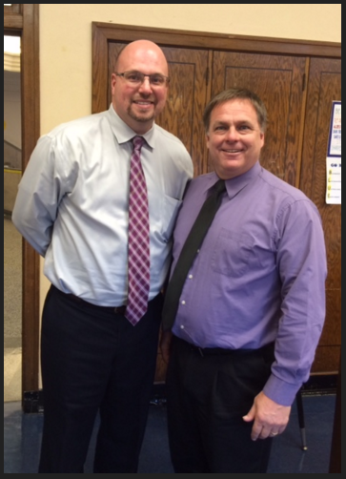
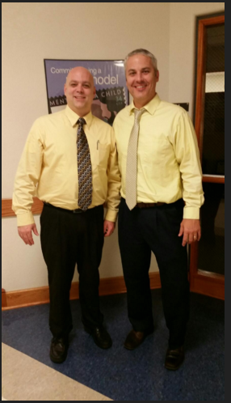
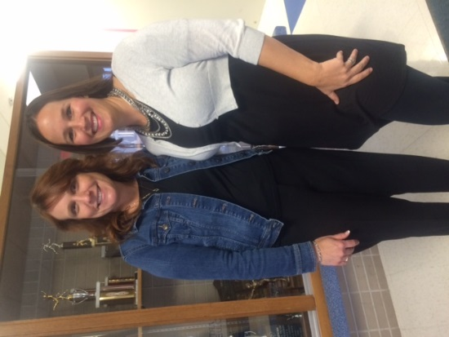
2015-2016
Principal Mentors & Interns
Danielle Edgar, Mentor & Lisa Otten, Intern
Kaleb Smith, Intern &
Mark Pfleiger, Mentor
Dan Sparrow, Mentor & Scott Douglas, Intern
Tony Fesler, Intern &
Brian Trowbridge, Mentor
Lisa Otten
2016-2017
QHS School Administration Manager (SAM)
Kaleb Smith
2016-2017
QAVTC Teacher/
Curriculum Facilitator
Scott Douglas
2016-2017
QHS Athletic Director
Tony Fesler
2016-2017
Pikeland Assistant Principal

Slide 44

Post
Completion Impact
3 of 4 Principal Interns Hired within Quincy Public Schools
1 of 4 Principal Intern Hired within ROE 1
4 of 4 Principal Interns Hired in a Leadership Role for the 2016-2017 School Year

Slide 45

Goals for Next Year
Dissemination of IL-PART evaluation findings and emerging best practices in principal preparation and partnership development.
Capacity building among other districts around the state.
Quincy School District as a regional hub of innovation and an economic engine.

Slide 46
IL-PART Web Site: www.ilpart.org

Slide 47

Questions?

Slide 48
Follow the Work
Center for the Study of Education Policy Web Site: http://education.illinoisstate.edu/csep/
CSEP_ISU
https://www.facebook.com/ISU.CSEP
IL-PART Web Site:
www.ilpart.org
Illinois School Leader Web Site:
www.illinoisschoolleader.org

