Slide 1
Principal Project Advisory Team
October 19, 2016

Slide 2
Agenda Item #1: Greetings/Introductions
Enclosed in your packet is a list of members
Welcome new members Cecilia Golden and Allen Williams
What has happened since we last met
  USDOE released Title IIA guidance (Sept 27)
  Decision was made to add meetings & extend meetings to 3 hours each (Sept 30)
  An online survey was opened to school board members and educators (Oct 12)
  Advisory Tm member Erika Hunt hosted webinar on yr-long internships (Oct 14)
  NYS Board of Regents heard presentation on Every Student Succeed Act (Oct 17)
  Wallace published video titled “A Bold Move to Better Prepare Principals” (Oct 18)

Slide 3
Title II Guidance
Called “Building Systems of Support for Excellent Teaching and Leading”
Permits sustaining and expanding current activities
Categories of allowable expenditures
  Principal Prep Academies
  Clinical experiences (residencies)
  Developing standards, certification, licensure
  Induction and mentoring
  Leader evaluation systems
  Principal professional development (including PLCs)
  Principal supervisors
  Principal pipeline
  Retaining leaders in high needs schools

Slide 4
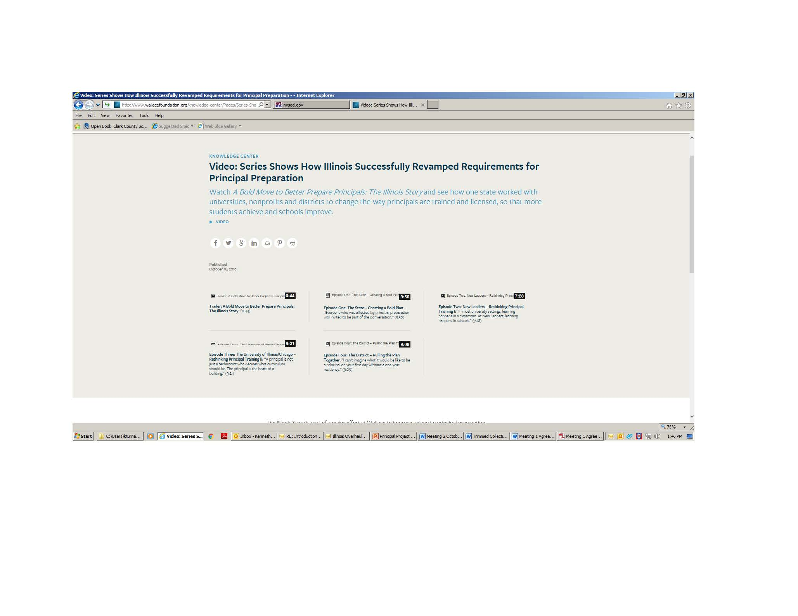

Slide 5
Agenda Item #2: Meeting Objectives
Reach consensus on homework task (“If you could have what you want . . ?”)
Identify insights from data (survey results, focus group, pass rate data)
Reach consensus on beliefs that will inform work and drive recommendations
Assemble a theory of action telling how recommendations enhance leadership
Place recommendations that could emerge from this work into rank order
Decide how to organize into working subgroups

Slide 6
Agenda Item #3: Platform
Minutes - accept “as is” or suggest needed change
Receive a proposed (and revised) meeting schedule
  Nov. 30, 2016
  Jan. 25, 2017
  Feb. 22, 2017
  Mar. 22, 2017
  Apr. 12, 2017
  May 31, 2017
Now propose to set a common meeting time for all remaining meetings
Propose 12:30 – 3:30 pm for each meeting
We will return to this item for closure the end of our meeting today

Slide 7
Review our process to reach consensus
Fist to Five
  The goal is to something that every member can live with and support.
  When co-chairs call a question, members show hands to show support.
  Those who hold up 3, 4, or 5 fingers support the option
  2 fingers means “I cannot live with it ‘as is’”
  1 finger means “A larger reservation prevents me from supporting it”
  Showing a fist means “I cannot support it, as a matter of conscience.”
Note: Options that are forwarded enjoy consensus support. For these, every Team member shows 3, 4, or 5 fingers. Those who show a fist, 1, or 2 fingers will be asked, “What would it take to make this something you can live with and support?”

Slide 8
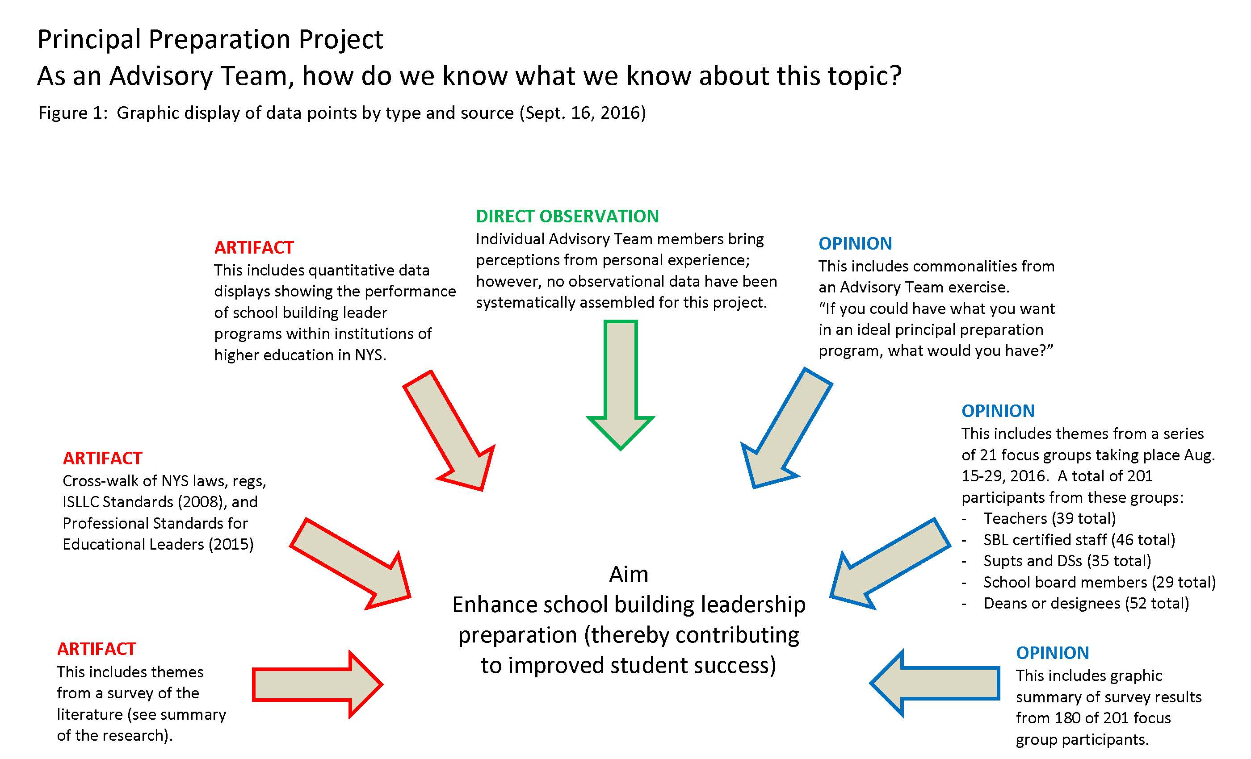

Slide 10
Takeaways: “If you could have what you want in a program to prepare school leaders, what would you have?”
Agenda Item #4: Old business
These were the directions that were given on Sept 21
  Work individually and silently
  Review the table of member responses to the homework prompt
  Identify two important “takeaways” from the homework
  Turn to your two neighbors to form a group of three
  Compare notes on your “takeaways”
  Reach as much consensus as you can on rank ordering of takeaways
  Write the consensus list on chart paper and place it on the wall
  Be ready as a team to report out

Slide 11
Agenda Item #4: Old business
Takeaways: “If you could have what you want, what . . . ?”
On October 19, as a whole group we will . . .
Review consensus agreement reached by each small group
Extract an element common to all (or nearly all small groups)
Gauge support for a proposal to make this a recommendation
Iterate (see if consensus can be reached on other items)

Slide 12
Agenda Item #4: Old Business
Recommendation #1 (a proposal)
  Expand the time and improve the quality of the internship in ways that enable aspiring principals to apply knowledge and skill in authentic settings under the supervision of qualified mentors.

Slide 13
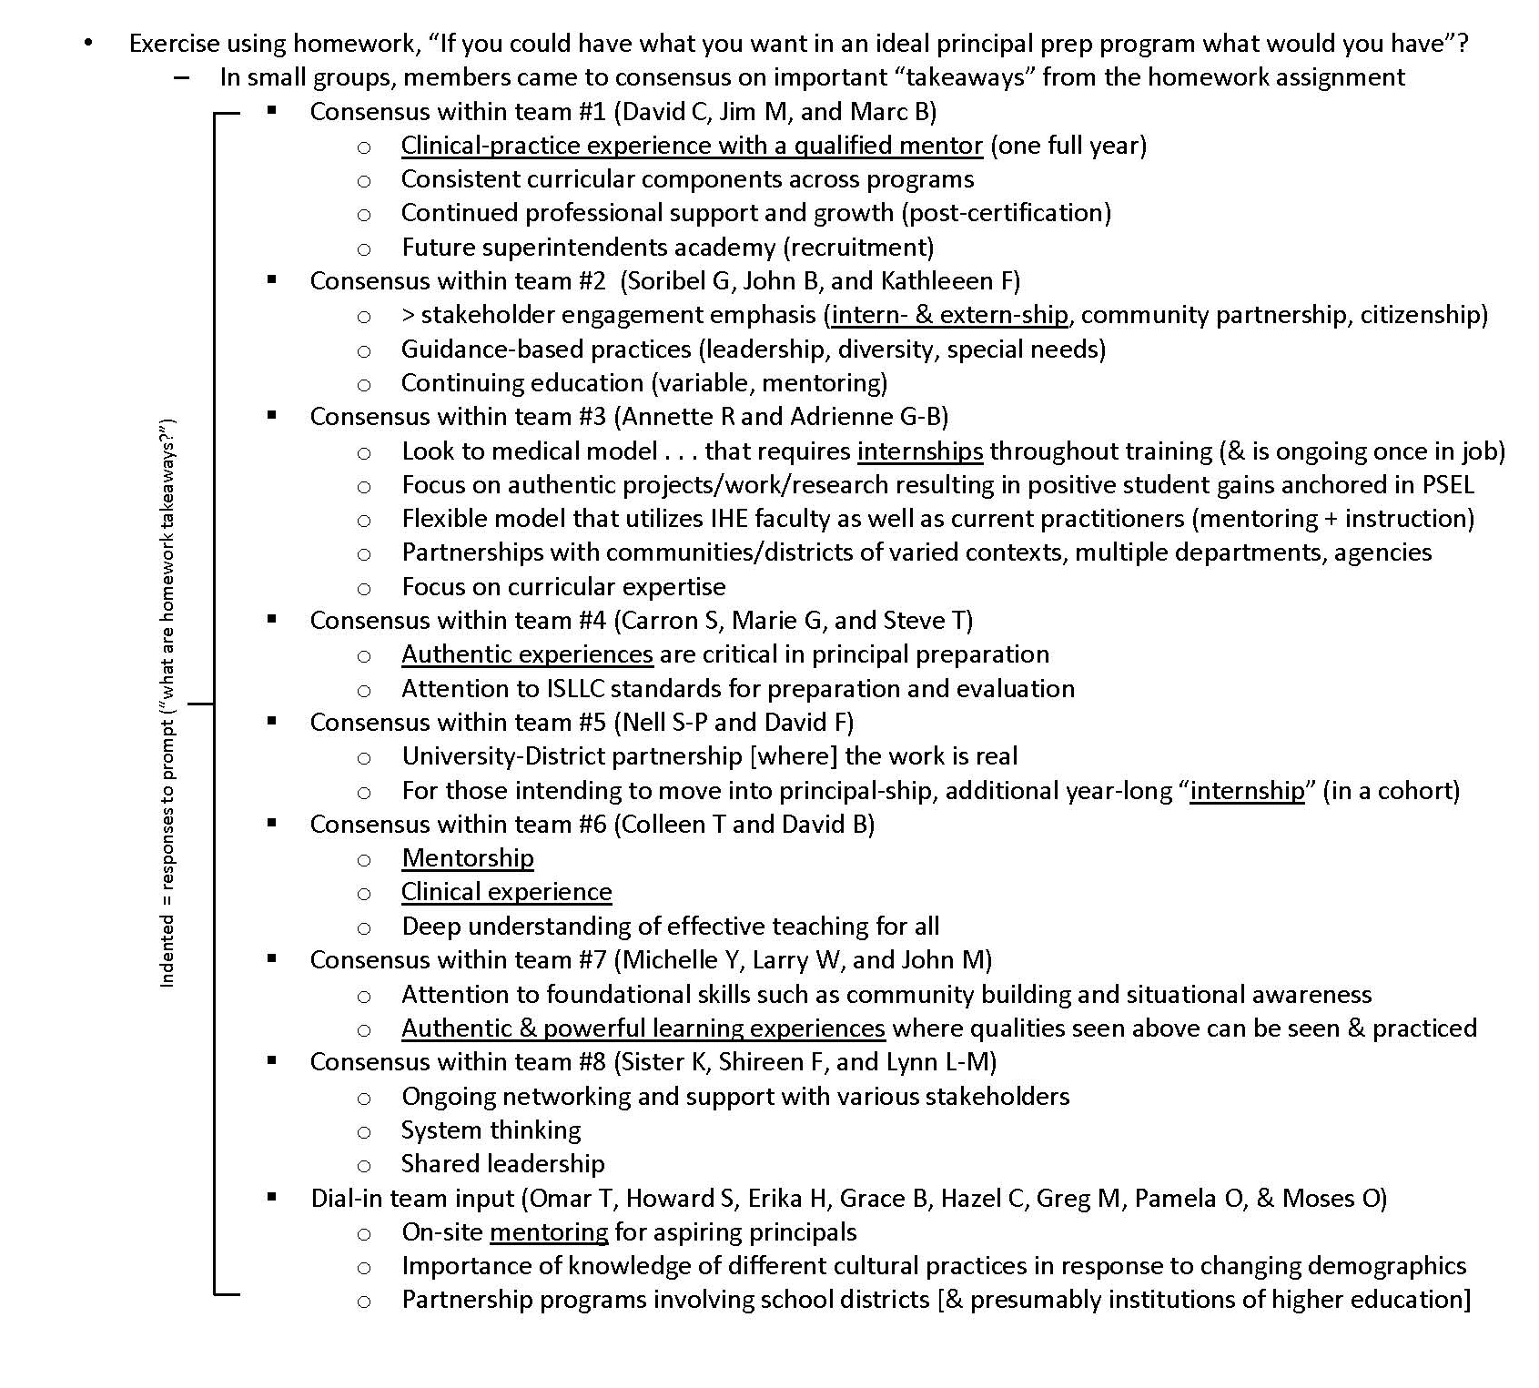
Excerpt from the minutes of the September 21, 2016 meeting

Slide 14
Agenda Item #4: Old Business
Data by source: Results from survey results
As a whole group . . .
Review how the survey was constructed

Slide 15
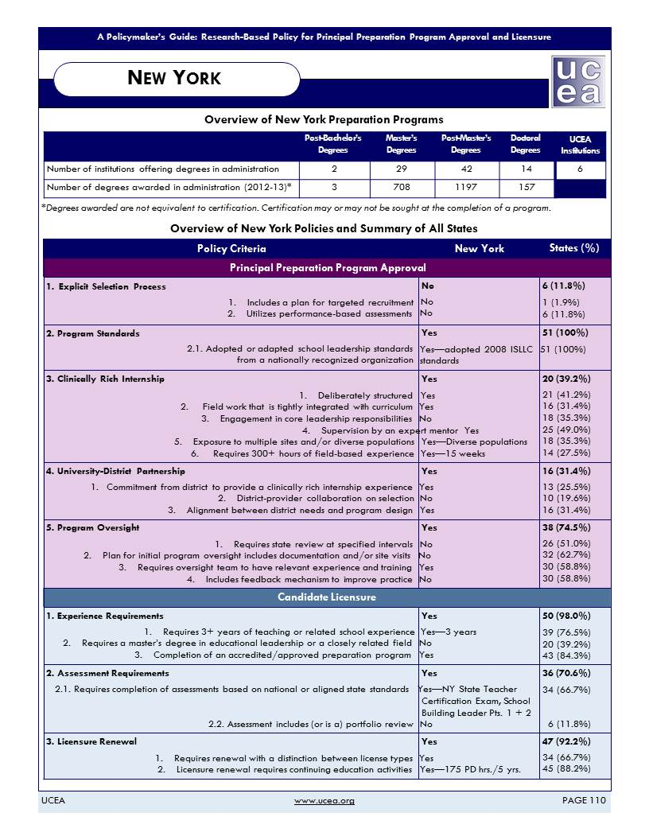
Survey Intent
It was to illuminate respondent opinions of the strengths, weaknesses, opportunities, and threats associated with the current system in NYS to prepare school building leaders.
For guidance we turned to a 2015 UCEA doc titled “Research-Based Policy for Principal Preparation Program Approval and Licensure”.
(Anderson and Reynolds, University Council for Educational Administration p 110-111)

Slide 16
When it comes to the strengths of the NYS school leader prep programs, this shows how responses to question #4 from the survey correspond to Research-Based Policy for Principal Preparation Program Approval and Licensure (2015, pg 110). To find the document, see item #20 of Readings section on web site.
Question 4: In my experience, the greatest strengths of NYS school leader preparation programs are:
100%
Appraisal of Strengths
90%
80%
70%
60%
50%
40%
30%
20%
10%
0%
Percent Strongly Agree/Agree
NYS laws organize SBL
programs around national leadership standards (2008 ISLLC
standards)
Admissions to SBL prep programs require applicant to have 3+ years teaching experience
NYS
approval required university SBL
programs to have district partnership for internships
SBL
programs in NYS must include at least 15 weeks of clincally-rich supervised internship
On SBl certificate exams, candidates must show their knowledge of program standards
University- based SBL programs infuse classroom instruction with skilled practioner input
A university is barred from admitting SBL
students if 50% of its graduates fail the SBL exam.

Slide 17














Question 5: Within available resources, areas of possible improvement in leader prep programs include:
100%
Appraisal
of Weaknesses
Percent Strongly Agree/Agree
90%
80%
70%
60%
50%
40%
30%
20%
10%
0%
Preparation program could be organized around most current (2015)
national leadership…
Better data (reliable & valid for its purpose) could be available to judge program adequacy
State oversight of leader prep programs could include a feedback cycle to improve practice
School leader prep programs could be evaluated annually to gauge program adequacy
Initial state approval of leader preparation programs could include a site visit
Steps could be taken so fewer IHEs fall below the target pass rate of 80% on SBL
exams.
Steps could be taken to support the developmen t of ethnicall- or racially diverse leaders
When it comes to areas of possible improvement in the NYS school leader prep programs, this shows how responses to question #5 from the survey correspond to Research-Based Policy for Principal Preparation Program Approval and Licensure (2015, pg 110). To find the document, see item #20 of Readings section on our web site.

Slide 18
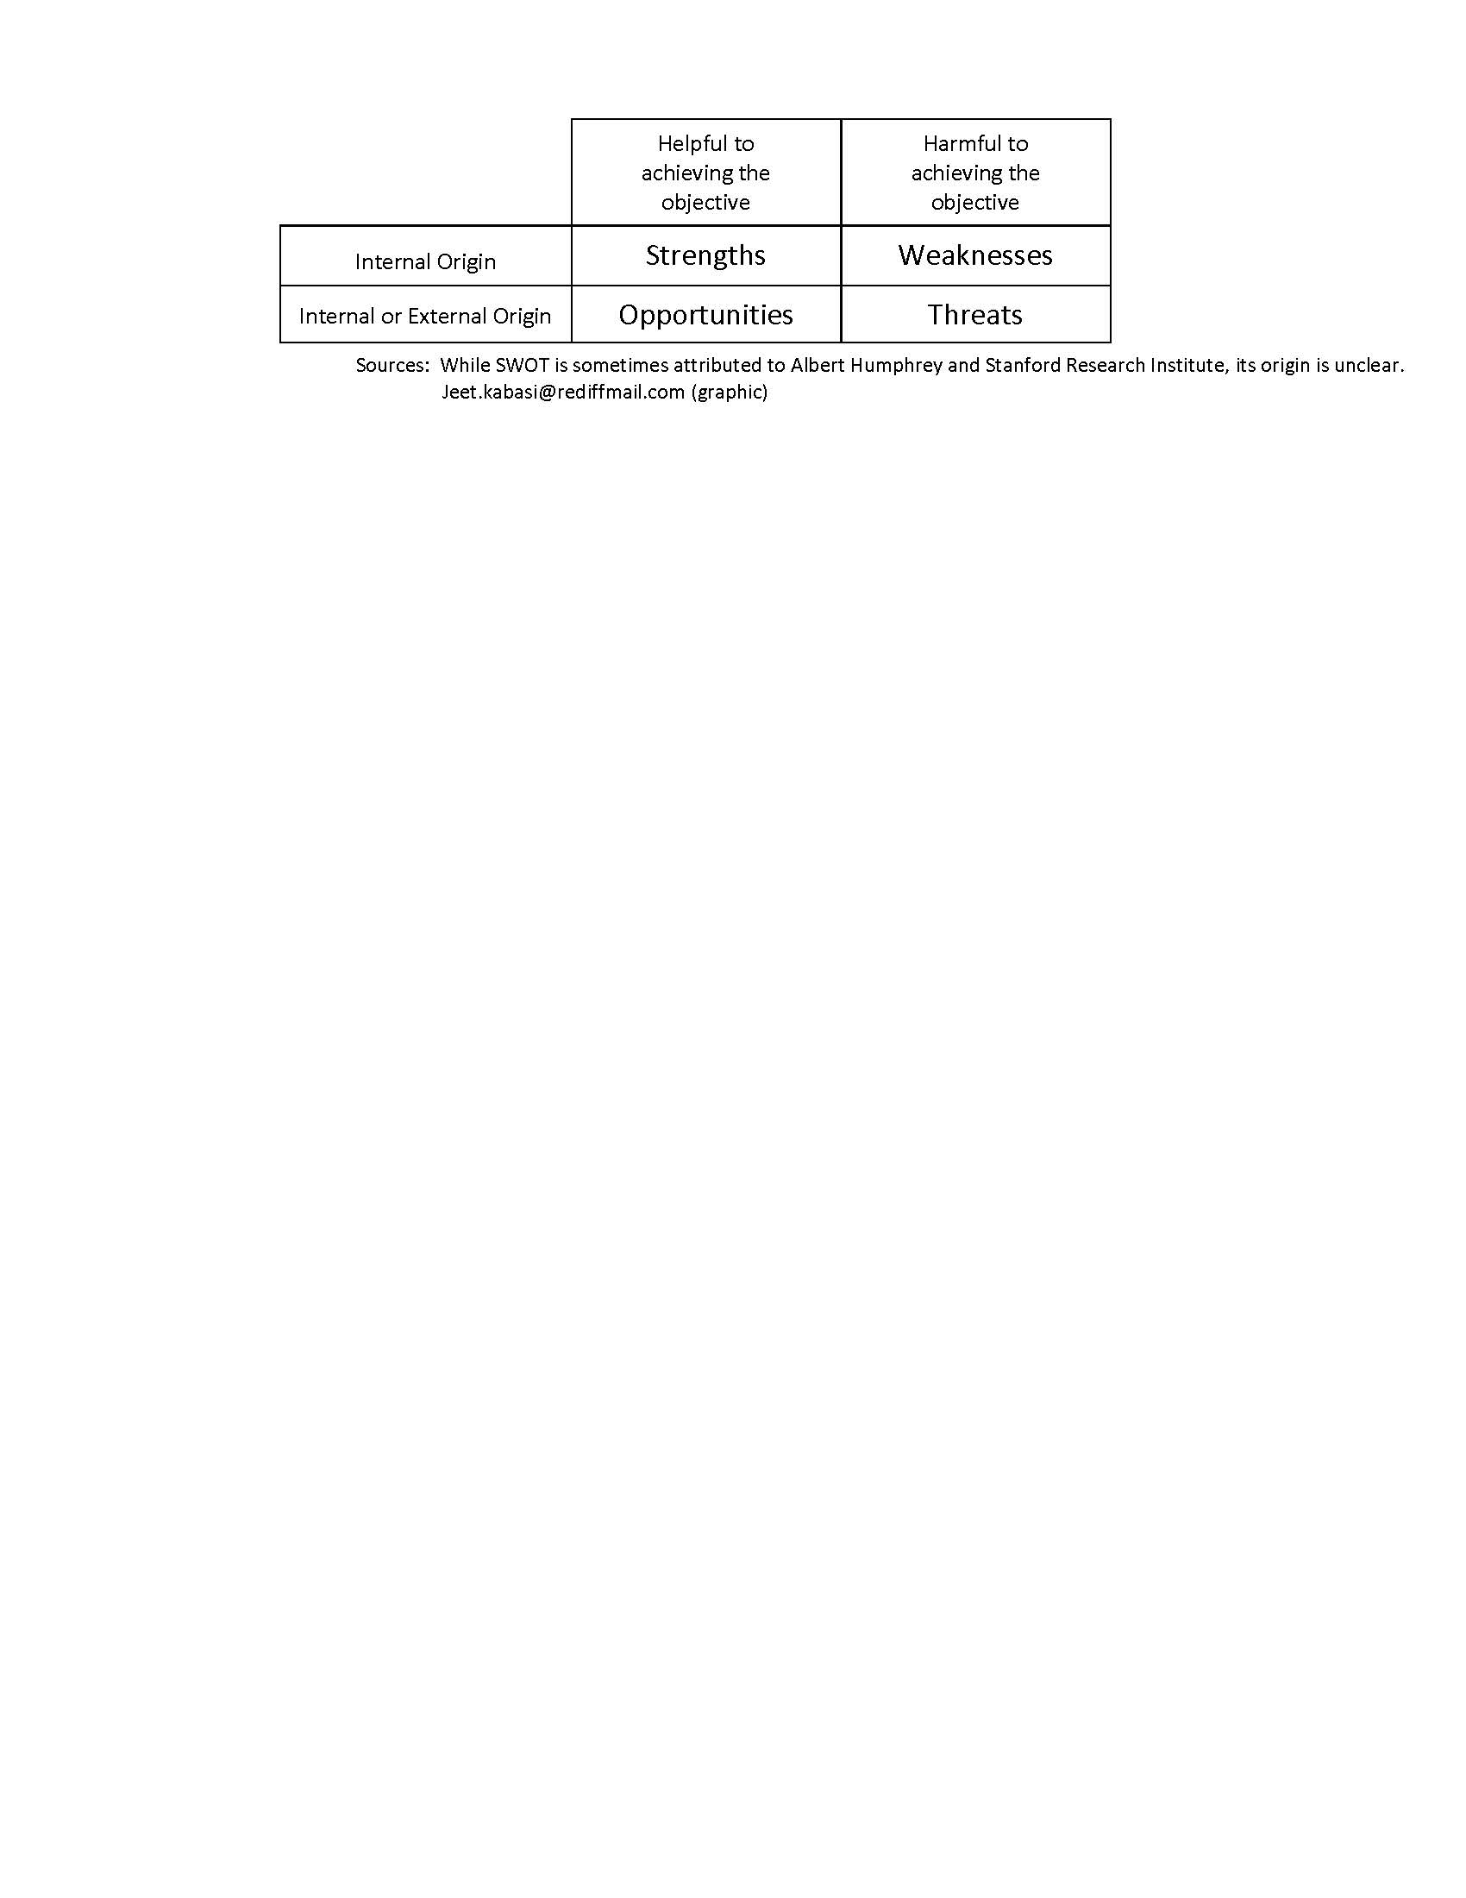
Question 3: Leader-preparation programs in New York are sufficiently responsive to:
100%
Percent Strongly Agree/Agree
90%
80%
70%
60%
50%
40%
30%
20%
10%
0%
Trends in technology
Changes in laws the affect public education
Varying demographic characteristics of the student population
Strongly Agree/Agree
49%
74%
43%
When it comes to the opportunities and threats facing the NYS school leader prep programs, question #3 from the survey highlights three areas of change that affect the learning environment in schools.
Appraisal
of
Opportunities and Threats

Slide 19
Question 10: How important is it for leader preparation programs to develop the following knowledge, dispositions, competencies, or skills in leaders?
100%
90%
80%
70%
60%
50%
40%
30%
20%
Need Assessment
and
Expected Competencies
Percent Very Great Importance/Great Importance
0%
Managing facilities and resources in a fiscally- responsibl e way
Ability to coach to enhance teacher instructio n and student learning
Knowledg e of how to adapt instructio n so it is culturally responsiv e
Ability to engage families in open, ongoing, two-way communi cation
Managing conflict in school settings in a fair and equitable manner
Developin g school culture that focuses on the whole child
Creating an inclusive and caring learning environm ent
Promotin g equity of opportuni ty for every student
Knowledg e related to sound instructio nal practice
Acting with integrity, transpare ncy, and fairness
Reference standard # below 9 10 6 4 8 3 7 2 5 1
“Professional Standards for Educational Leaders” from the National Policy Board for Educational Administration (CCSSO, 2015)
Standard 1: Advocate for each student and for a child-centered approach (Competency: Stress child-centered equity)
Standard 2: Support professional norms of behavior (Competency: Promote integrity, fairness, and transparency)
Standard 3: Advance equity of opportunity & culturally responsive practice (Competency: Address misconduct in unbiased way)
Standard 4: Create coherent curriculum, instruction, assessment system (Competency: Apply culturally responsive instruction)
Standard 5: Develop inclusive, caring, & supportive school community (Competency: Each student is known, accepted, valued)
Standard 6: Develop prof’l capacity of staff (Competency: Competency: Differentiate opportunities for learning and growth)
Standard 7: Foster professional community among school staff (Competency: Promote accountability for each student’s success)
Standard 8: Engage families and community (Competency: Understand, value, and employ community resources)
Standard 9: Manage school operations & resources (Competency: Be a responsible, ethical, & accountable steward of resources)
Standard 10: Act as an agent of continuous improvement (Competency: Instill mutual commitment/promote teacher leadership)

Slide 20
Agenda Item #4: Data by source
Working in small groups . . .
Review how the survey was constructed
Turn to your neighbors to form a group of three
Review the graphs found in Section 8 of your notebook
These are the “Preliminary Results from a Field Test of a Survey”
Identify noteworthy patterns
Record observations that could translate into a recommendation
Record your consensus agreement (and be ready to report out)
As a whole group . . .
Extract an element common to all (or nearly all small groups)
If consensus support exists, then make this an Advisory Team recommendation
Reach as much consensus as we can on recommendations
Iterate (but this time focus on the 1-page narrative of themes from focus groups)

Slide 21
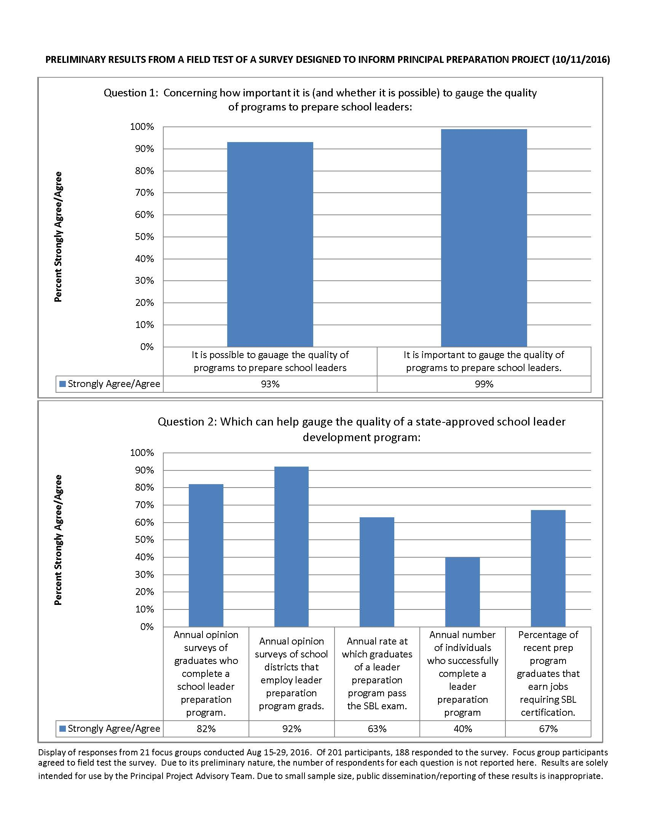

Slide 22
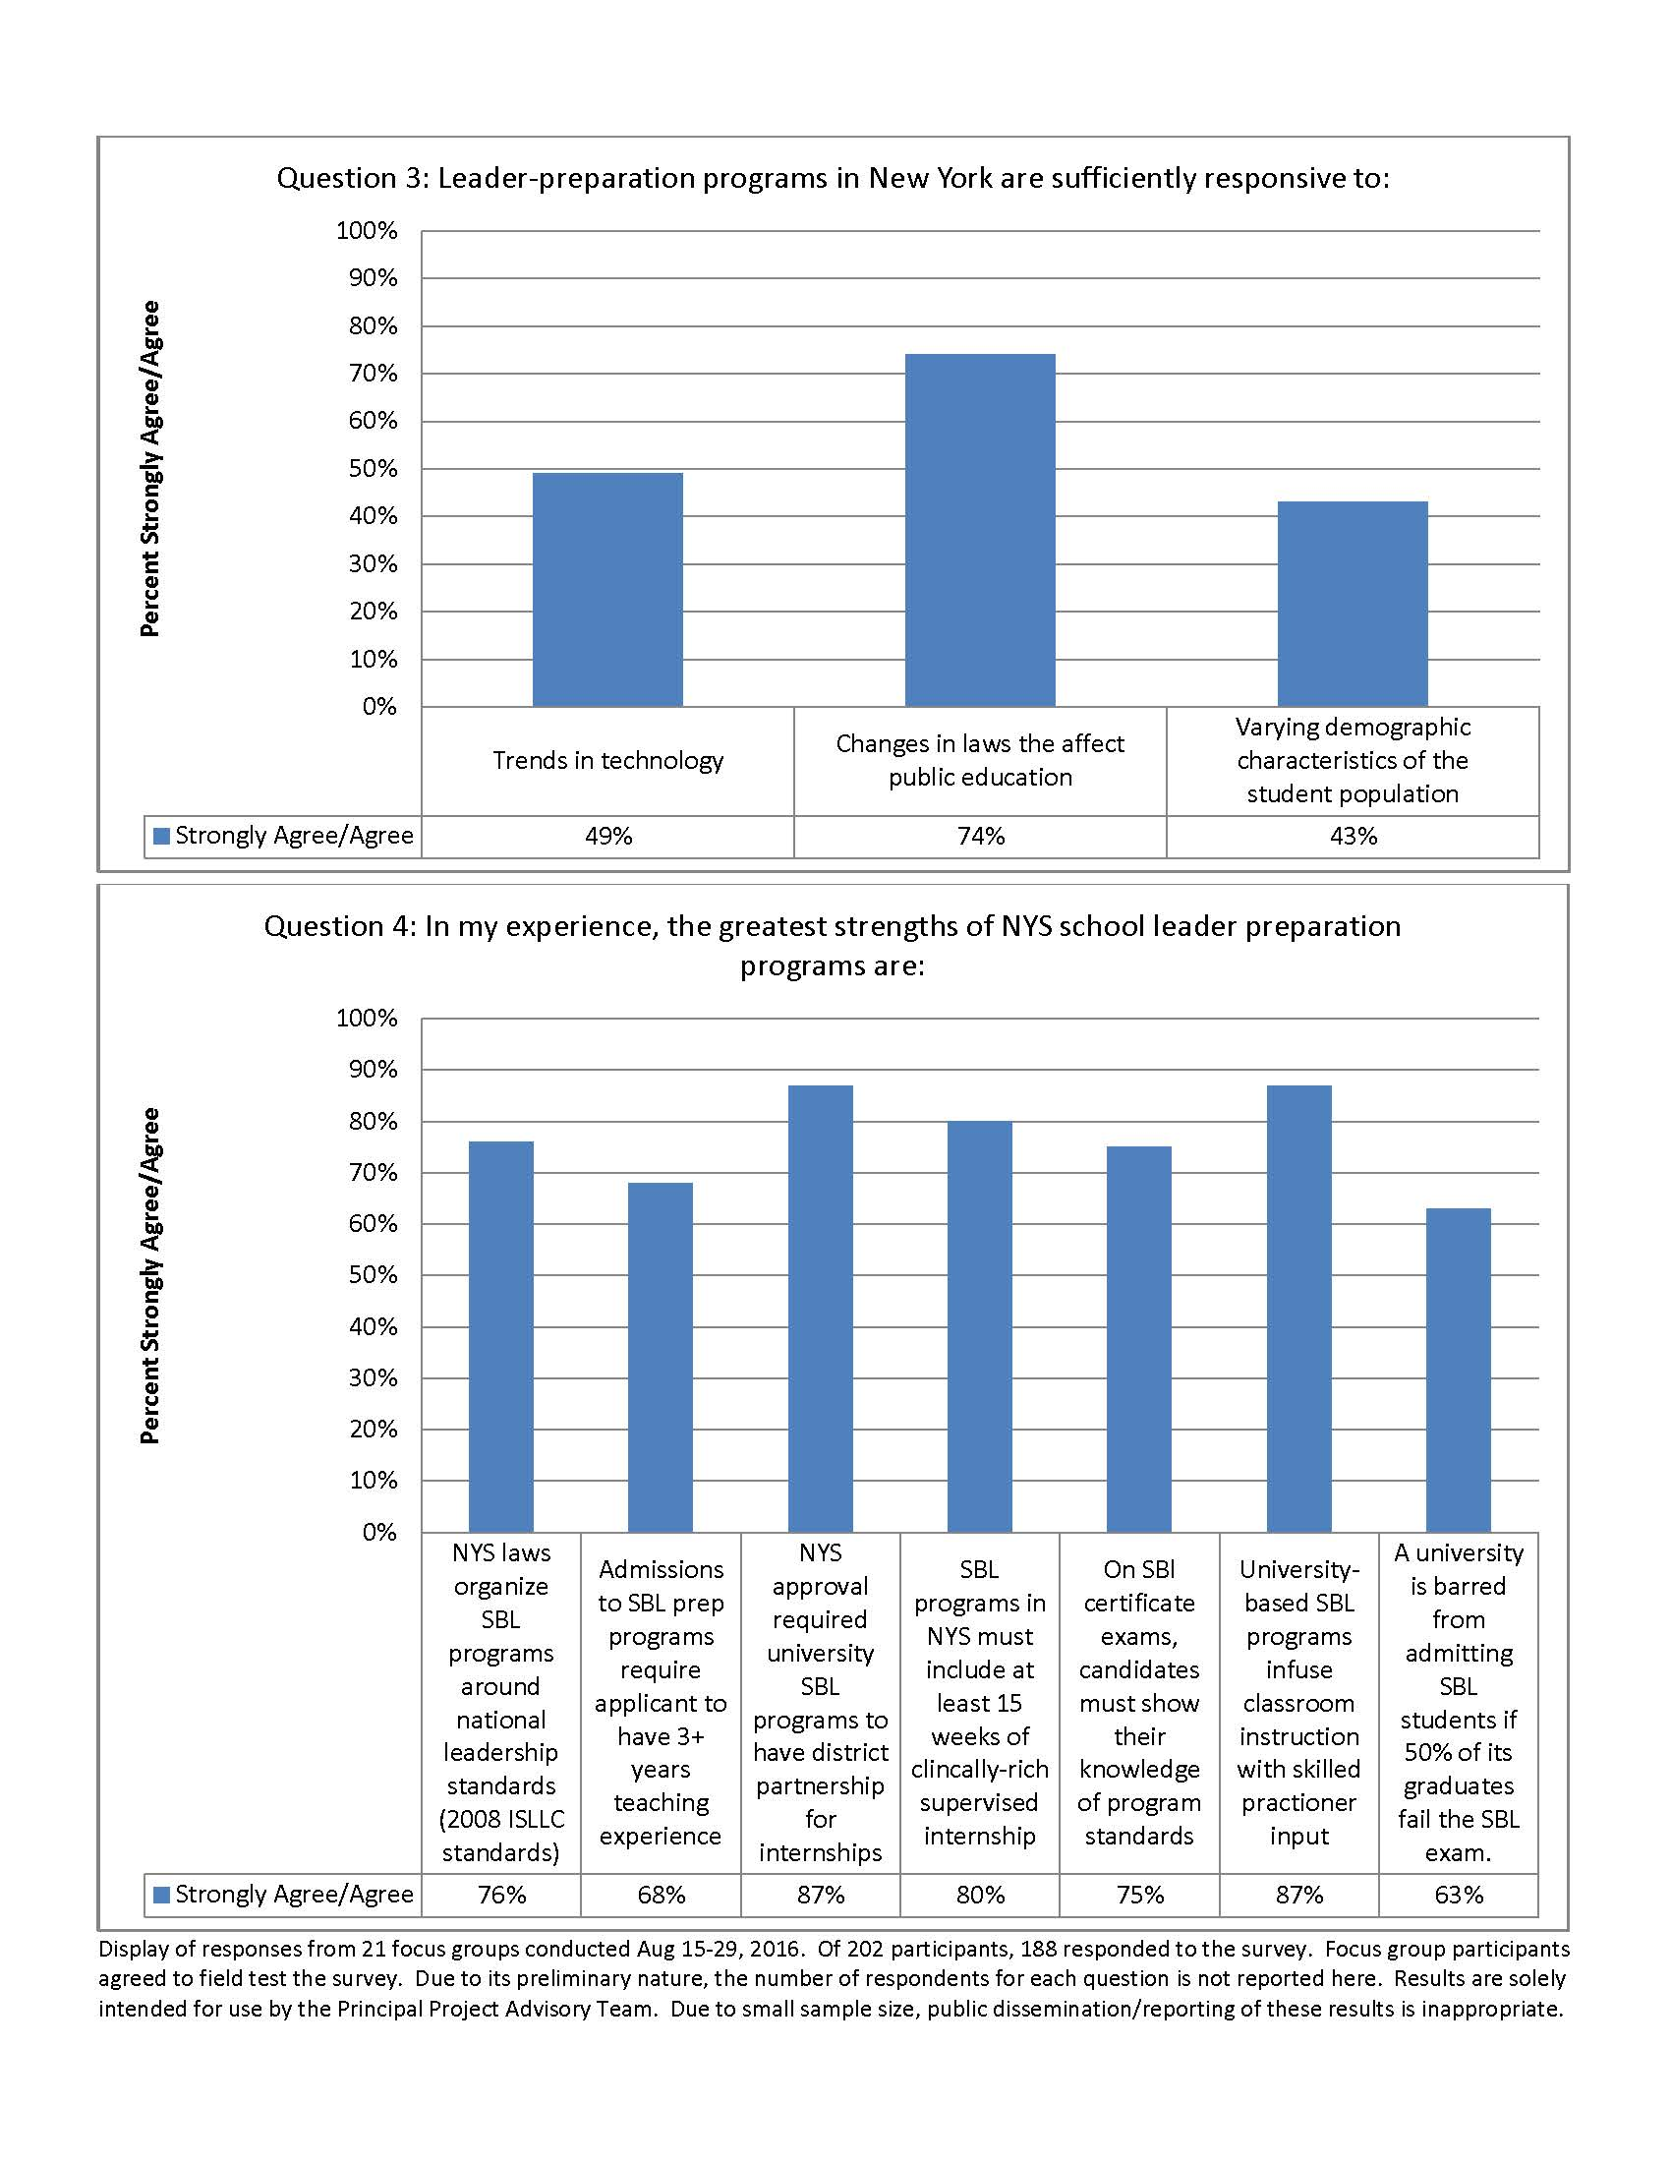

Slide 23
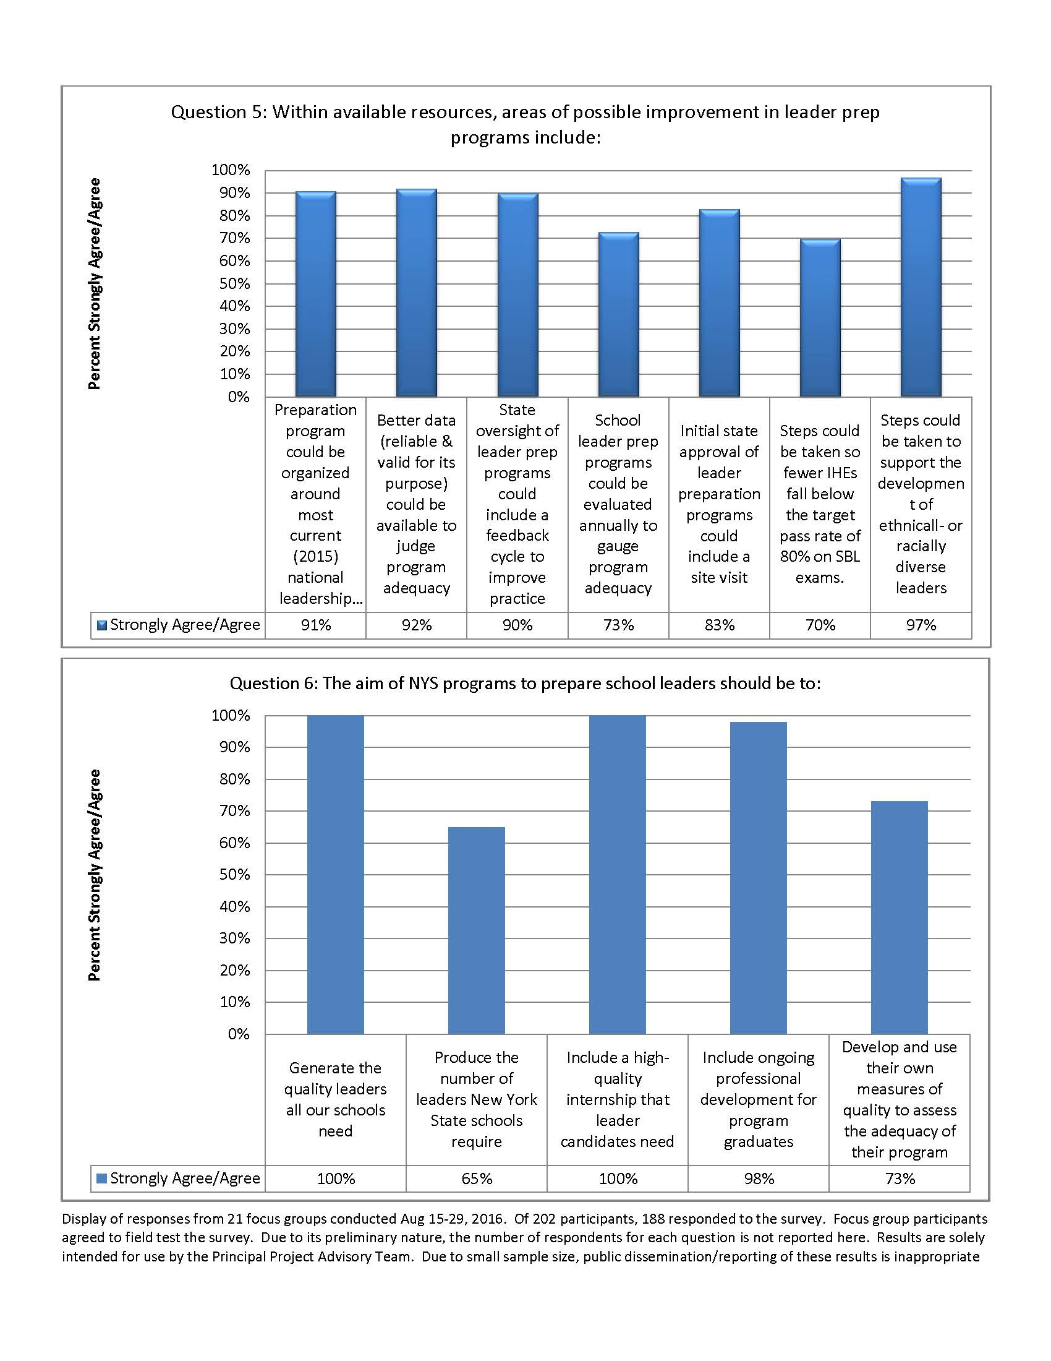

Slide 24
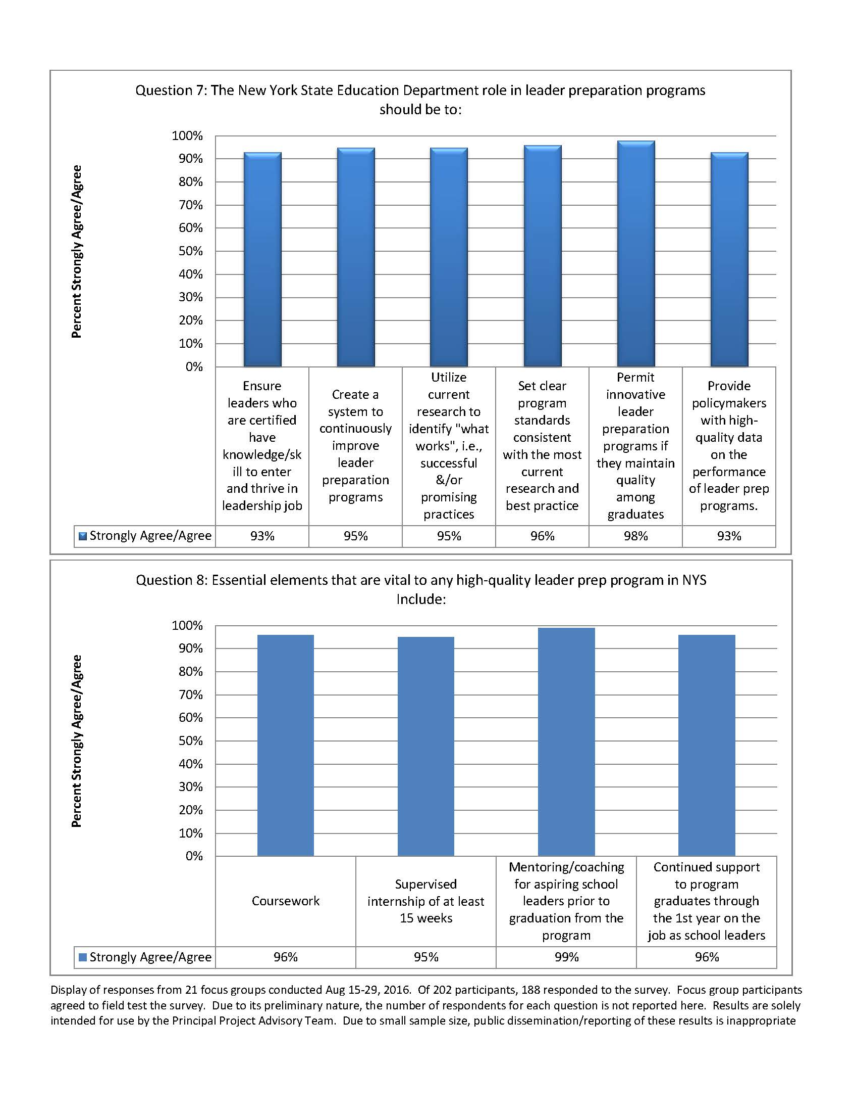

Slide 25
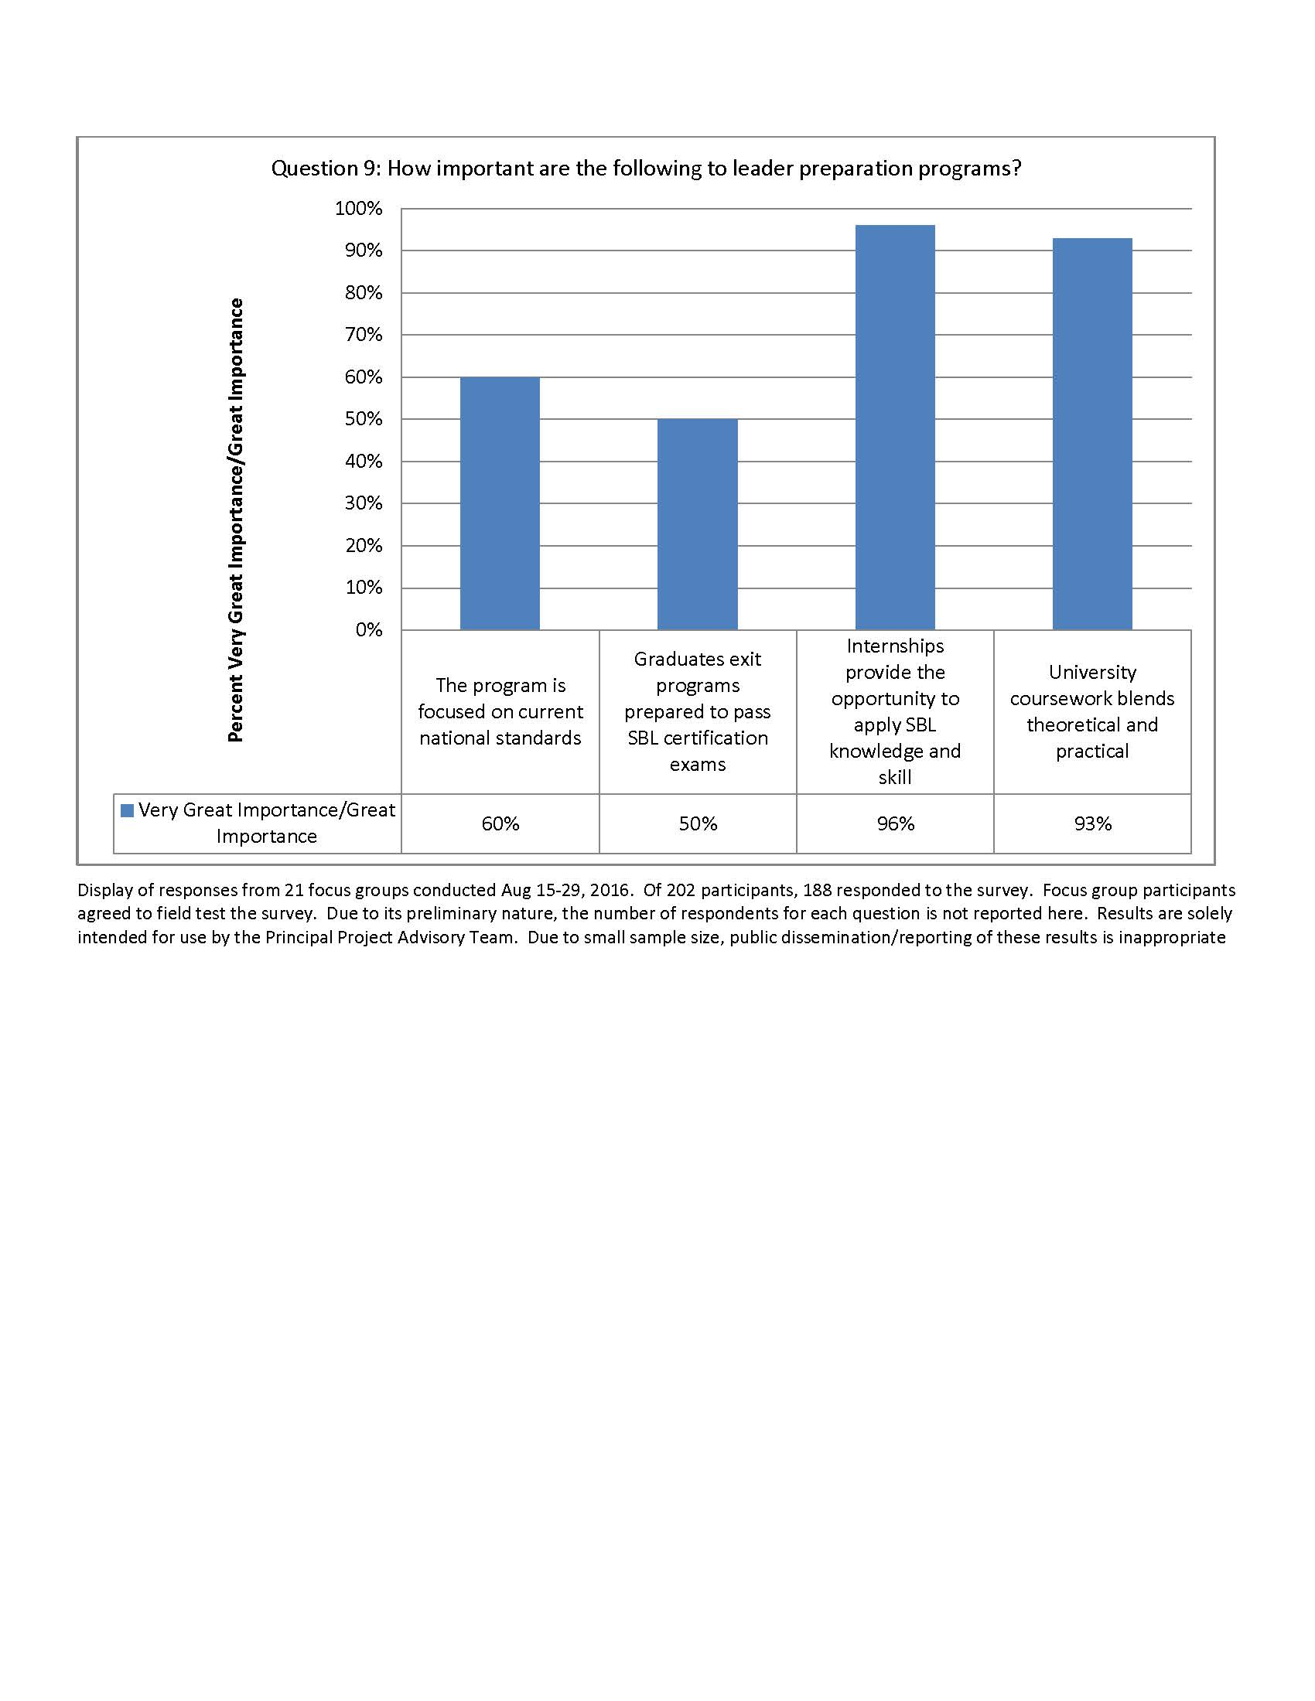

Slide 26
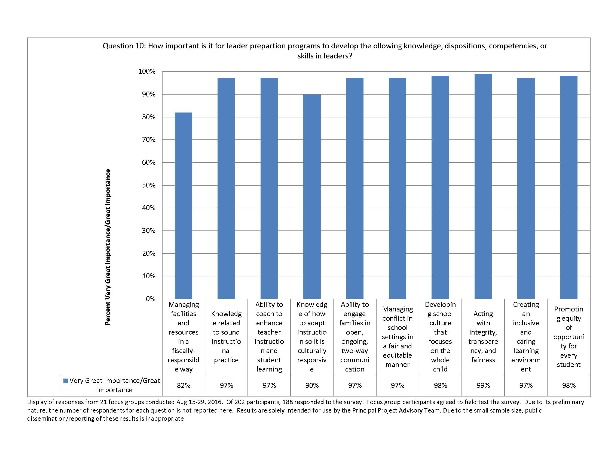

Slide 27
Agenda Item #5: SBL Exam Pass Rates
Review figure titled “Comparison of Pass Rates (current SBL exam vs previous SBL exam), how impact varies by race/ethnicity”
Working as a whole group, identify the possible implications (both for our work and for statewide policy)
Call the question on whether enough support exists to create another consensus recommendation

Slide 28
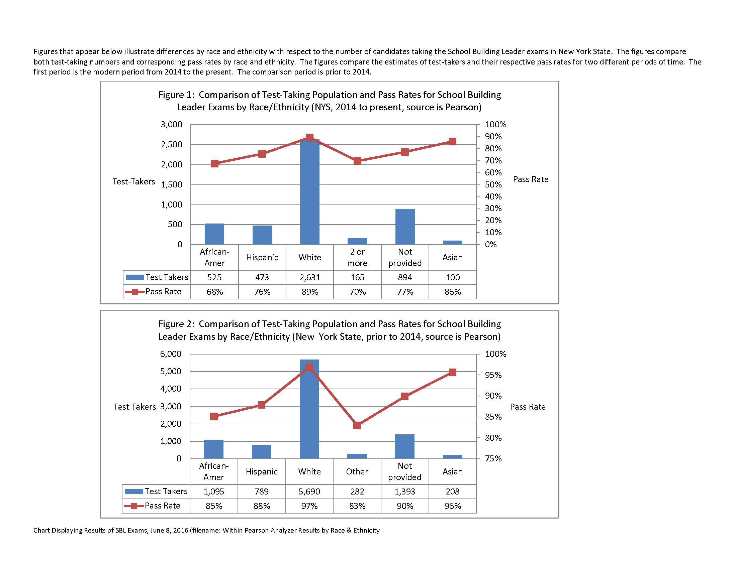

Slide 29
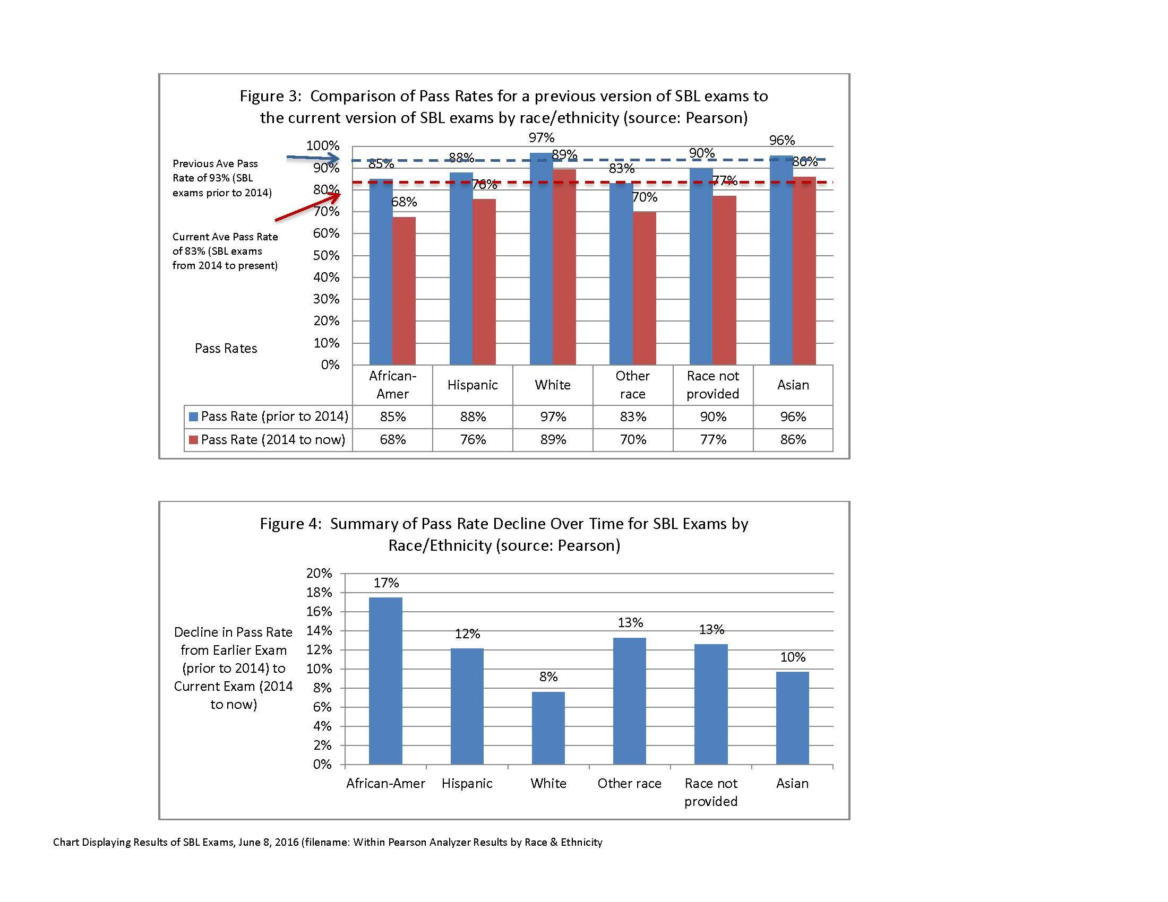

Slide 30
Agenda Item #6: Strategy follows vision
Review results from homework that invited each member to draft beliefs that should ground and inform our work
Each member receives an envelope with 12 slips of paper
Working independently, each member ranks the 12 beliefs
Form a group of 3; compare notes and try to reach as much agreement as possible on a rank-ordered list of beliefs
Record your consensus list on chart paper
Determine if enough support exists to reach consensus as a whole Team on beliefs that inform our work & drive recommendations

Slide 31
Agenda Item #7: Theory of Action
Review handout titled “Theory of Action: Samples from States and Districts”
Consider the belief statements we generated as a team in the previous exercise
Work silently and on your own to produce an “if this then that statement” that describes how the recommendations that could emerge from our Advisory Team will help enhance school building leadership in NYS.
Find two other members with whom you have not worked; make sure each of you have different titles.
Compare notes with 2 others; as a team of 3, strive to reach agreement on a single theory of action. Record it on chart paper
After each 3-person group reports out, note similarities & differences among & between groups (this topic will be revisited)

Slide 32
Agenda Item #8: Getting organized to produce
Rank order recommendations our team has generated
Decide how to organize members into work-groups

Slide 33
Agenda Item #9: Common Time for Future Meetings
Schedule for future meetings
  Nov. 30, 2016
  Jan. 25, 2017
  Feb. 22, 2017
  Mar. 22, 2017
  Apr. 12, 2017
  May 31, 2017
Proposed common meeting time for remaining meetings
12:30 pm – 3:30 pm for each meeting
ADJOURN

