Slide 1
Principal Preparation Project Advisory Team (Phase 2)
March 21, 2018

Slide 2
Agenda Item #1
Welcome by the Chairs (10:30 am)
Gladys Cruz
Suzanne Rosenblith
Reggie Landeau
Introductions

Slide 3
Agenda Item #2 (see pg 1 in folder)
Goal
Identify recommendations we support by consensus

Slide 4
Friendly Reminder: Reaching consensus
Fist to Five
The goal is to something that every member can live with and support.
When co-chairs call a question, members show hands to show support.
Those who hold up 3, 4, or 5 fingers support the option
2 fingers means “I cannot live with it ‘as is’”
1 finger means “A larger reservation prevents me from supporting it”
Showing a fist means “I cannot support it, as a matter of conscience.”
Note: Options that are forwarded enjoy consensus support. For these, every Team member shows 3, 4, or 5 fingers. Those who show a fist, 1, or 2 fingers will be asked, “What would it take to make this something you can live with and support?”

Slide 5
What’s happened since last meeting
Project management is passing to SED staff

Slide 6
Agenda Item #3
Minutes (see pages 2-16 in folder)
Accept “as is” or agree on needed change.

Slide 7
Agenda Item #4
Logic Models (10:35 am – 10:40 am)
Context ESSA requires this if using Title IIA for principal prep
Objective Decide whether to support a revised logic model
Note Changes suggested in our Feb. 28, 2018 meeting:
- Unpack “outputs” (short-, medium-, long-term)
- Provide rationale for the “problem statement”
- Investigate to see whether activities and outputs that appear should be hypothesized or actual

Slide 8
Where do we look for guidance?
See pg 17 in your folder (competencies for school turnaround leaders)

Slide 11
Logic Model Guidance (RAND, 2017, pg 4)
A logic model presents a framework that identifies the components of proposed strategy (i.e., the includes active ingredients that are hypothesized to be critical to achieving the relevant outcomes) and also shows and describes how key components and outcomes are related, theoretically and operationally (U.S. Department of Education, 2016)
Source: Logic Models for Selecting, Designing, and Implementing Evidence-Based School Leadership Interventions (L. Daugherty, R. Herman, F. Unlu, RAND, 2017)

Slide 12
The Problem (RAND, 2017, pg. 9)
Many states and districts struggle with a shortage of new principals who possess competencies needed for effective leadership. Attending training programs, principal candidates often do not receive coursework and clinical experiences that prepare them for leadership positions in real life. After graduation, new principals often do not receive sufficient support and mentoring.

Slide 13
Intervention Types (RAND, 2017, pg. 9)
RAND identifies 6 intervention types (policy levers):
- Principal preparation programs
- Recruitment, selection, and placement
- Supervision and evaluation
- Professional learning
- Working conditions
- School improvement

Slide 14
Prep Program Interventions (RAND, 2017, pg. 9)
Leadership interventions broadly include any effort to improve leadership capacity in schools by altering programs, practices, or policies. Interventions can include specialized programs that target certain groups of principals or districtwide/statewide practices that affect all principals. Interventions can be developed in-house by states and districts, purchased from external organizations, or developed collaboratively

Slide 15
Prep Program Interventions (RAND, 2017, pg. 9)
A principal preparation program aims to prepare current and aspiring educators to become principals through training that combines high-quality classroom instruction and some type of school-based internship. These programs can lead to an advanced degree or certification. They may be provided by universities, districts, or independent organizations or some combination

Slide 16
What is meant by “interventions are related?”

Slide 17
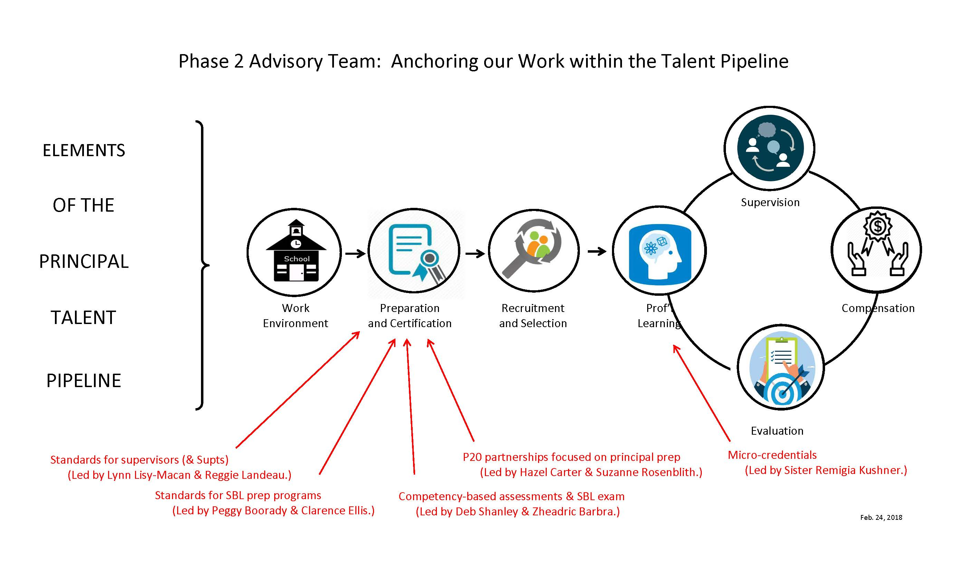

Slide 18
What is meant by “competencies?”

Slide 23
SBL exam competencies (See pg 55-61 in folder)
Examples of NYS competencies (SBL exam, Pearson)
Instructional leadership
School culture and learning
Developing human capital
Family and community engagement
Operations, data, and legal

Slide 24
What does logic model look like with changes?

Slide 27
Agenda Item #5
“First Principles” (10:40 am – 11:00 am)
Objective Decide how many and which to adopt.
Activity Use SurveyMonkey results (from February).
Be ready to use Fist-to-Five.
Consensus recommendations go forward.

Slide 28
First Principles
(supported by all respondents to February survey)
The Foundation
Realizing educational excellence and equity throughout NYS requires well-trained leaders who have a convincing command of competencies associated with the Professional Standards for Educational Leaders (PSELs).

Slide 29
First Principles
(supported by all respondents to February survey)
Purpose and Effect
We agree with Linda Darling Hammond. The intent is to create a P20 educational system that learns to get better at getting better. Improving principal preparation contributes to school and student success.

Slide 30
First Principles
(supported by all respondents to February survey)
Feedback and Data
Feedback is at the heart of learning to get better; thus data collection, analysis, and reporting are vital because they make it possible to gauge whether activity translates into improvement.

Slide 31
First Principles
(supported by all respondents to February survey)
P20 Partnership
Districts are clients of (and partners with) preparation programs; so close and ongoing feedback between field-based practitioners and university-based programs are essential elements of principal preparation

Slide 32
First Principles
(supported by all respondents to February survey)
Mentoring and Coaching
Because continuous learning is a necessity, principals need ongoing support in the form of high-quality mentoring and coaching up to and beyond the full first year on the job

Slide 33
First Principles
(not yet supported by all survey respondents)
Quality is the Driver, not Dollars (survey included one “1” and one “2”)
The ability of program graduates to assume a leadership role and lead schools to higher ground is not just the aim and purpose of preparation programs but the driver of program success (not revenue generation).

Slide 34
First Principles
(not yet supported by all survey respondents)
Aim of Prep Program (survey included one “2”)
Sound programs equip candidates to lead schools in continuous school improvement and to lead turnaround in schools that struggle most.

Slide 35
First Principles
(not yet supported by all survey respondents)
Competency Matters Most (survey included one “1” and one “2”)
Candidates enrolled in preparation programs demonstrate certification readiness by leading efforts at a district school that lift staff, student, or school performance.

Slide 36
First Principles
(not yet supported by all survey respondents)
Defensible Judgments (survey included two “2s”)
We work toward ensuring that judgments about the adequacy of preparation programs and/or candidate readiness for certification are reliable, valid for their purpose, and comparable across individual, program, and year.

Slide 37
First Principles
(not yet supported by all survey respondents)
Residency (survey included four“2s”)
During a full-time, year-long, (ideally paid), school-based internship, candidates identify problems of practice and design and lead interventions that help improve opportunities and outcomes for staff and students.

Slide 38
Agenda Item #6 (see pg 1, pg 18-21, and pg 22-28 in folder)
Straw Poll (11:00 am – 11:05 am)
Objective If we called the question now, determine how much support exists for recommendations from each group.

Slide 39
Agenda Item #7 (see pg. 1, pg 18-21, and pg 22-28 in folder)
Food for Thought (11:05 am – 11:30 am)
Objective One by one, each small group provides flyover on its recommendations and invites input from colleagues.

Slide 40
Agenda Item #8
Small Team Breakout Sessions (11:30 am – 12:45 pm)
Objective Finalize recommendation concepts and phrasing.
Activity Over working lunch, use colleague input to finalize recommendations (note changes on chart paper).
Re-convene (ready to report out) when video ends.
https://duckduckgo.com/?q=paul+sings+nessum+dorma+idol&t=hg&atb=v103-5_f&ia=videos&iai=2I3Ha8PABzc

Slide 41
Agenda Item #9 (see pg. 1, pg 18-21, and pg 22-28 in folder)
Report out (12:45 pm – 1:15 pm)
Objective Understand proposed final phrasing
Activity Small group leaders summarize, field questions

Slide 42
Agenda Item #10
Calling the Question (1:15 pm – 1:45 pm)
Objective Identify recommendations having consensus support
Activity Use Fist-to-Five

Slide 43
Agenda Item #11
Overview of Final Report (1:45 pm – 2:00 pm)
Objective Identify elements of the final report
Activity Acknowledgments; members, chairs, group leaders
How Phase 2 builds on work of our predecessors
Evidence base
Process for assembling consensus
First principles, logic model (if approved)
Recommendations

Slide 44
Agenda Item #12
Possible next steps (2:00 pm – 2:15 pm)
Objective Decide our response if asked about next steps.

Slide 45
Agenda Item #13
Evaluating this effort (2:15 pm – 2:30 pm)
Objective Identify strengths and areas of possible improvement in process and product

Slide 46
- ADJOURN

