Slide 1
Principal Preparation Project Advisory Team (Phase 2)
February 28, 2018

Slide 2
Agenda Item #1
Welcome by the Chairs (10:30 am)
Gladys Cruz
Suzanne Rosenblith
Reggie Landeau
Introductions
Members
Guests (Mary Strain, Teaching Matters)

Slide 3
Agenda Item #2
Goal
Finalize recommendations in each area of our charge

Slide 4
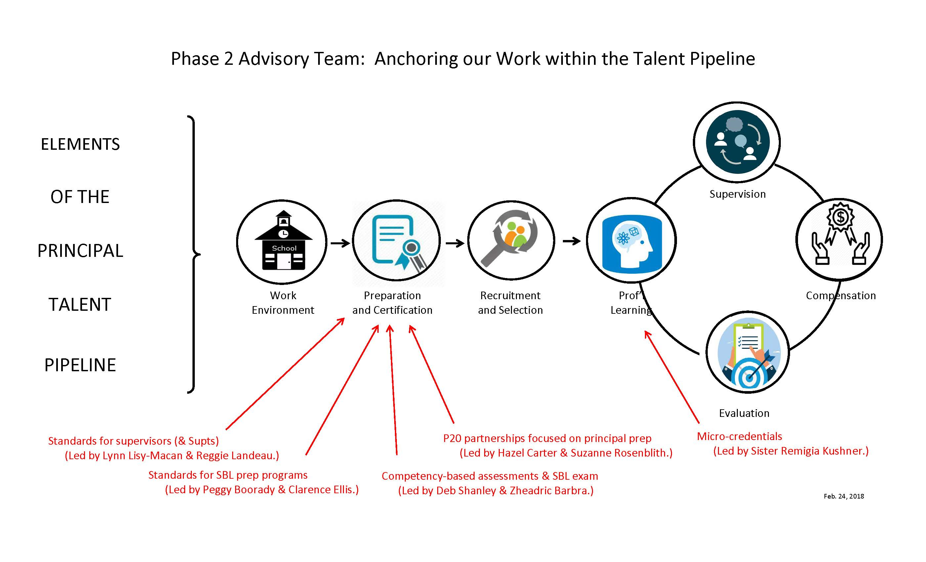

Slide 5
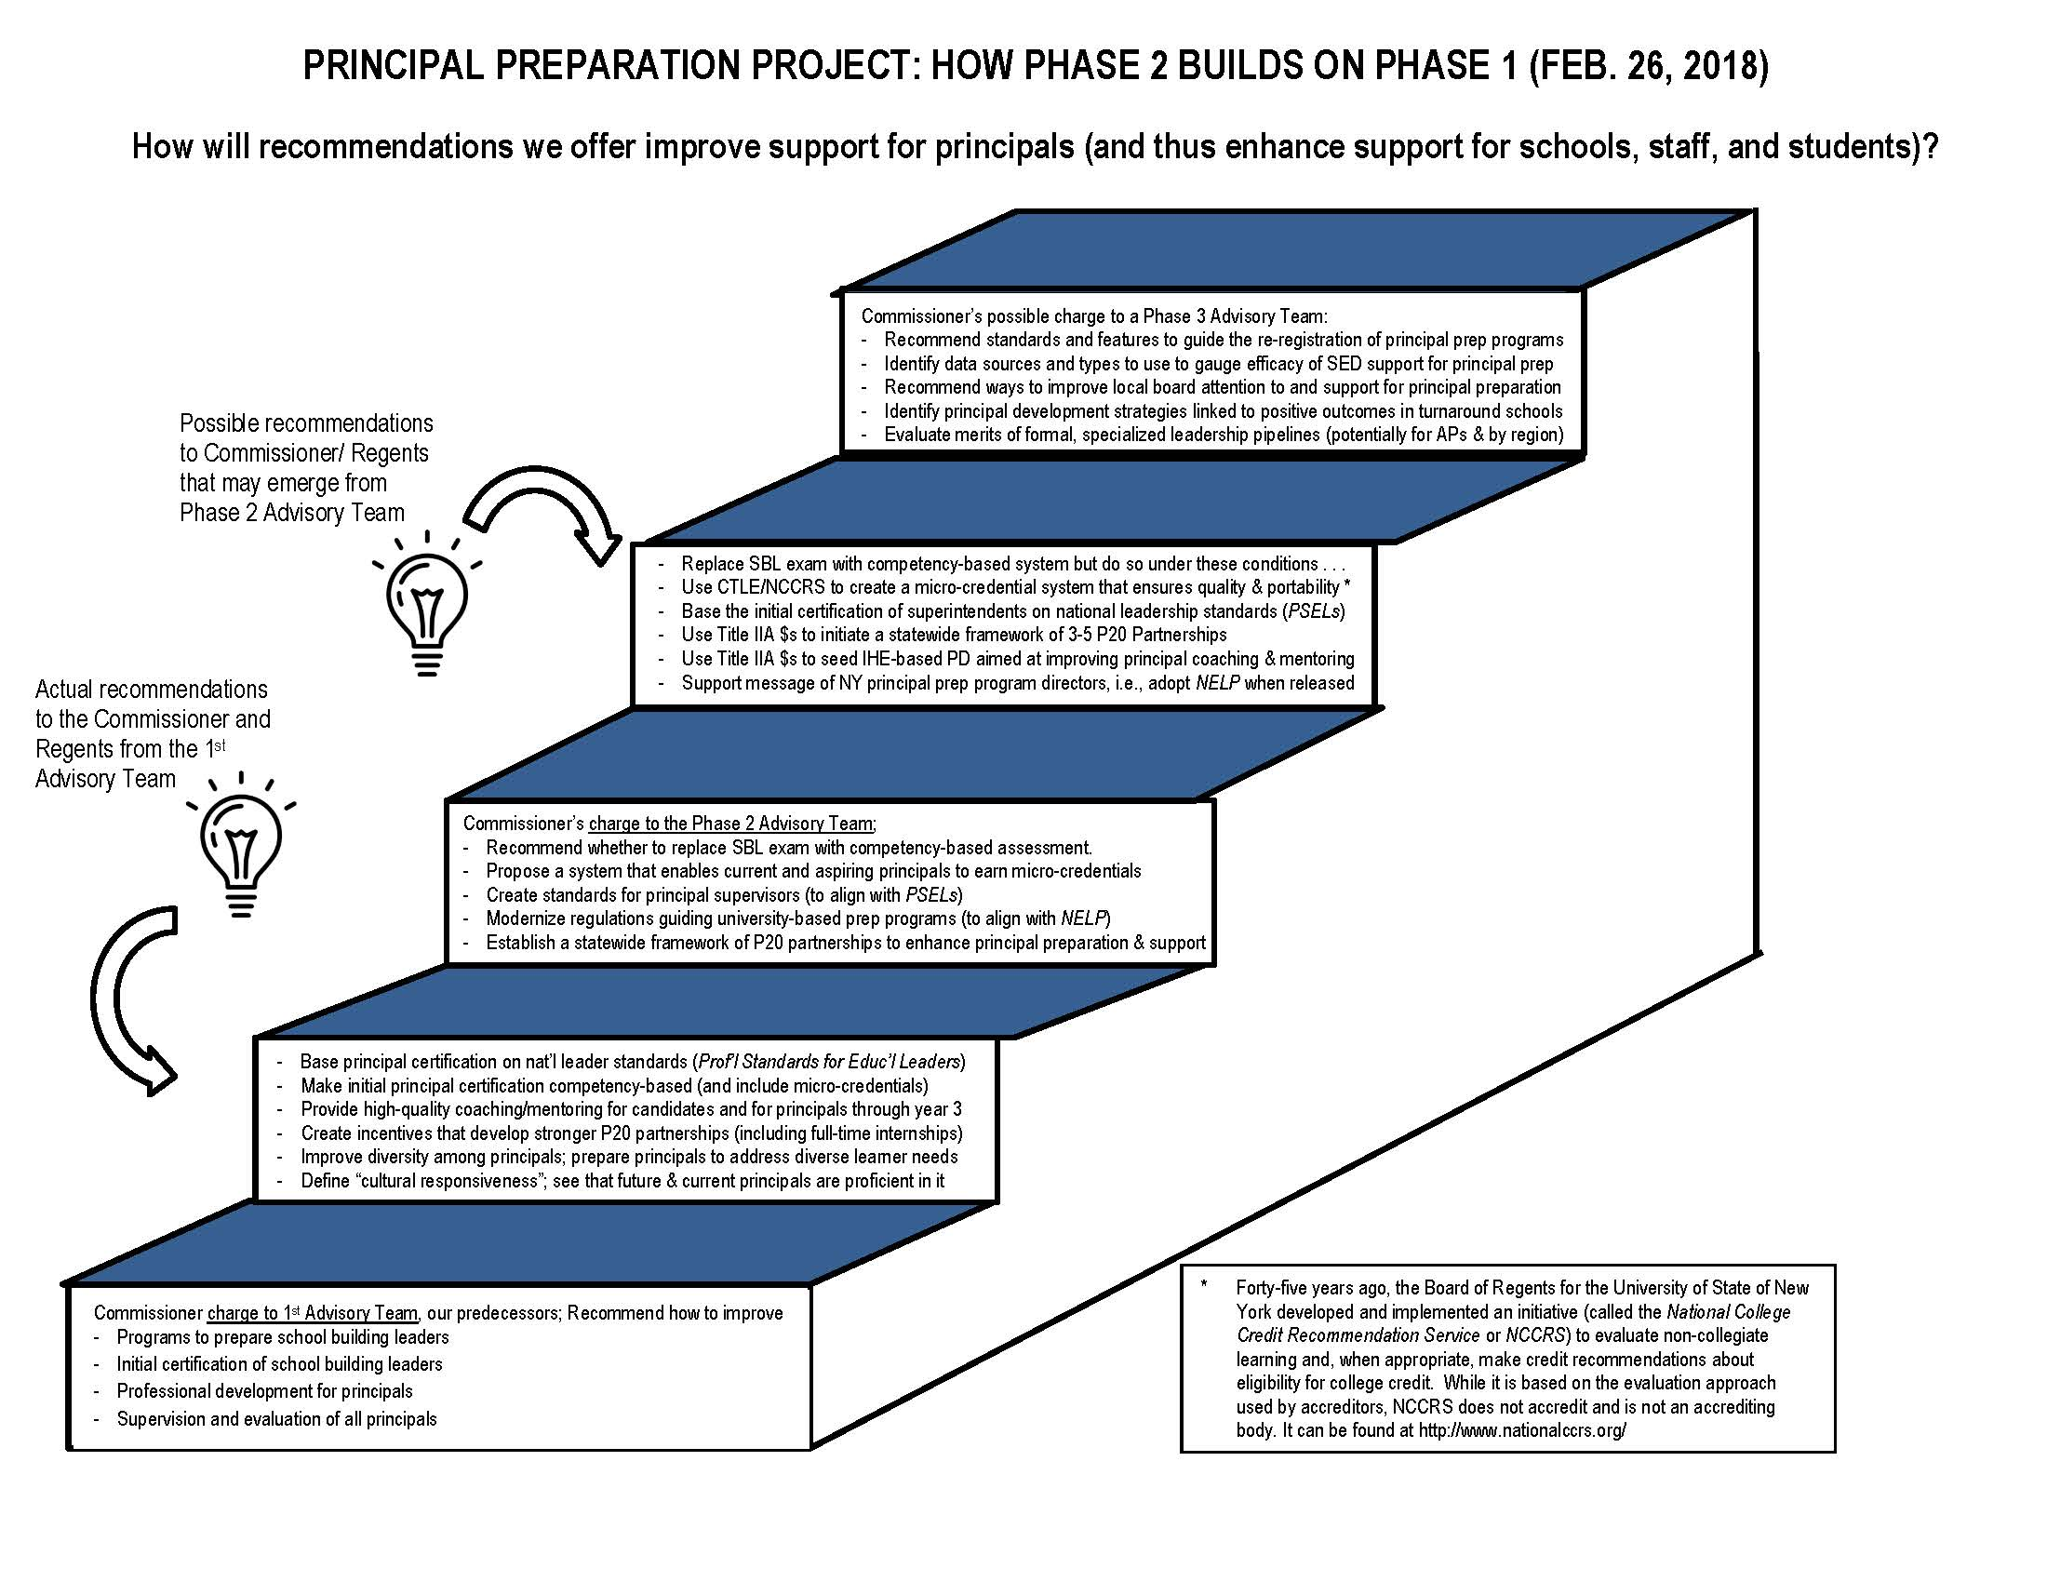

Slide 6
Agenda Item #3
What has happened since our last meeting?
SUNY Trustees called for a system-wide micro-credential framework
NELP development team sent us their most recent draft
CADEA gave suggestions to SED on how to re-register SBL programs
There is a growing consensus in SED to allocate Title IIA funds directly
$1M → principal PD (mentoring/coaching) via state-funded postsecondary
$3.4M → P20 partnerships (includes district, IHE, and other entities)
Note: “IHE” includes independent and/or state-funded institutions
“Other entities” may include BOCES, professional organizations that represent school building leaders for the purpose of collective bargaining, or organizations with leadership development expertise (either for-profit or not-for-profit).

Slide 7
CADEA Program Redesign Recommendations
All programs (regardless of enrollee number) should be prepared to:
Redesign in alignment with PSELs and forthcoming NELP standards
State Education Department in Albany should:
Match redesign application to CAEP/NELP accreditation requirements
Streamline the application to reduce redundancy
Align assessment with PSEL & NELP so results can be used as evidence
Require evidence of program effectiveness & prep of effective leaders
Require proof of proactive steps to recruit diverse candidates
Allow multi-site versions of a program to be registered as one program
Plan for program re-registration after NELP standards are released.
Allow 7 months for program redesign applications to be submitted

Slide 8
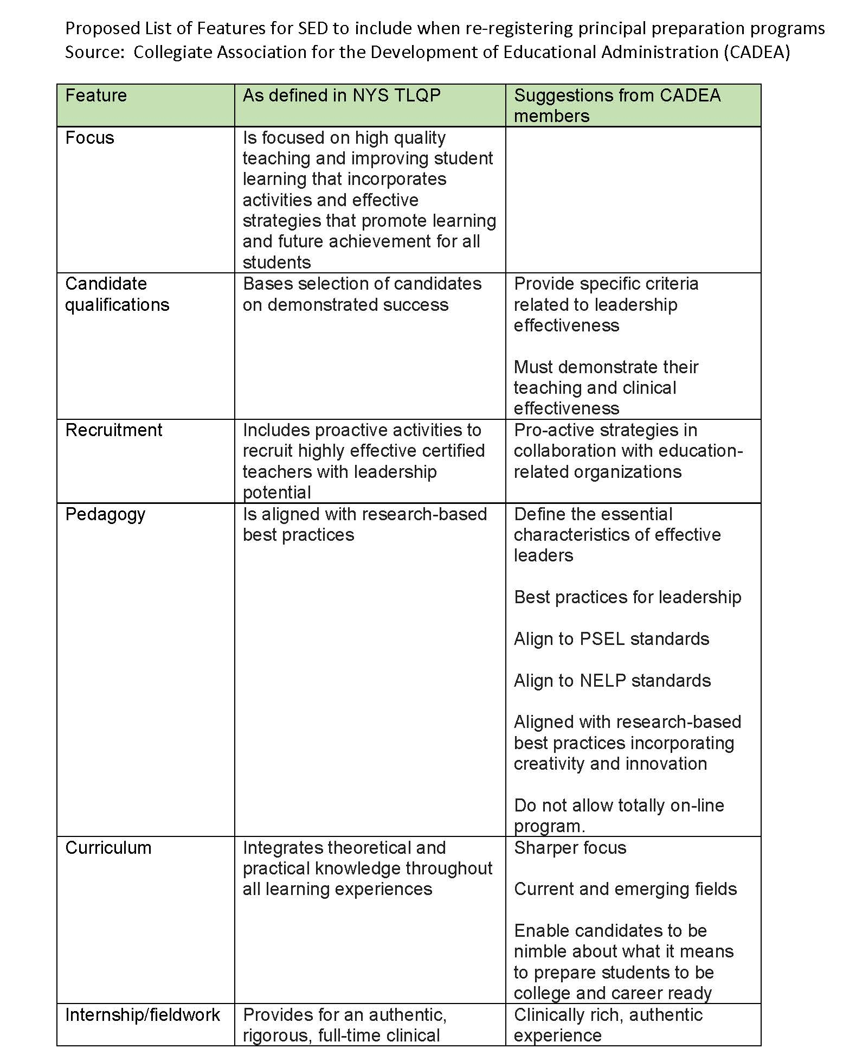
Align to PSEL
Align to NELP
Do not allow totally on-line programs
Clinically rich, authentic experiences

Slide 9
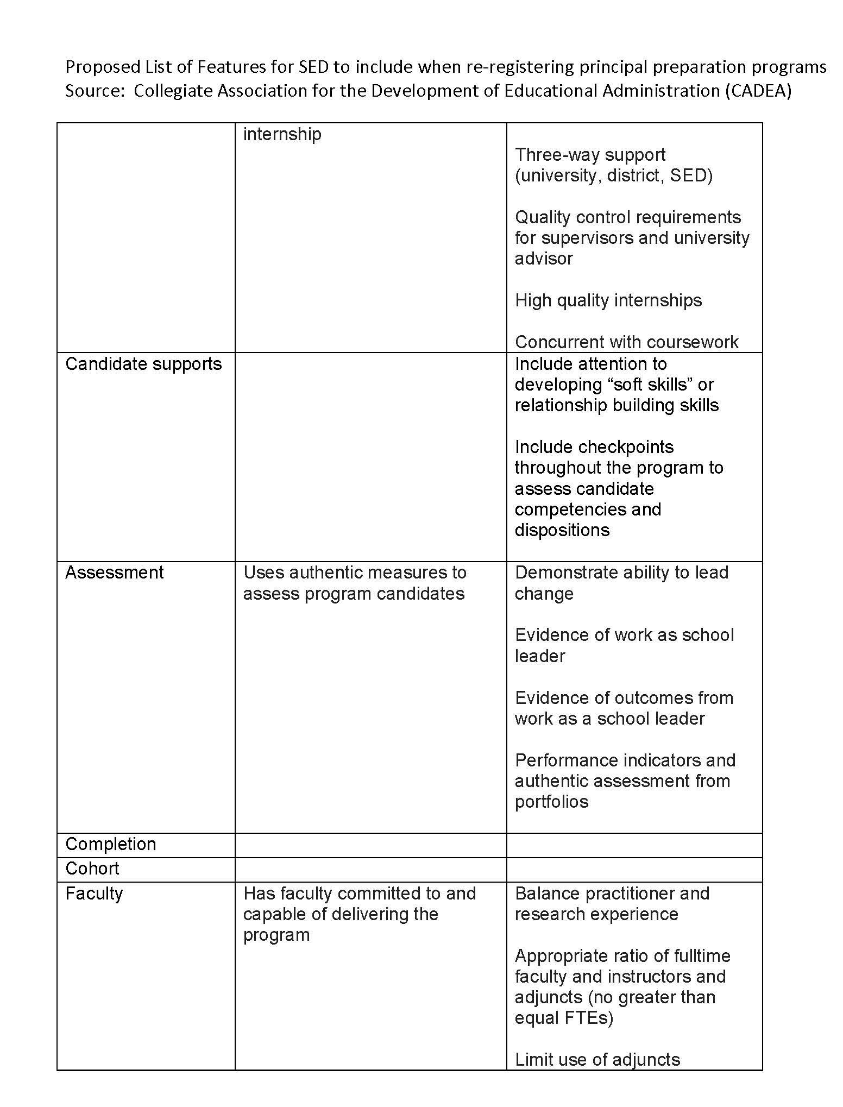
3-way support for internship
High quality internships
Evidence of outcomes from work as a school leader
Performance indicators & authentic assessment

Slide 10
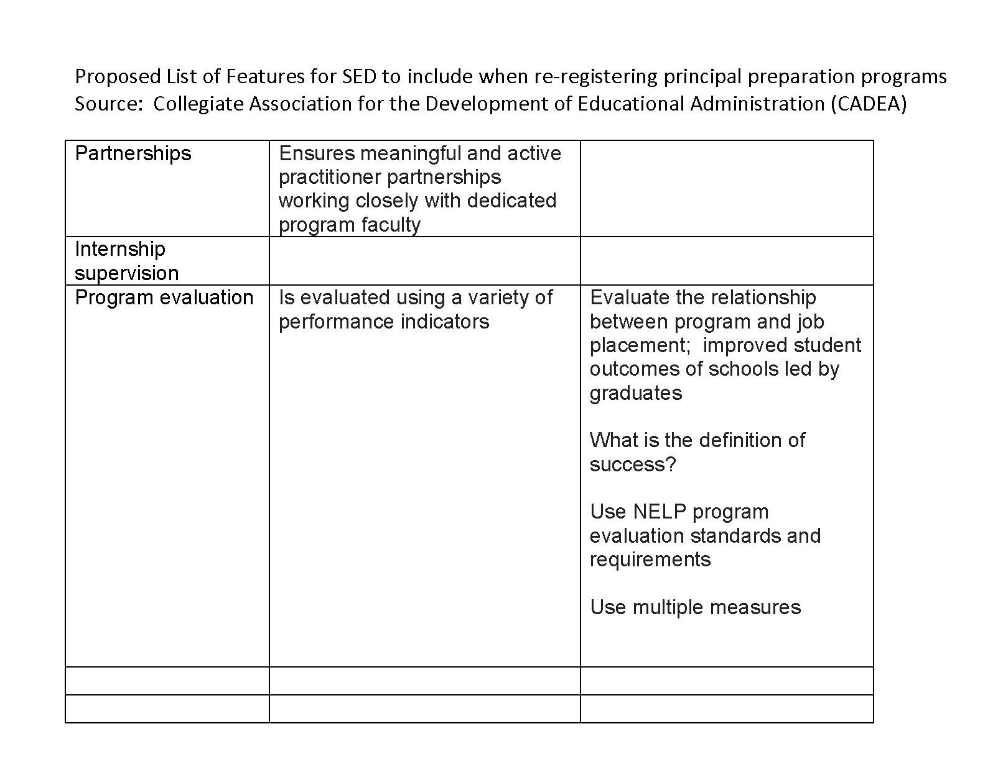
Define what is meant by program success
Align to NELP

Slide 11
Agenda Item #4
Housekeeping
Review minutes
Accept (or agree on any needed change)

Slide 12
Agenda Item #5
Logic Models (10:35 am)
Context ESSA requires this if using Title IIA for principal prep
Objective Decide whether to adopt model “as is” or refine it
Activity In groups of 3, compare views on the following
A strength of the model (as presented)
A possibility for improvement
A question that may help us improve the model
Be ready to use “Fist to Five”

Slide 13
Review our process to reach consensus
Fist to Five
The goal is to something that every member can live with and support.
When co-chairs call a question, members show hands to show support.
Those who hold up 3, 4, or 5 fingers support the option
2 fingers means “I cannot live with it ‘as is’”
1 finger means “A larger reservation prevents me from supporting it”
Showing a fist means “I cannot support it, as a matter of conscience.”
Note: Options that are forwarded enjoy consensus support. For these, every Team member shows 3, 4, or 5 fingers. Those who show a fist, 1, or 2 fingers will be asked, “What would it take to make this something you can live with and support?”

Slide 14
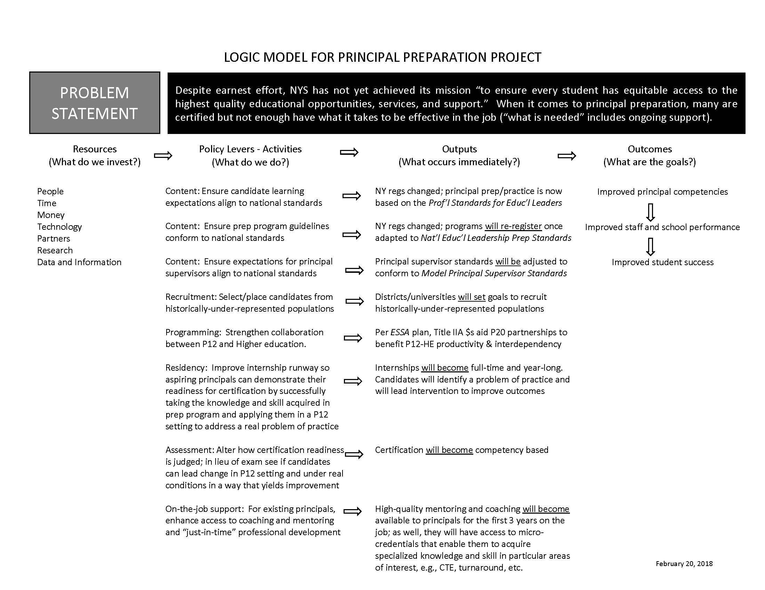

Slide 15
Agenda Item #6
Two Surveys on “First Principles” (10:40 am)
Context Survey results point to support for the possibilities
Objective Decide which of these will help add coherence
Activity Review results from the recent SurveyMonkey
Be ready to use Fist-to-Five; we will accept those that we all support by showing a “3” or better; we will continue to work on others until Mar. 21, 2018

Slide 16
Agenda Item #6 (continued)
Two surveys on “First Principles”
Background What will bring coherence to recommendations that emerge from 5 work groups? First principles provide common thread for the work of 5 groups. These are elements that we agree guided the work of all groups
We conducted two surveys of members. Based on a January survey we reduced the list of principles from 12 to 10. A February survey showed that all respondents support five principles. A few of us still question five other principles.

Slide 17
First Principles
(supported by all respondents to February survey)
The Foundation
Realizing educational excellence and equity throughout NYS requires well-trained leaders who have a convincing command of competencies associated with the Professional Standards for Educational Leaders (PSELs).

Slide 18
First Principles
(supported by all respondents to February survey)
Purpose and Effect
We agree with Linda Darling Hammond. The intent is to create a P20 educational system that learns to get better at getting better. Improving principal preparation contributes to school and student success.
Feedback and Data
Feedback is at the heart of learning to get better; thus data collection, analysis, and reporting are vital because they make it possible to gauge whether activity translates into improvement.

Slide 19
First Principles
(supported by all respondents to February survey)
P20 Partnership
Districts are clients of (and partners with) preparation programs; so close and ongoing feedback between field-based practitioners and university-based programs are essential elements of principal preparation
Mentoring and Coaching
Because continuous learning is a necessity, principals need ongoing support in the form of high-quality mentoring and coaching up to and beyond the full first year on the job

Slide 20
First Principles
(those not yet supported by all survey respondents)
Quality is the Driver, not Dollars (one “1” and one “2”)
The ability of program graduates to assume a leadership role and lead schools to higher ground is not just the aim and purpose of preparation programs but the driver of program success (not revenue generation).
Aim of Prep Program (one “2”)
Sound programs equip candidates to lead schools in continuous school improvement and to lead turnaround in schools that struggle most.

Slide 21
First Principles
(those not yet supported by all survey respondents)
Competency Matters Most (one “1” and one “2”)
Candidates enrolled in preparation programs demonstrate certification readiness by leading efforts at a district school that lift staff, student, or school performance.
Defensible Judgments (two “2s”)
We work toward ensuring that judgments about the adequacy of preparation programs and/or candidate readiness for certification are reliable, valid for their purpose, and comparable across individual, program, and year.

Slide 22
First Principles
(those not yet supported by all survey respondents)
Residency (four“2s”)
During a full-time, year-long, (ideally paid), school-based internship, candidates identify problems of practice and design and lead interventions that help improve opportunities and outcomes for staff and students.

Slide 23
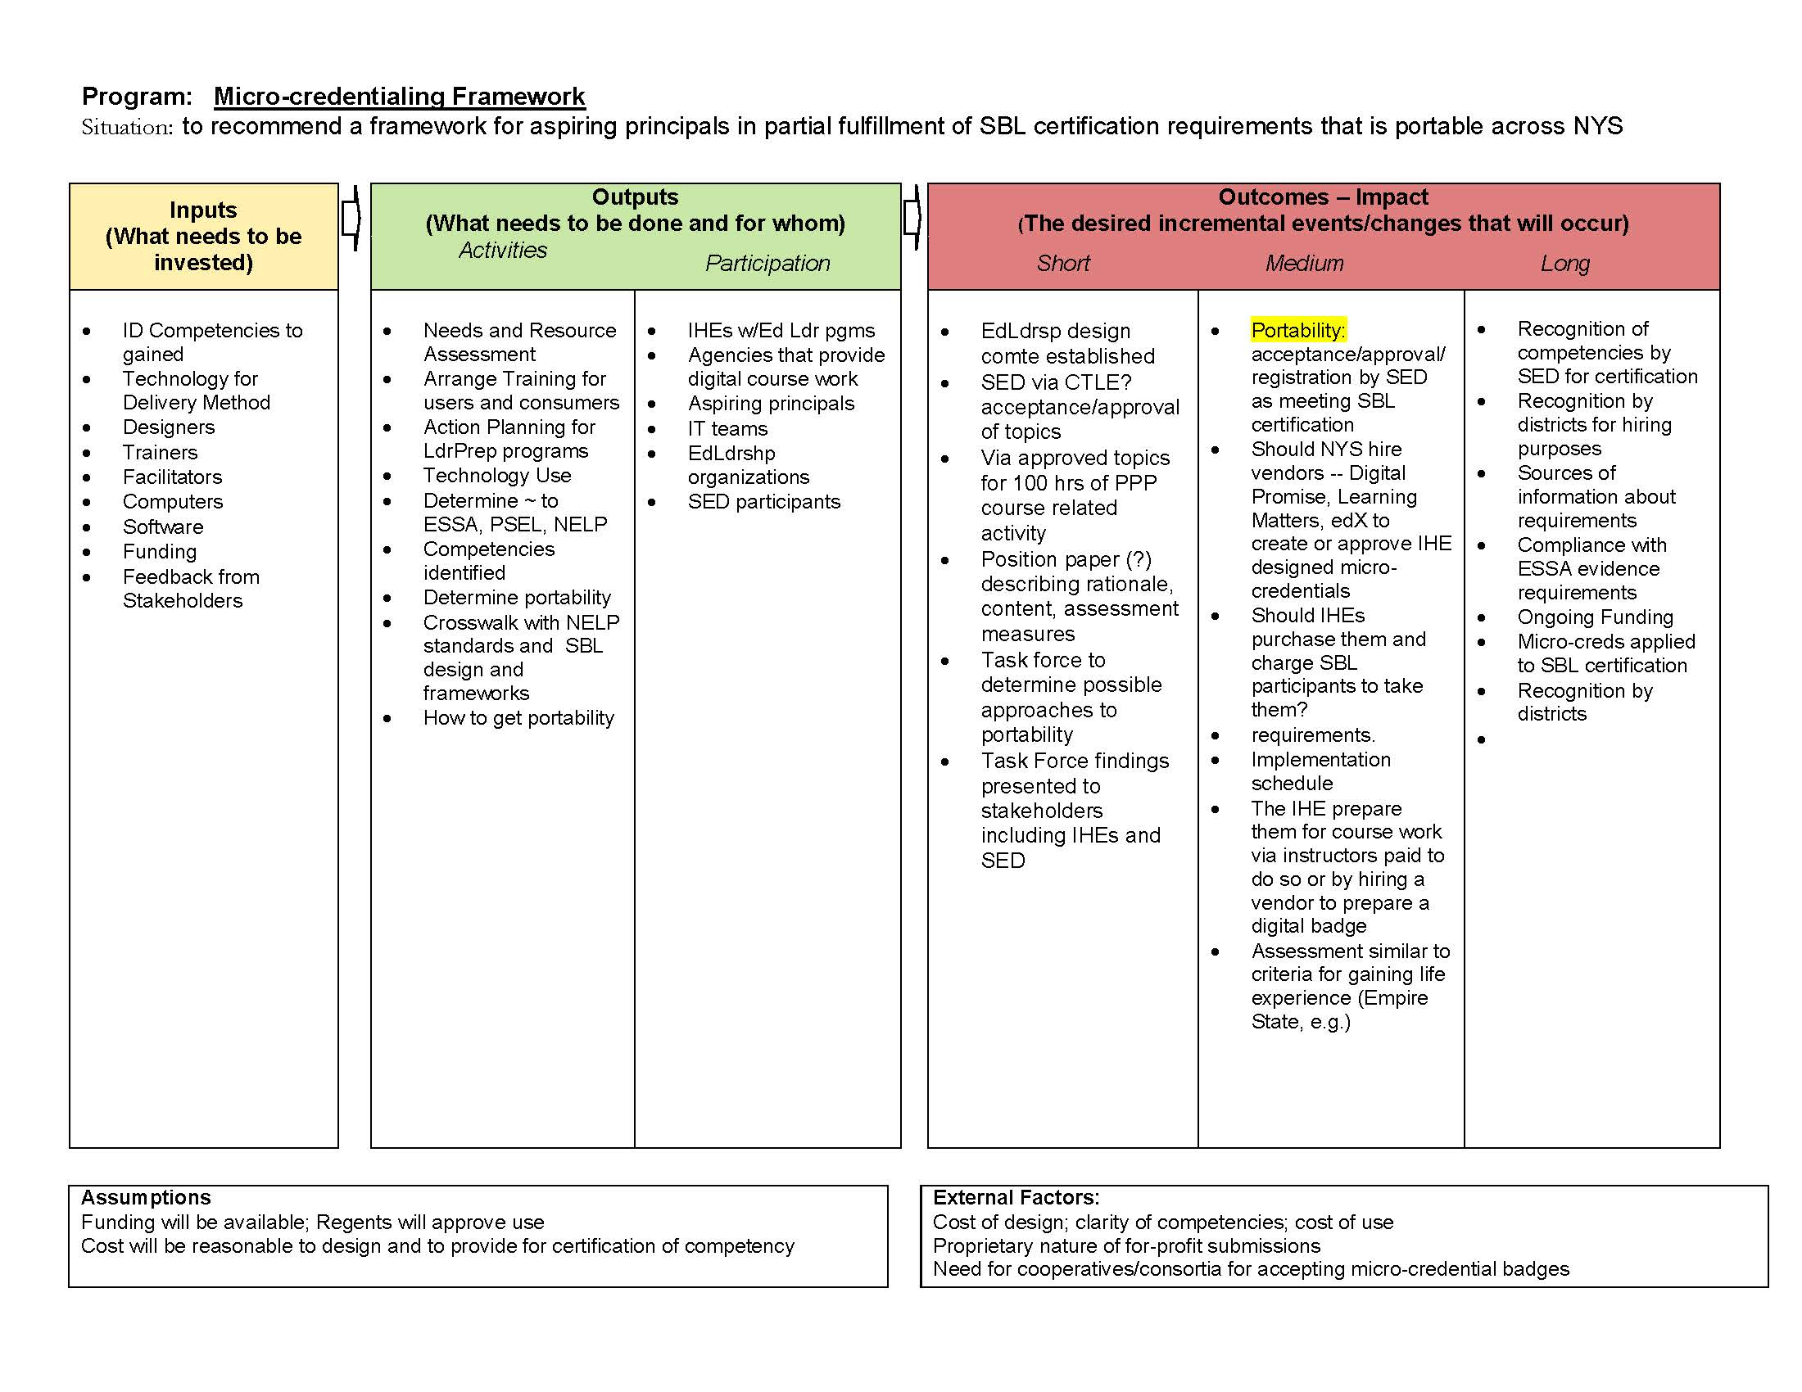

Slide 24
Agenda Item #7
Priming the Pump: Conversation with Mary Strain (10:45 am)
Context Our predecessors gave the Commissioner and the Regents 11 recommendations. Included was this.
“Consistent with regs pertaining to competency-based practices and internship, create a mechanism culminating in issuance of a micro-credential recognized by NYS”.
Our task is to provide a framework for that to happen.
Objective Understand how micro credentials are used throughout the US and how those examples can inform our work

Slide 25
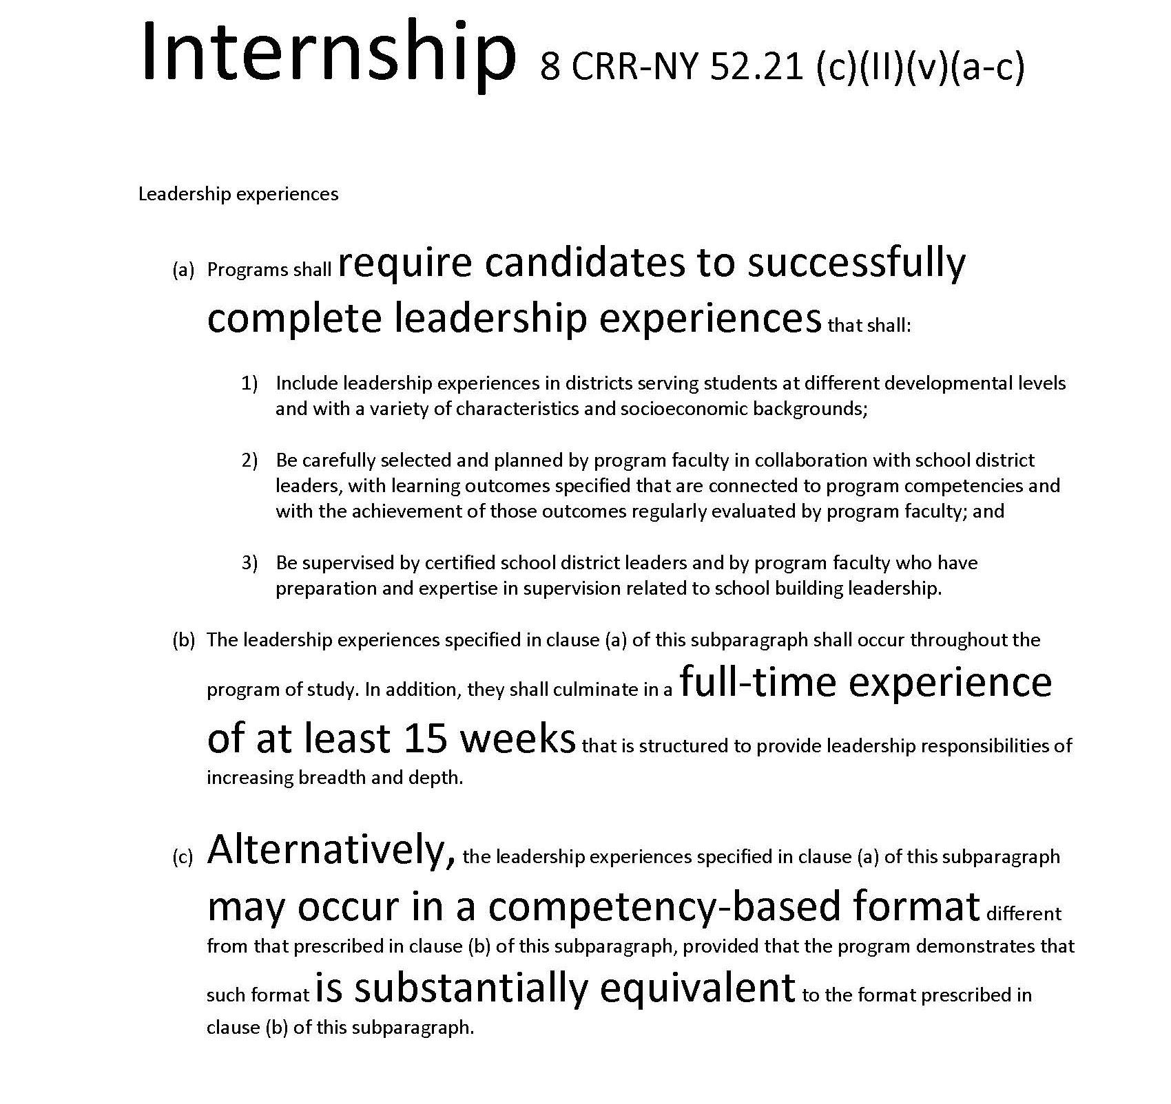

Slide 26
Prelude to Agenda Item #8 (continued)
Value proposition describes a promise of benefit that attracts and satisfies clients, customers, or consumers
(Frankhauser, 2013)

Slide 27
Prelude to Agenda Item #8 (continued)
iTunes
You’ve never been so easily entertained
Skype
Wherever you are or they are – Skype keeps you together
Disney
Magical, many-times-in-a-lifetime experiences for kids of all ages
Pinterest
A few (million) of your favorite things

Slide 28
Prelude to Agenda Item #8 (continued)
Context “When you are up to your eyeballs in alligators, it is easy to forget that the goal was to drain the swamp.”
At this stage, we’re awash in questions:
What would it costs?
Who would do the work?
Whose support are we waiting for?
Where would the money come from?
At moments like this it helps to remember our goal . . . consensus recommendations that are the best solutions we can imagine.

Slide 29
Prelude to Agenda Item #8 (continued)
We know the challenges:
The job of principal has changed in ways we can’t control
From accountability (more of it)
To expectations (higher)
To funding (tighter)
To technology (for better and worse)
To demography (linguistic, cultural, racial/ethnic, poverty)
Our system is perfectly designed to get results we get now
Yet, as competitive as we are, we know we can do better

Slide 30
Prelude to Agenda Item #8 (continued)
We know and accept that:
Continuous improvement calls for self-reckoning
Our systems can (should) adapt
Improvement is more than alignment
Real change means changing the narrative
Real change begins with believing we can be better
It means embracing changes that define our world
Redefining what it means to be excellent
Seeing equity as the North Star
So “I can, I will, I know how” is in every child’s script

Slide 31
Prelude to Agenda Item #8
What is our highest aspiration?
We seek:
Relentless statewide support for leadership development that enables NY to advance equity, expand opportunity, and enhance outcomes for every student.

Slide 32
Agenda Item #8
Breakout Sessions, Small Work Tms (11:15 am - noon)
Context The good news; we’re invited to re-imagine the system.
To do that set aside implementation concerns (for now)
What matters now is to point the way for policymakers in ways that lift our game as a state.
Today, we choose a heading and set a course. Identify things that will boost the benefit to those in the system

Slide 33
Agenda Item #8
Breakout Sessions, Small Work Tms (11:15 am - noon)
Objective Prepare recommendations for a “gallery walk”
Activity Working for 45 minutes as a small group, finalize recommendations and place them on chart paper.

Slide 34
Agenda Item #9
Carousel fashion gallery walk (Noon – 12:20 pm)
Objective Gather member feedback to each recommendation
Record feedback on a post-it (1 idea per post-it)
Place post-it in a category (plus, delta, question)
Note This is a 20 minute activity
Re-convene as a small group when video ends
Lunch follows video (12:20 pm to 1:25 pm)
https://duckduckgo.com/?q=paul+sings+nessum+dorma+idol&t=hg&atb=v103-5_f&ia=videos&iai=2I3Ha8PABzc

Slide 35
Agenda Item #10
Working lunch, seated with small group (12:20 – 1:25 pm)
Objective Revise recommendation given gallery walk feedback
Activity Gather with your small work group
After digesting feedback, make any needed changes.
Replace original chart paper with revised version

Slide 36
Agenda Item #11
World Café (1:25 – 2:05 pm)
Objective Gather feedback from all Phase 2 team members
Activity Co-leaders stay at their table.
Think of this session as four 10-minute periods
“Ring and run”
On 10 minute intervals, members shift tables
Co-leaders field questions
Phase 2 members use post-its to record feedback

Slide 37
Agenda Item #12
Re-convene, re-engage as small group (2:05 – 2:35 pm)
Objective Digest and discuss feedback that was offered
Make any needed improvements
Co-leaders be prepared to report out

Slide 38
Agenda Item #13
Re-convene as a whole group (2:35 – 3:00 pm)
Objective Co-leaders each have 3 minutes to report out
Present latest version on behalf of small team
If requested, use Warm/Cool to gauge support

Slide 39
Final Meeting Reminder and Adjourn
Schedule for future meetings
Mar. 21, 2018
ADJOURN

