Slide 1
Micro Credentials for Educators
NY State Principal Preparation Project
February 28, 2018

Slide 2
Defining Micro Credentials
Competency Based Micro Credential is digital badge that recognizes demonstration of a competency based on evidence assessed and validated by issuing organization
Digital Badge is issued by an organization, embedded with metadata including the achievement assessed and evidence of achievement - Open Badge 2.0 Compliant
Key Terms: Stack Issuer
Earner Recognizer
Issuer Reviewer/Assessor

Slide 3
Growing Ecosystem
At least 17 States including NY State have included educator micro credentials in their ESSA plans
Early Adopter: Arkansas:
State legislature has adopted select micro credentials as approved pathway for teacher career advancement (Tiers 1- 4)
Leadership Quest project includes select micro credentials for principal professional learning aligned to career pathways for school leaders
Early Adopter: Tennessee:
State legislature approved select micro credentials for Continue Education Units
2017-18 Pilot of a select stack of micro credentials to qualify for career pathway roles for teachers
American Institutes for Research: Micro credentials for Teachers Lessons from Three Early Adopter States
Notes:
N Hi

Slide 4
Growing Ecosystem
Early Adopter K-12 Systems
Baltimore Co, MD
District offered select micro credentials for teacher professional development - in lieu of attending in person PD
NYC DOE - Office of Teacher Recruitment and Quality
more than 500 educators and 1,500 micro credentials issued
Micro Credentials provided a solution for equitable transparent pathway into new teacher leader roles
Grown across the system as a strategy to elevate teachers with high value expertise

Slide 5
Teaching Matters recognized a professional learning Challenge
1
Traditional professional learning models have too often failed to engage educators in context based practice and have often lacked evidence of impact.
Traditional models for assessing success have relied on methods and sources that are not sufficiently aligned to the specific practices they seek to measure and are not designed to support continuous improvement
Schools and school systems are unique ecosystems - with unique assets, challenges and contexts. Preparation and professional learning must reflect these needs and respond with supports that address systemic values
2
3

Slide 6
Micro Credentials Offered A Possible Solution
1
Competency based micro credentials can be designed to support demonstration of context based learning and impact - throughout the course of educators’ careers.
Competency based micro credentials offer an opportunity to craft assessments and an assessment for learning process specifically aligned to high value competencies
Micro credentials offer transparent, flexible learning pathways that can be aligned to school system values and career pathways
2
3

Slide 7
Evolution of Micro Credentials: Teaching Matters
2016
Mineola Union Free School District - 18 Micro Credentials with over 30 Teachers Leaders (2016-present)
NYC DOE Stack of micro credentials for Emerging Teacher Leaders (Over 500 teachers 2017-present)
2017
Tennessee State DOE Partnership supporting (85 teacher leaders across 6 districts)
Bill and Melinda Gates Foundation Grant - Master Teacher Program (60 Teacher Leaders)
NYC DOE Expanded Emerging Teacher Leader Program expanded to content specialization:
  Culturally Responsive Educators and AP for All (over 100 teachers)
2018
NYC Council of Supervisors and Administrators: Strategic School Leader Fellowship Program: Culturally Responsive School Leadership and Leading Formative Assessment Practices (25 school leaders)
Arkansas State DOE Partnership for Tier 3 Licensure - (50 Teacher Leaders across 3 districts) Spring, 2018

Slide 8

Anatomy of Teaching Matters’ Micro Credentialing Process

Slide 9
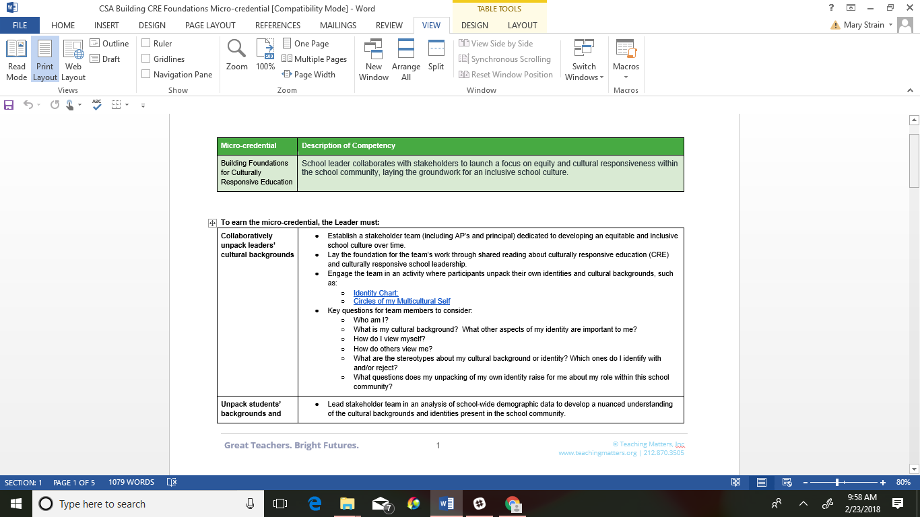
Example: Teaching Matters School Leader Micro Credential

Slide 10
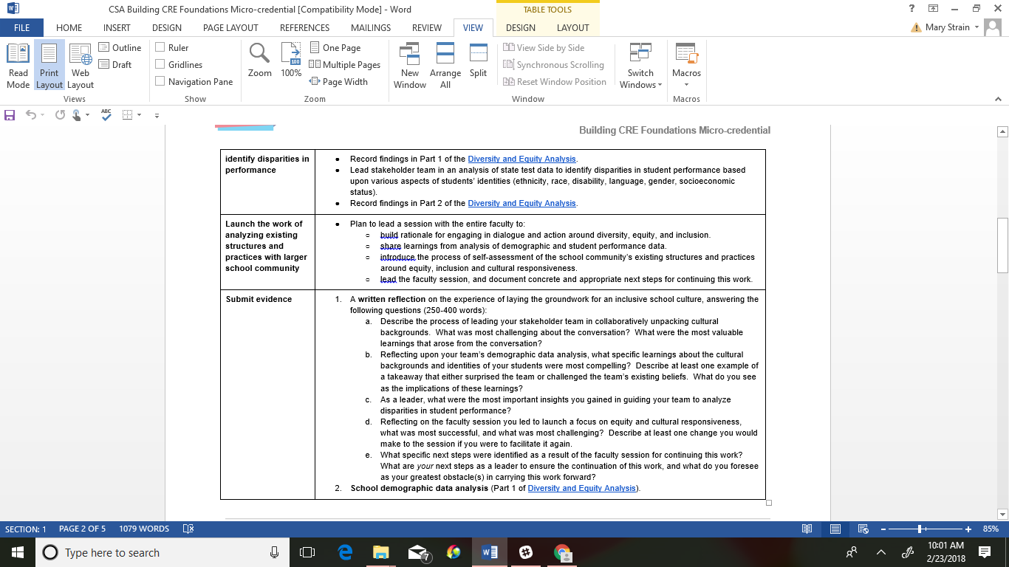
Example: Teaching Matters School Leader Micro Credential

Slide 11
“
“The micro credentialing process was a way to document my achievements, make it clear to my colleagues, administrators and coaches in the school what I was doing. They helped me improve the culture at the school and helped others understand and accept the role of teacher leader.”
Vicky Dedaj, teacher leader, X468 Bronx, NY
“Once the teachers earned the micro credentials then you really saw the shifts. They felt they earned the right to lead PLC’s in ways that moved the whole team toward improved student outcomes.”
Pat Burns Asst. Sup. Mineola Union Free SD
“This type of professional development is powerful in that it isn't just about going to a session, listening and going home. It is fundamentally built on a process that requires learners to implement practices, reflect on the work and demonstrate mastery.”
Ann Williams, Director of Teacher Recruitment and Quality NYC DOE
“
Accolades
“

Slide 12
What Have We Learned?
Currency matters- incentives such as career advancement, financial incentives, credit or accreditation increase participation and completion rates
Educators find the process and agency associated with micro credentials appealing and valuable - establishes a mindset of earning vs receiving

Slide 13
What Have We Learned?
Systems find micro credentials to provide more data, support transparency, are more flexible and locally aligned to systemic needs, as well as have strong potential for more strategic recruitment and allocation of talent
Stacks and progressions allow for deeper learning
Approaching assessment as an opportunity For learning rather than just of learning is powerful for moving toward mastery

Slide 14
Recommendations for Improved Micro Credentialing Ecosystem
Establish Competency Based Micro Credentials as a standard
Establish a framework to align micro credentialing systems to standards and learning objectives - what learning is most appropriate for micro credentialing
  Pre service - opportunities for authentic practice based demonstrations
  Post graduation and throughout career - continuing professional learning, certification processes, endorsements and principal evaluations
Create guidance/standards for assessment of micro credentials and learning pathways through micro credentials

Slide 15
Recommendations for Improved Micro Credentialing Ecosystem
Redefine CTLE process to include competency based micro credentials -shift from seat time requirements to outcomes based evidence
Establish an approval process for micro credentials and issuers - at the local or state level
  Consider “term limits” for review of micro credentials,
  Focus on stacks of learning
  Utilize the “endorsement” features of digital badges as strategy for approval or quality measure
Embrace the opportunity for distributed learning to support continuous innovation and to leverage expertise

Slide 16
Considerations for Principal Preparation Project
How can NY State establish guidelines for rigor and quality while maintaining central benefits of micro credentialing for professional learning?
How can Higher Ed and NY State support currency for demonstration of critical competencies through micro credentials?
How can micro credentials enhance pre-service learning?
How might micro credentials strengthen principal evaluation?
How might micro credentials provide more meaningful pathways to certification, endorsements and specialization credentials - particularly in meeting local needs?

Slide 17
Contact
Mary Strain, Teaching Matters
mstrain@teachingmatters.org
www.teachingmatters.org
@teachingmatters

