Slide 1
Illinois Partnerships Advancing Rigorous Training (IL-PART)

Slide 2
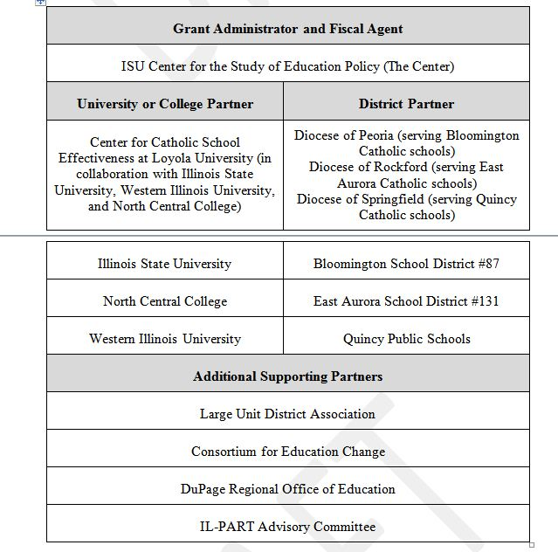
Partners and Partnerships

Slide 3
Illinois State Legislation on Principal Preparation
Schools Demonstrate Positive Change(s) via Working Conditions and Student Growth Gains (outcome)
Partnership Advisory Committee
University-–District Partnerships
Principal and APs Retained for at Least 2 Years (outcome)
Principal Preparation Program(s)
Principals and APs Placed in High-Need Schools (outcome)
Selection of High-Potential Candidates
School-Based Learning Experiences (Internships)
Performance-Based Assessments
Principal Certification Earned
Pool of Highly Effective Principals and Assistant Principals (APs) for High- Need Schools in the State or Region
Extensive teaching experience
Knowledge & and Skills
Portfolio of accomplishments (including evidence of student growth and leadership)
Training for faculty supervisors
Training for district mentor
Network and development opportunities
Data sharing and analysis
Alignment of assessments with district principal evaluation system
Assessments used to match potential principals with high- need schools
IL-PART Theory of Action
Notes:
This is the meat
Our focus: what does it look like on the ground? We are working it/implementing it and AIR is studying it along the way
What does this look like in action?
Importance of TIME- it takes time to develop relationships
Research is important but the pragmatic piece is too

Slide 4
Impact on Preparation Programs
A cumulative total target of 80 principal candidates enrolled was exceeded in Year 2, when enrollment totaled 102
The retention rate of those 102 at the end of PY3 is 99%
Year 3 enrollment at 161 candidates.
Notes:
29 candidates from ISU; 38 candidates from North Central, and 39 candidates from WIU
OVER ACHIEVEED enrollment target!
Shortages are talked about but…
106 includes IL-PART and others
Go into some detail here

Slide 5
Impact on Partner Districts
IL-PART set a training target of 60 principals and assistant principals in partner districts by PY5.
Currently 99 principals and assistant principals have participated in IL-PART supported professional development, representing 165% of target.
92% retention of principals and assistant principals participating in IL-PART activities through PY3.
Of the participating principals and assistant principals, 100% were rated effective or highly effective on their annual performance evaluations after at least one year of participation in IL-PART activities.
Of participating principals and assistant principals, more than 94% demonstrated positive student growth after at least one year of participation in IL-PART activities.
Notes:
58 principals & 30 assistant principals & 31 Central Office Administrators from partner districts
13 principals, 1 AP in non-partner districts and 4 Superintendents and 1 Regional Superintendents in non
Practicing Principals were trained

Slide 6
Illinois’ New State Requirements
Mandated year-long, performance-based internship designed to provide authentic leadership experiences intended to increase proficiency in areas shown to improve student learning.
Mandated competency-based assessments of candidate performance aligned to both the ISLLC Standards and Southern Regional Education Board’s 13 Critical Success Factors and 36 Leadership Tasks.
Required 80% of internship activities be completed in a leadership capacity rather than an observational role.
A PreK-12 grade span focus that requires coursework and internship experiences across the grade levels including a focus on specific student subgroups (special education, ELL, early childhood, gifted).
Established minimum qualification and training requirements for mentor principals and faculty supervisors.

Slide 7
Full Time Internship Model
IL-Part has piloted and intensive full time/full semester long internship model (funding substitute teachers to provide release time for candidates).
The intensive model provides a longer duration of full-time, job embedded experiences.
The intensive model’s approach to funding the substitute is a cost effective and replicable strategy.
Project covers the substitute teacher’s cost, versus the salary cost of the principal intern.
Lessons learned on compliance with:
How to utilize this model for successful succession planning to sustain the principal pipeline.
Implications involving the new teacher evaluation system
Implications involving the Affordable Care Act.
Identification and placement of quality substitute teachers.

Slide 8
IL-PART Satisfaction Survey
Candidates completing full time internships expressed greater satisfaction with the program than do those completing traditional internships.
Candidates serving full time internships reported a higher degree of supervision and a stronger belief that their programs prepared them to take on the challenge of school principal.
Principal candidates, mentor principals, and university supervisors all acknowledged the benefits of the full time internship experience.

Slide 9
80 percent of respondents strongly agreed that their full time internship experience provided them with opportunities to learn…

Slide 10
Satisfaction among traditional candidates also high…

Slide 11
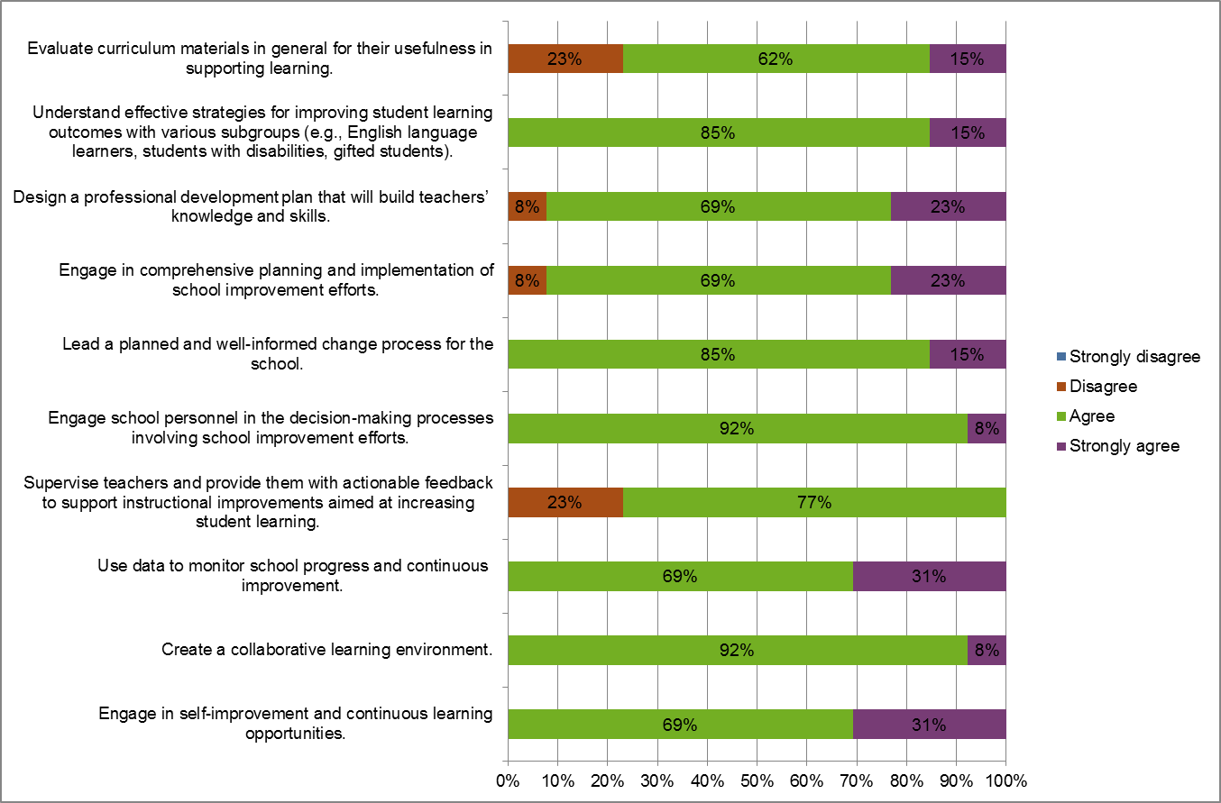
Perceptions of Principal Candidate Preparedness by Faculty Supervisor and Principal Mentor

Slide 12
Purpose of IL-PART Symposium
Content delivered along three specific topic strands aimed at participant’s needs.
Participants will receive a flash drive that includes a toolkit to assist districts and programs in preparing excellent school leaders and hiring the best principals, along with other resources provided at the symposium.
Participants will be provided a free copy of the book Brain Science for Principals: What School Leaders Need to Know.
Professional networking and partnership development discussions.

Slide 13
Strands Designed for Your Needs
Strand #1: How to Replicate IL-PART Successes in Other School Districts | Strand #2: Leadership Professional Development Strand | Strand #3: Future Leaders Fellowship Strand
How to Replicate and Budget for Best Practices of IL-PART | Brain Science for Principals: What School Leaders Need to Know | Lessons Learned by Interns
Building Leadership Capacity and Supervision Support for Mentors | Assessment Lessons for Supporting Teachers | Interview Preparation Strategies
How to Implement a District Succession Plan for a Leadership Pipeline | Bridging School and University Partnerships to Enhance Use of Instructional Rounds for Continual School Improvement | Mock Interviews

Slide 14
Follow the Work
Center for the Study of Education Policy Web Site: http://education.illinoisstate.edu/csep/ CSEP_ISU
https://www.facebook.com/ISU.CSEP
IL-PART Web Site:
www.il-part.org IL-PART Twitter:
#leadershipmatters#ILPART

