Slide 1
Principal Project Advisory Team
November 30, 2016

Slide 2
Agenda Item #1: Greetings/Introductions
Seating today by Breakout Groups
  Authentic Experiences and Internship
  P12-Higher Education Partnership
  2015 Standards
  Diversity
Those participating via WebEx are in group titled “Professional Learning and Support”
What has happened since we last met
  An online survey of school board members and educators closed (Oct 11. - Nov. 2)
  Presidential election (Nov. 8)
  Work group within the ESSA Think Tank considered “High-Concept Paper” (Nov. 21)
  President-elect nominated Betsy DeVos for US Secretary of Education (Nov. 23)
  Team completed online Monkey-Survey on beliefs & Theory of Action (Nov. 17 - 29)
  US Dept of Educ issued final guidance on Every Student Succeeds Act (Nov. 28)

Slide 3
Agenda Item #2: Meeting Objectives
Confirm schedule of remaining meetings
Reach consensus on belief statements that form foundation for our work
Identify if consensus can be reached on elements of a theory of action describing how recommendations lead to enhanced school leadership
Recognize national efforts to create SBL program standards aligned to Council for the Accreditation of Educator Preparation (CAEP) and 2015 Professional Standards for Educational Leaders (PSEL)
Begin to develop recommendations in 5 areas (working in small subgroups)

Slide 4
Agenda Item #3: Platform
Accept “as is” or suggest needed changes to:
Minutes from second Advisory Team meeting (Oct 19)
Agreements reached & Transcription of Notes (Oct 19)

Slide 5
Confirm Schedule of Remaining Meetings
Wednesday
Noon – 3:00 pm
New York State Education Department, 89 Washington Ave, Albany (Rm 5A-5B)
Nov. 30, 2016
Jan. 25, 2017
Feb. 22, 2017
Mar. 22, 2017
Apr. 12, 2017
May 31, 2017

Slide 6
Review our process to reach consensus
Fist to Five
  The goal is to something that every member can live with and support.
  When co-chairs call a question, members show hands to show support.
  Those who hold up 3, 4, or 5 fingers support the option
  2 fingers means “I cannot live with it ‘as is’”
  1 finger means “A larger reservation prevents me from supporting it”
  Showing a fist means “I cannot support it, as a matter of conscience.”
Note: Options that are forwarded enjoy consensus support. For these, every Team member shows 3, 4, or 5 fingers. Those who show a fist, 1, or 2 fingers will be asked, “What would it take to make this something you can live with and support?”

Slide 7
Review material you received this month

Slide 8
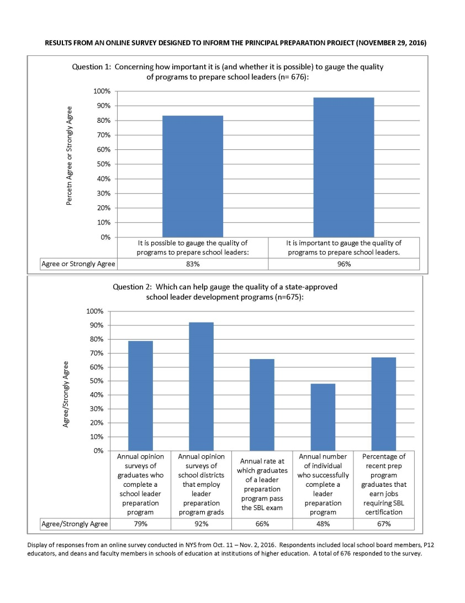
Summary of results from online survey
Survey was open to local school board members and educators
(Oct. 11 – Nov. 2)
“Educators” includes P12 staff and deans and faculty from Schools of Education at Institutions of Higher Education

Slide 9
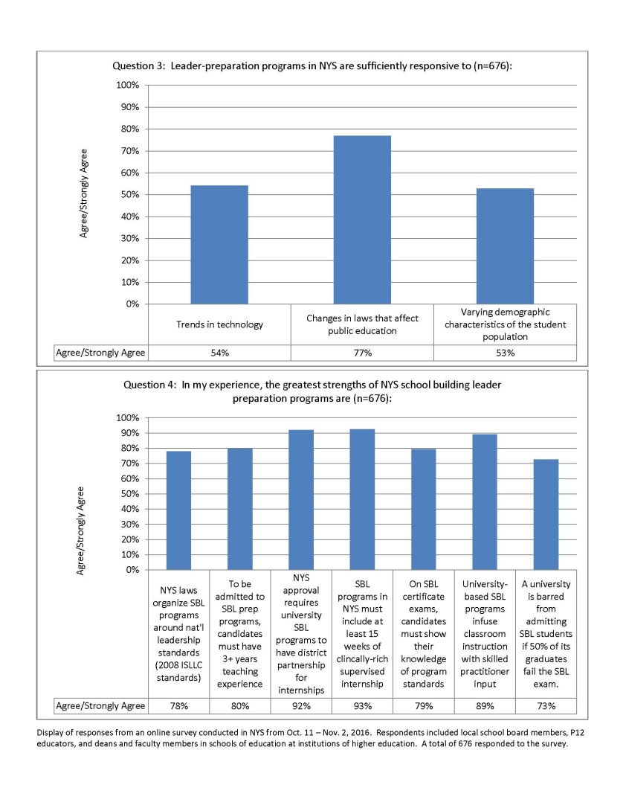

Slide 10
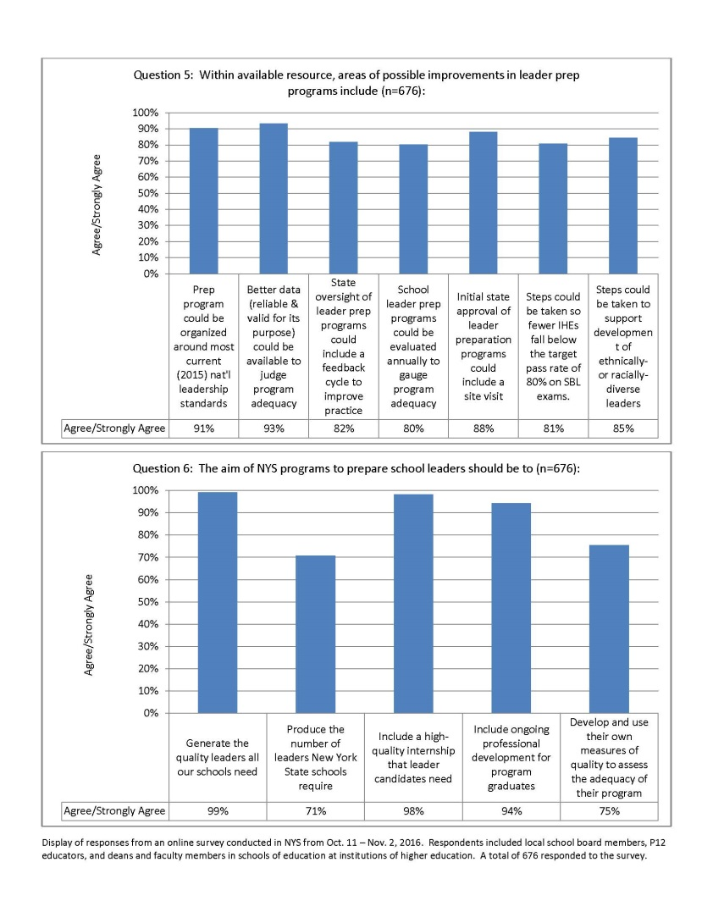

Slide 11
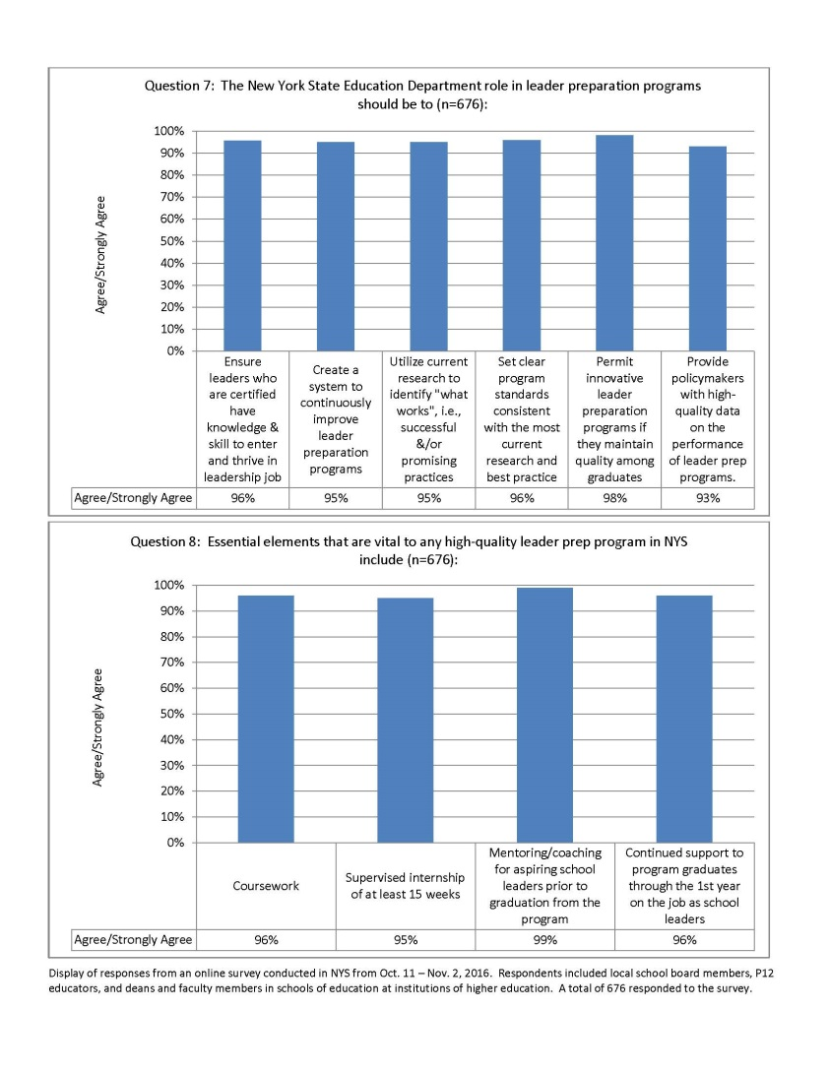

Slide 12
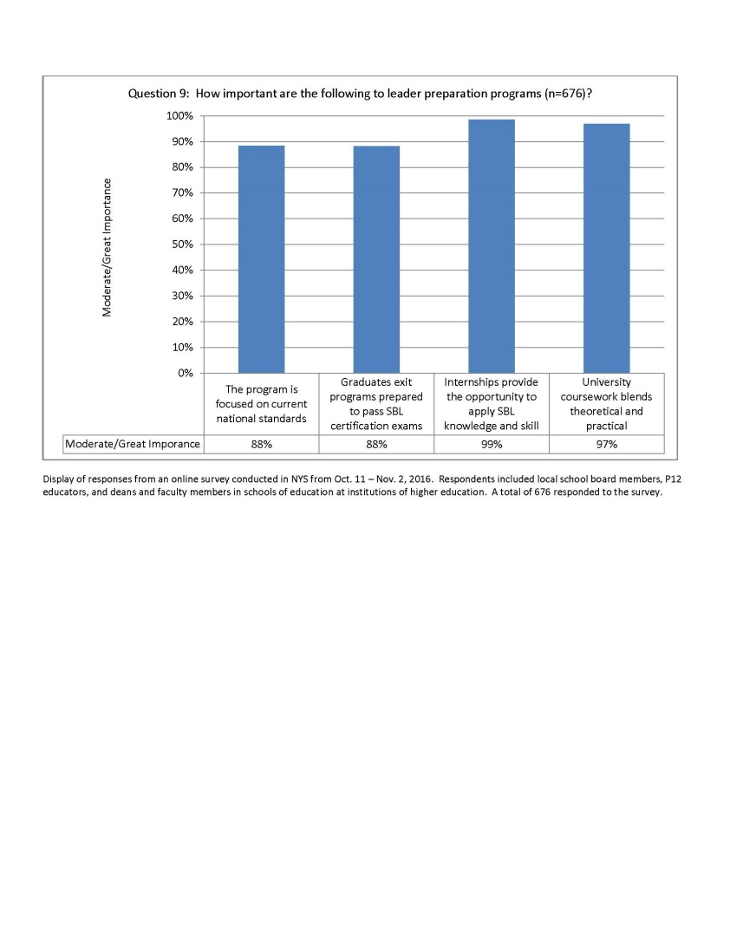

Slide 13
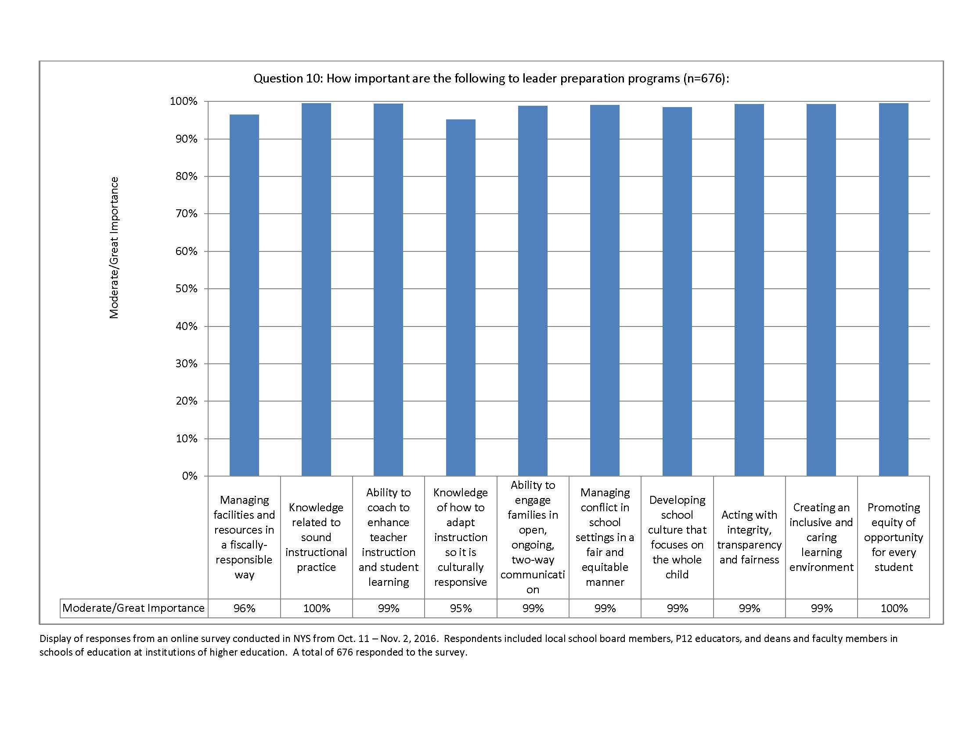

Slide 14
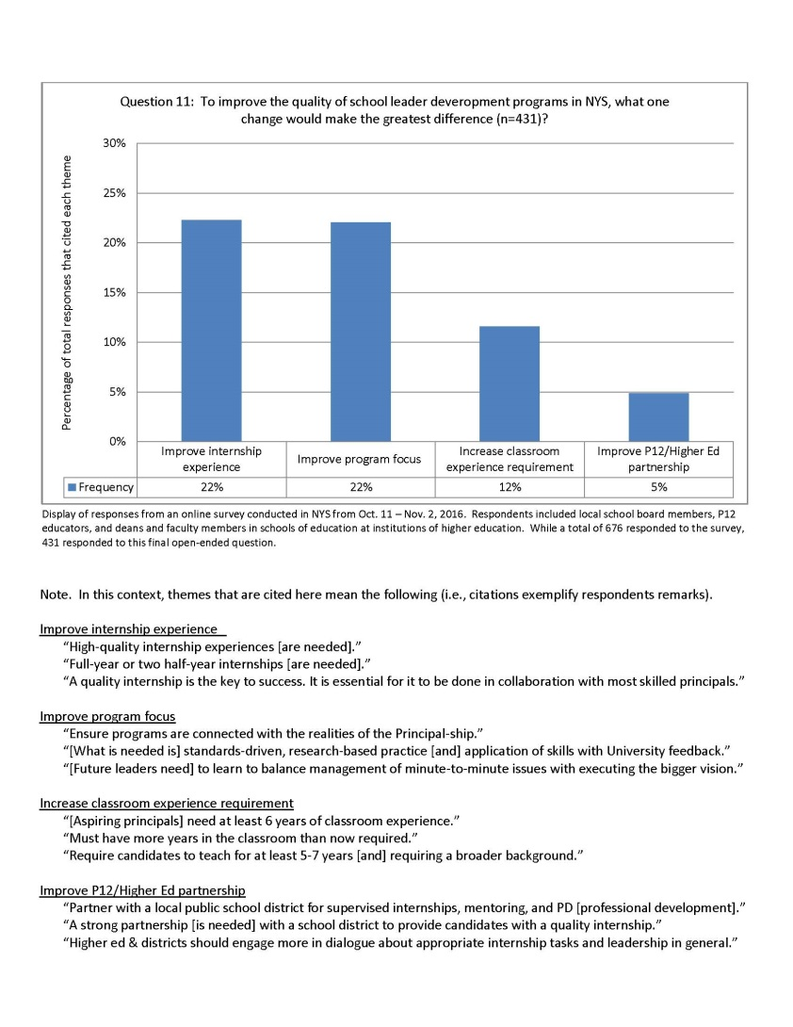

Slide 15
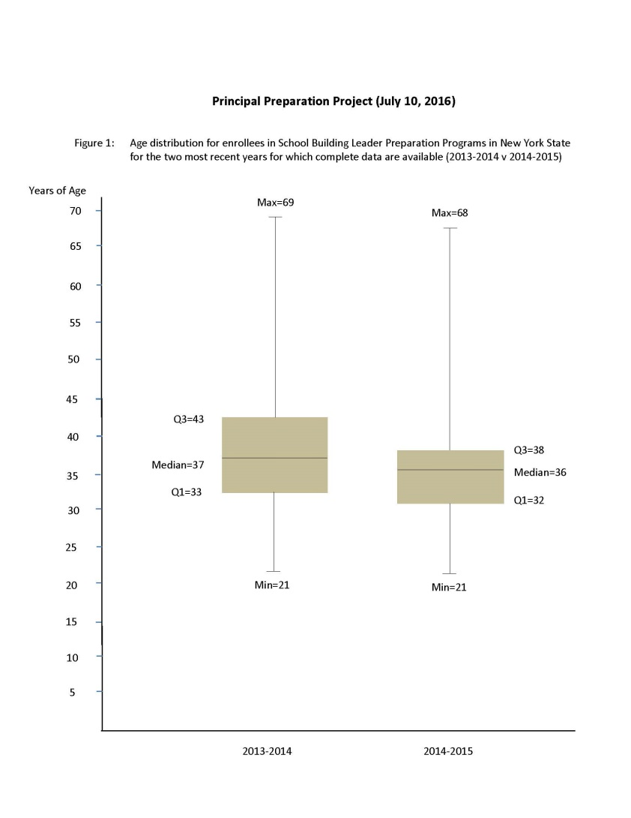
This compares age distribution of those enrolled in leader prep programs for the two most-recent years for which data are available.
It shows the distribution becoming younger and more-tightly bunched.
The median age in 2014-2015 is 36 (vs 37 the previous year).
Half of those enrolled in 2015-2015 are between 32 and 38 years old (vs 33 and 43 the previous year)

Slide 16
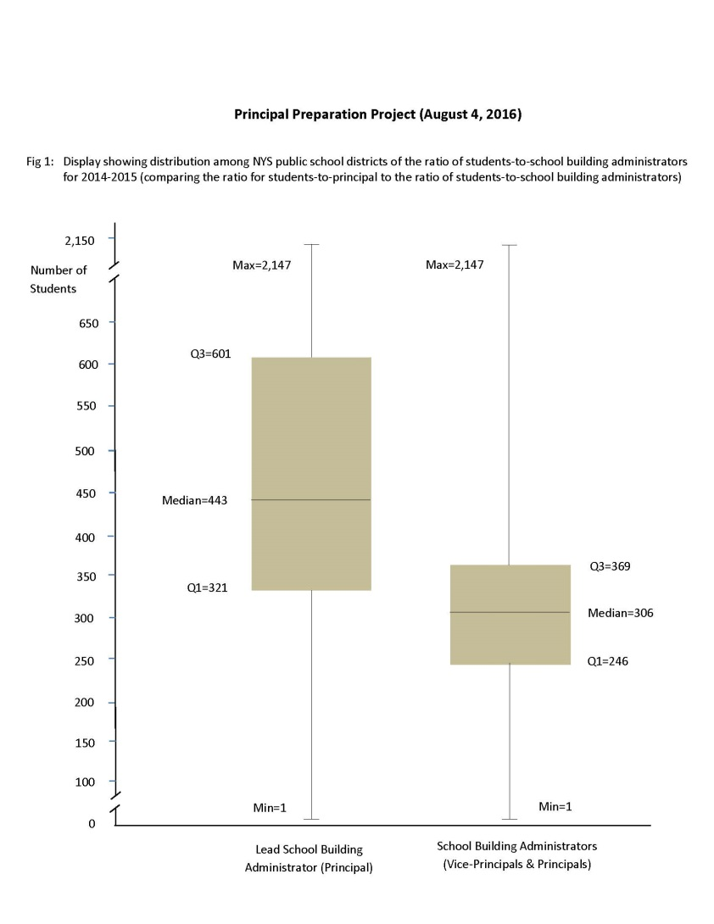
This compares students-to-principal ratio for the most-recent year for which data are available.
The typical students-to-principal ratio is 443:1.
The typical students-to-school administrators (principals and vice principals or assistant principals) ratio is 306:1
If this display were created for urban districts versus other districts, results would vary considerably

Slide 17
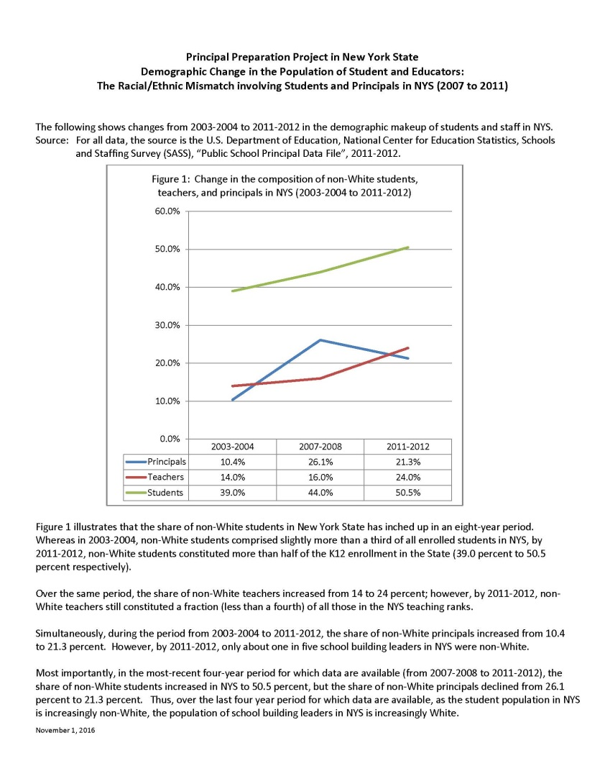
This displays data over the period from 2003-2004 to 2011-2012.
This shows that the share of non-White students in NYS has inched up in an 8-year period (reaching 50.5% by 2011-2012).
Yet simultaneously, in the most-recent 4-year period (2007-2008 to 2011-2012), the share of non-White principals in NYS declined from 26.1 percent to 21.3 percent.

Slide 18
Agenda Item #4: Old business
Belief Statements
  MonkeySurvey results reviewed (27 respondents by noon Nov. 29)
  Identify how many and which beliefs enjoy consensus support
  Fist to five
Theory of Action
  MonkeySurvey results reviewed (gauging support for “straw man”)
  Identify whether support exists for (any) elements
  Fist to five

Slide 19
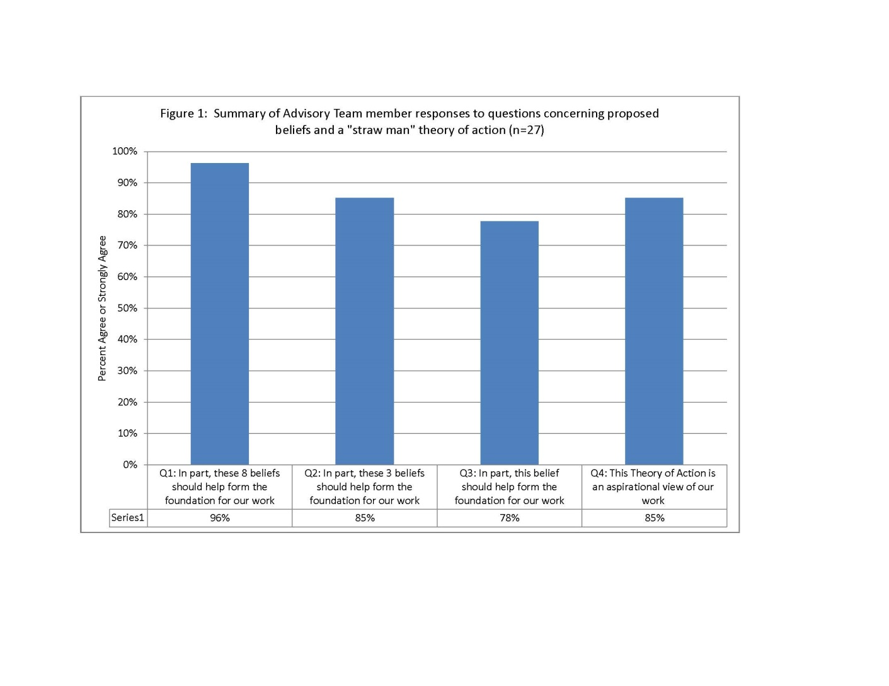

Slide 20
Responses to one open-ended question

Slide 21
Agenda Item #5: Overview of Nat’l Effort
Topic: National Educational Leadership Preparation Standards (NELP)
Presenter
Michelle D. Young, Ph.D.
Executive Director, University Council for Educational Administration
Professor of Educational Leadership, University of Virginia
Chair, NELP
Chair, Educational Leadership Constituent Council (ELCC)
Author, “The Research Base Supporting the ELCC Standards”, 2012
Following presentation, whole group discussion to address implications

Slide 22
Agenda Item #6: Breakout Group Meetings
Process . . .
Choose recorder and spokesperson
Helpful question prompts are found in your “Meeting in a Box”
Work toward completing Table of Breakout Group “Look Fors”
Use pad to record if group reaches understanding/consensus
Be ready to report out on accomplishments and next steps

Slide 23
Agenda Item #7: Next Meeting Reminder & Adjourn
Schedule for future meetings
  Jan. 25, 2017
  Feb. 22, 2017
  Mar. 22, 2017
  Apr. 12, 2017
  May 31, 2017
ADJOURN

